Slide 1

Notes of revised deck:
This is a revised deck created after the initial Data Challenge submission, which now includes a second Chance Quality Model created using XGBoost (see slide 25), building on the work created in the initial submission that used only a Logistic Regression model.
For more information about this secondary model, for which has been created in a separate notebook to the Logistic Regression model, see the following notebook in GitHub [link].
Additional slides regarding the technical details of Logistic Regression and XGBoost, their strengths and weaknesses, metric selection and model calibration, as well a detailed slides of each key shot, can now be found in an extended appendix, aimed to answer any outstanding questions that there may be not bee address in the initial challenge submission.
New slides since initial submission have a orange diamond in the top-right corner -
Junior Data Science Challenge
Edward Webster
April 2021
Slides: https://docs.google.com/presentation/d/116D0U_ue2sv6hgLBgHniI228cRhph0qfMuOFA4uuxhs/edit?usp=sharing
Code: https://github.com/eddwebster/mcfc_submission
Full pack including all attachments: https://drive.google.com/drive/folders/1Ts_5YOL8JpVpRcaEhqmcTCceLmcBRY3L?usp=sharing

Slide 2
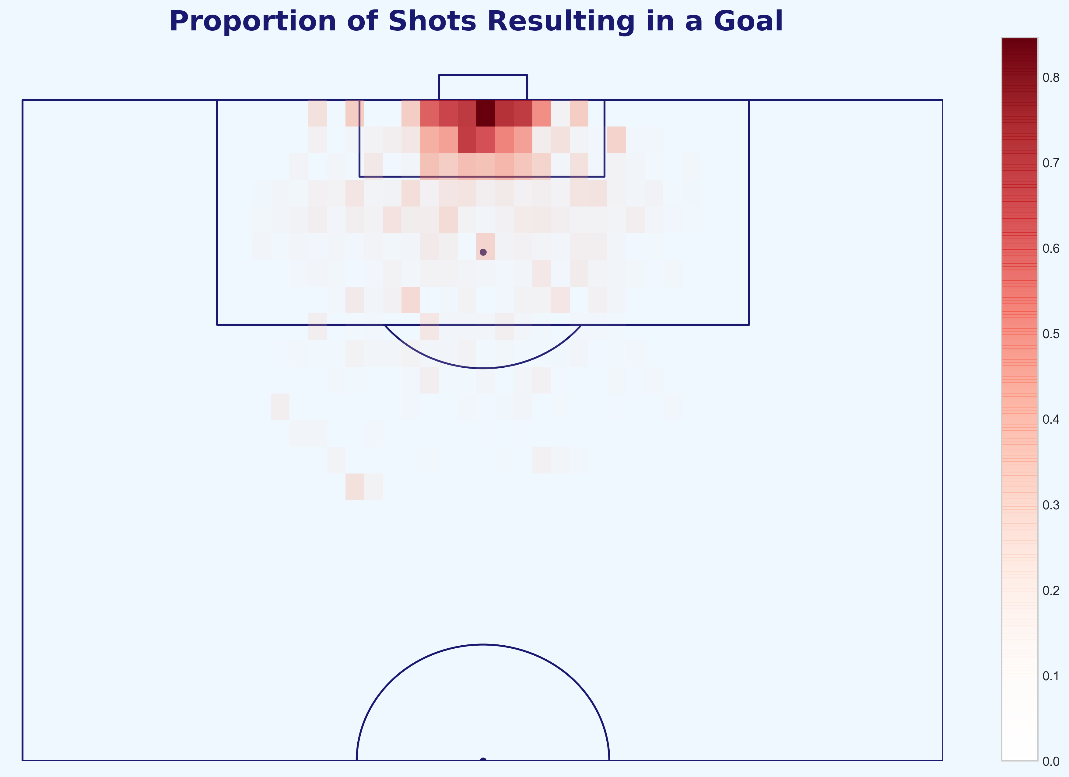
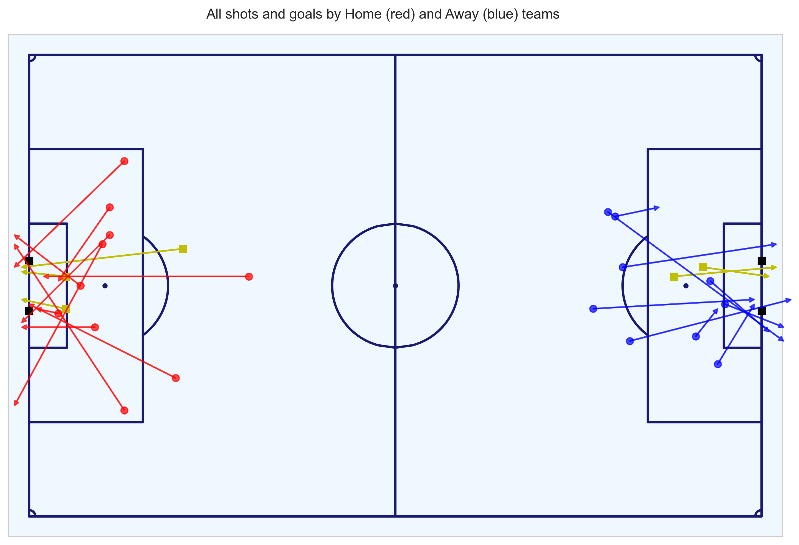
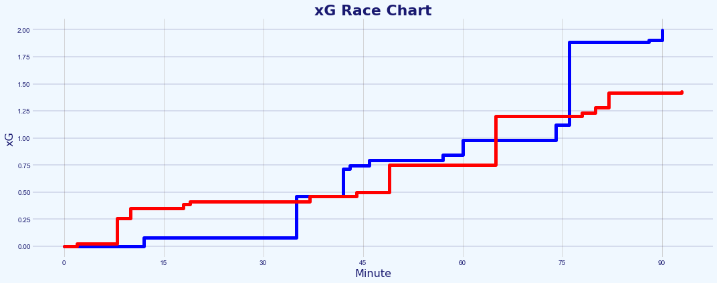
Contents
Update contents with new slide numbers
Intro and Brief (slide 3)
Brief (slide 4)
Analytical Process (slide 5)
Challenge:
Chance Quality Modeling from Shot Event data [code] and [code] (nine slides: 6-5)
Metrica Sports Tracking and Event data [code] (five slides: 16-20)
Application of the Chance Quality Model with the Metrica Sports data and assessment of the match in question (four slides: 21-26)
Conclusion and Next Steps (slide 27-31)
References (slide 36-40)
Appendix (slide 41-61)
All code for this challenge: https://github.com/eddwebster/mcfc_submission/tree/master/notebooks/

Slide 3
Introduction and Challenge Brief

Slide 4
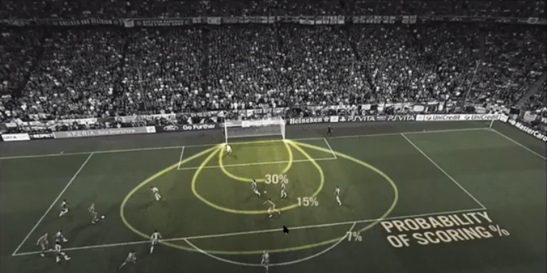
Brief
Part 1 and 2 of the data challenge as outlined in the brief
1
Building a Chance Quality Model using shots data
Provided is a sample of just under 11,000 shots (ShotData.csv, and the description in ShotData.txt). Using this data, build a Chance Quality Model (CQM) that calculates the probability of a shot resulting in a goal (i.e. P[goal|shot,situation]) using whichever situational variables in the data deemed informative. Provide a description of the method that you chose, including any metrics and plots that you have used to understand and assess the performance of your model. This description may take the form a slide pack (PowerPoint, Google slides, etc); no more than a total of 10 slides).
Application of Tracking Data
The second step is to work with the Tracking data for a single game. to analyse the shooting opportunities that each team created. In this GitHub repository*, there is the Tracking data for two matches, along with a description of the data. Using the data for sample game 2 in the repository, identify the shots in this game and write a short report describing the major chances that each team created during the game, making use of the Chance Quality Model developed in Step 1 and any other information that is relevant. Based solely on the quality of chances that each team created, which team deserved to win the game? This report may take the form a slide pack (PowerPoint, Google slides, etc); no more than a total of 10 slides).
2
Expected Goals images taken from both David Sumpter’s Friend of Tracking seminar: ‘How to Build An Expected Goals Model 1: Data and Model (https://www.youtube.com/watch?v=bpjLyFyLlXs).
All code for this challenge: https://github.com/eddwebster/mcfc_submission/tree/master/notebooks/.
Sample Tracking data provided by Metrica Sports: https://github.com/metrica-sports/sample-data.

Slide 5
Analysis Process
Explanation of how this data challenge was tackled in three parts
1
Define, build and train and Chance Quality Model using the Shots data
Build and train a basic Logistic Regression model, to determine likelihood of shots resulting in goals from a sample of just under 11,000 shots. Performance of the model observed throughout, through iterations of: performance metric selection and definition, outlier treatment, univariate and multivariate analysis with subsequent feature engineering, production of a final model, measurement of performance, and feature interpretation.
Analysis of game 2 of the sample Metrica Sports Tracking and Event Data
Using the Tracking data and corresponding Event data, determine all the shots for selected match (game 2) and extract features required to determine the Expected Goal value for each shot using the trained Chance Quality Model. These features include: distance to the goal; distance to the centre of the pitch; angle to the goal; number of intervening opponents; number of intervening team mates; interference on the shooter; whether the shot resulted in a goal; whether the shots was a penalty or direct free kick; and whether the shot was taken with the player’s foot or head.
Assessment of the performance of the teams in the sample Metrica Sports data through application of the Chance Quality Model (derived in step 1) and exported Metrica Sports shot data (derived in step 2)
Using the exported Metrica shots data with engineered features, predict the likelihood that the chances that took place in the match resulted in a goal or not using the trained Chance Quality Model. Brief analysis of the match includes a visualisation of an xG race chart for the match and also further discussion about why Expected Goals, when used in isolation for one match, should be treated lightly.
2
3
All code for this challenge: https://github.com/eddwebster/mcfc_submission/tree/master/notebooks/.
See definitions table in the appendix for the full list of features and their definitions, as used in the final trained Chance Quality model.

Slide 6
Part 1: Chance Quality Modeling
Creation of a Chance Quality Model (CQM) using a provided sample dataset of shots

Slide 7
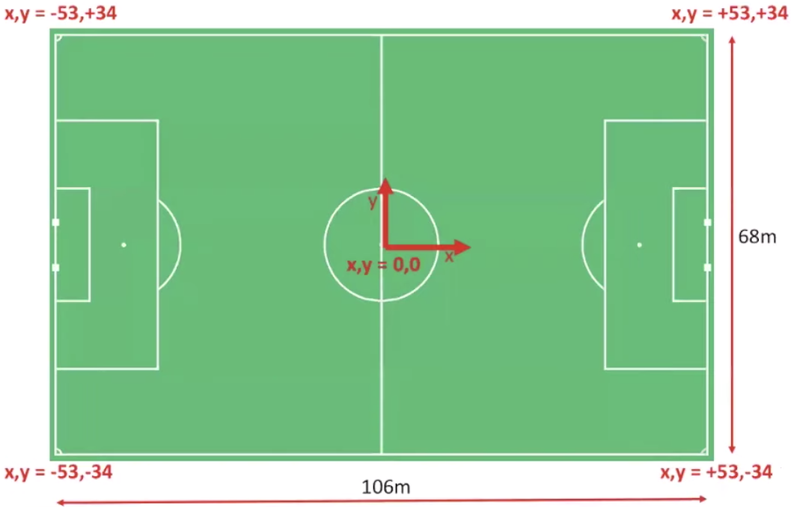
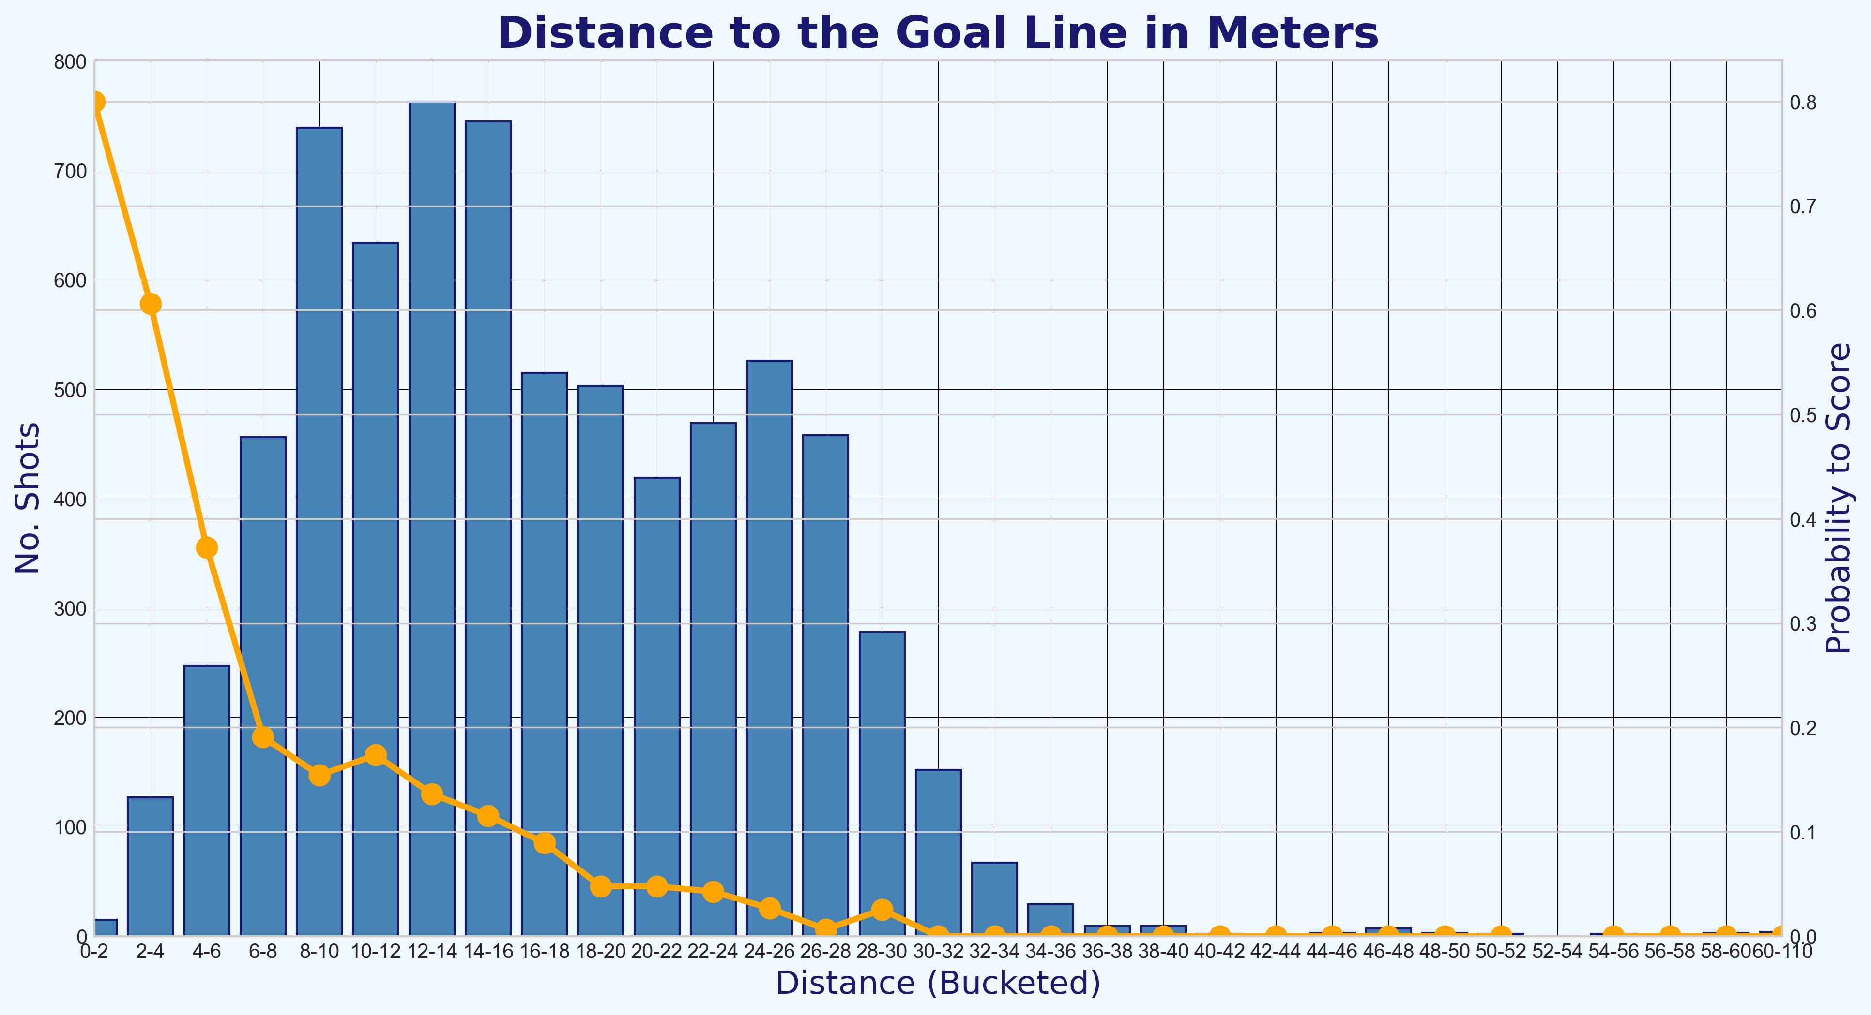
Chance Quality Model
Key objectives achieved with the Shots dataset, summarised in this section
1
What are Expected Goals (xG)?
Background information about the proxy of choice for the Chance Quality Model. What is this xG metric and why has it made such a huge impact on football data analysis.
Data Engineering
Reworking the dataset into a form ready for modeling including: converting the pitch coordinates to a standardised coordinate system, filtering the data for just Open Play goals, and cleaning attributes.
Building a Chance Quality Model via the logic of Expected Goals
A basic model to measure the likelihood of shots resulting in goals from a sample of just under 11,000 shots. The model uses Logistic Regression and the approach is made up of the following steps: exploratory data analysis (EDA) of the dataset, data engineering, evaluation metric selection, outlier treatment, univariate and multivariate analysis with subsequent feature engineering, production of a final model, measurement of performance, and feature interpretation.
2
3
Notebook to create the Chance Quality Model from the shots data: https://github.com/eddwebster/mcfc_submission/blob/main/notebooks/chance_quality_modelling/Creating%20a%20Chance%20Quality%20Model%20from%20Shots%20Data.ipynb

Slide 8
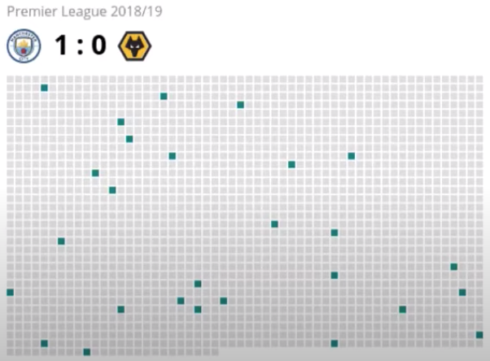
What are Expected Goals and Why is this an Important Metric?
Arguably the most important metric in football analytics so far – Expected Goals
‘Expected goals’, aften appreciated as 'xG', is a derived football metric created by Sam Green at Opta, that measures the shot quality or probability that a shot with defined position, conditions, and situation, will, on average, result in a goal (Fig. A). Put simply, shots are assigned a number between 0 or 1 determined by the proportion of similar shots that have resulted in a goal. The derivation of the xG is the metric is what is used create the Chance Quality Model for this challenge and is henceforth referred to in deck as either Expected Goals or ‘Chance Quality’ interchangeably.
The factors that Green took into account when creating his model included: the distance from goal, the angle of the shot, did the chance fall at the player's feet or was it a header? was chance a one-on-one? what was the assist like? (e.g. long ball, cross, through ball, pull-back), in what passage of play did it happen? (e.g. open play, direct free-kick, corner kick), is the shot a rebound?, and more.
In a low-scoring game and unpredictable game such as football, final match score often does not provide a clear picture of performance. This is reflected in the success rate of bookmakers, who pick the favourite in football matches less successfully than in other sports. In football, just over 50% of the favourites win, compared with over 60% in top American team sports.
Goals are also very rare, the average number of goals scored per game is 2.66, with a score every 69 minutes per team. This is also reflected in the number of attempts on goal, with football teams shooting around twelve times per match, around 0.4% of a 3,000 Event dataset. No other sport has so many efforts from a team before anything happens regarding the score line (The Numbers Game, Anderson and Sally). The second visualisation on the right shows the ratio of the number of shots (green) to other events in a match that took place between Manchester City and Wolves during a match in the 18/19 season, where fewer than 1% of the on-the-ball actions in the match resulting in shots (Fig. B).
Although goals in football are rare and random in isolation, they are predictable over a longer period of time and are closely fitted by a Poisson distribution. The average number of goals can be taken and the Poisson distribution applied (The Numbers Game, Anderson and Sally). Expected Goals allow analysts and statisticians to look an all shots, which happen around ten times as many times as the goals themselves, making for a much better predictor of goals scored by a team in the medium term (How to Build an Expected Goal Model, Sumpter).
Why is xG important? It can be used to make smarter decisions on recruitment, tactics, and strategy. For example, clubs who recruit strikers can look past the randomness of actual goals scored and identify the underlying shot quality. This can help aid club decrease the risk made by recruitment departments on signing players that are in purple patches, and instead, identify players constantly create enough high-quality chances at the level the scouting team is looking for.
A
B
Definition of Expected Goals derived from Laurie Shaw’s article: Bodies on the Line: Quantifying how defenders affect chances: http://eightyfivepoints.blogspot.com/2017/09/bodies-on-line-quantifying-how.html.
Expected Goals images taken from both David Sumpter’s Friend of Tracking lesson: ‘How to Build An Expected Goals Model 1: Data and Model (https://www.youtube.com/watch?v=bpjLyFyLlXs) and his book Soccermatics.
Visualisation of the number of shots in a game taken from Lotte Bransen and Jan Van Haaren’s talk ‘How to find the next Frankie de Jong’ for Friends of Tracking: https://www.youtube.com/watch?v=w0LX-2UgyXU.
Statistics taken from chapter two of The Numbers Game by Chris Anderson and David Sally and Soccermatics by David Sumpter.
Notebook to create the Chance Quality Model from the shots data: https://github.com/eddwebster/mcfc_submission/blob/main/notebooks/chance_quality_modelling/Creating%20a%20Chance%20Quality%20Model%20from%20Shots%20Data.ipynb

Slide 9
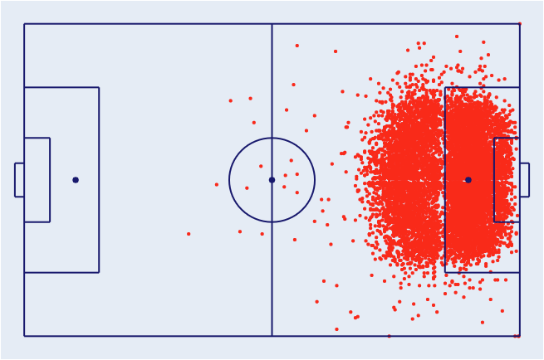
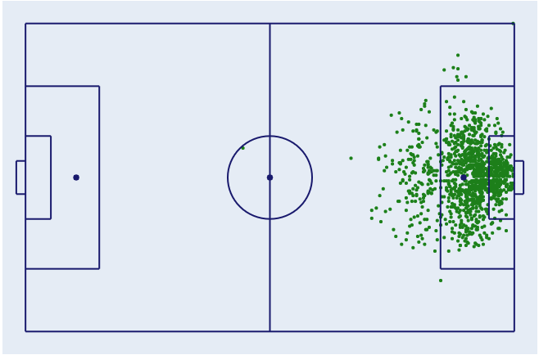
Exploratory Data Analysis of the Raw Dataset
Information about the provided Shots dataset of just under 11,000 shots used to train the Chance Quality Model
The shots DataFrame contains 10,925 shots (Fig. A) and 1,374 goals (12.6%) (Fig. B), of which there are:
10,777 Non-Penalty (NP) shots and 1,261 non-penalty goals (11.7% of all NP shots); and
10,269 Open Play (OP) shots and 1,218 Open Play goals (11.9% of all OP shots).
Each row consists of a single shot event.
The features available include:
match_minute: minute of the match in which the shot was taken.
match_second: second of match_minute in which the shot was taken.
position_x: position of the shot on the pitch in meters (x-coordinate).
position_y: position of the shot on the pitch in meters (y-coordinate).
play_type: game situation in which the shot was taken (open play, penalty, direct free kick, direct from a corner). This feature will be used to filter the dataset for only Open Play shots.
BodyPart: body part with which shot was taken (left foot, right foot, head, other).
Number_Intervening_Opponents: The number of opposing players that were obscuring the goal at the instant of the shot (from the perspective of the shot-taker).
Number_Intervening_Teammates: The number of teammates that are obscuring the goal at the instant of the shot (from the perspective of the shot-taker).
Interference_on_Shooter: The degree of direct interference exerted on the shot-taker from defenders (Low - no or minimal interference, Medium - a single defender was in close proximity to the shot-taker; High - multiple defenders in close proximity and interfering with the shot).
outcome: The outcome of the shot (blocked, missed, goal frame (post or bar), saved, goal or own goal).
< 11,000 Shots in the Dataset
A
B
Fig. A: All shots in the dataset.
Fig. B: All goals in the dataset.
Notebook to create the Chance Quality Model from the shots data: https://github.com/eddwebster/mcfc_submission/blob/main/notebooks/chance_quality_modelling/Creating%20a%20Chance%20Quality%20Model%20from%20Shots%20Data.ipynb
Full details of the dataset can be found in the provided documentation, ShotData.txt: https://github.com/eddwebster/mcfc_submission/blob/main/documentation/shots/ShotData.txt

Slide 10
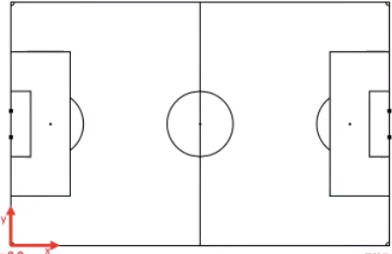
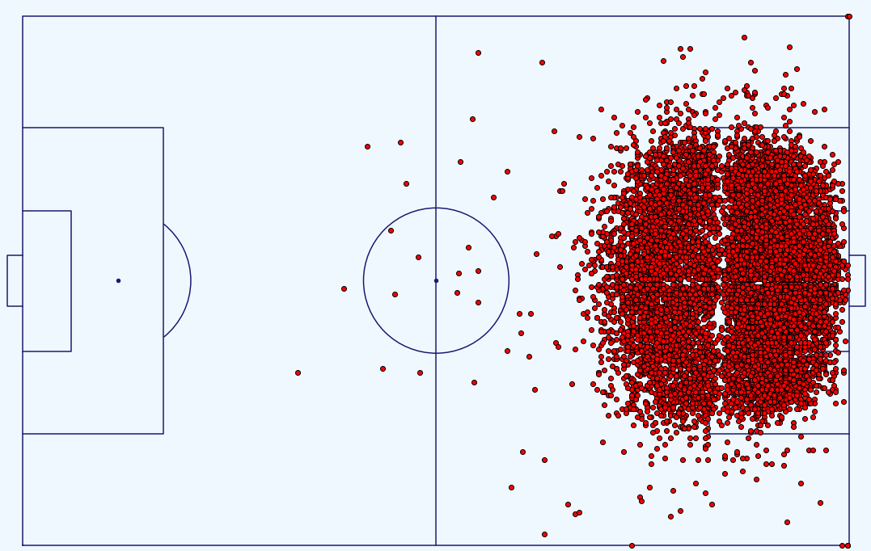
Initial Data Engineering
Steps to engineer the dataset before modeling – coordinate conversion, data cleaning, and subsetting the data
A
x,y = +106, +33.92
x,y = 0, +33.92
Pitch dimension conversion
The x-coordinate measures perpendicular distance from the goal line while the y-coordinate measures perpendicular distance from the line that joins the centre spot and the centre of the goal. The full dimensions of the pitch are not confirmed in the documentation but for this analysis, they have been assumed to be 106 meters by 67.84 meters (Fig. A). The min and max of the y coordinates are -33.92 and +33.92 respectively (y = 67.84) and the x coordinates have been assumed be the length of a standard pitch [link], with the penalty spot at (10.97, 0) meters.
The coordinate system was standardised to match those as used by Laurie Shaw when working with the Metrica Sports data, for simplicity in the following stages (Fig. B). See Laurie’s GitHub repository for code [link].
Data cleaning
Dataset relatively clean but certain attributes required some attention to detail before modelling.
NULL values for ‘Interference_on_Shooter replaced with ‘Unknown’ string.
Values in the ‘play_type’ column tidied including ‘Direct Corner’ and ‘Direct corner’.
43 own-goals removed from the dataset.
Attribute created for ‘isGoal’ derived from ‘outcome – used as the target attribute during the modeling. 1 is goal, 0 is no goal.
Subsetting the data
The data was subsetted to only include shots taken from open-play (OP), removing all shots from penalties, free kicks, or directly from corners. There is potential for a separate Expected Goals model to be created for these play types three, however, due to time constraints, this was not carried out (see next steps and conclusion for how this is dealt with and potential next steps).
Upon investigation, where ‘Interference_on_Shooter is ‘Unknown’, these 43 shots had 100% probability of resulting in a goal. As it is not known what this Interference is and how these could be related back to the Metrica Sports data, these were dropped from the dataset.
This leaves an OP DataFrame with 10,226 shots and 1,175 goals (11.5%).
In total, 699 shots (6.4%) and 199 goals (14.5%) were removed from the dataset.
x,y = +106, -33.92
x,y = 0, -33.92
Fig. A: Pre-conversion of coordinates
B
x,y =-53, +34
x,y = +53, +34
Notebook to create the Chance Quality Model from the shots data: https://github.com/eddwebster/mcfc_submission/blob/main/notebooks/chance_quality_modelling/Creating%20a%20Chance%20Quality%20Model%20from%20Shots%20Data.ipynb
Diagram of the pitch post-conversion credit to Laurie Shaw.
Dimension of a standard football pitch: https://en.wikipedia.org/wiki/Football_pitch
x,y = -53, -34
x,y = +53, -34
Fig. B: Post-conversion of coordinates including shots

Slide 11
Initial Modelling
Creation of a baseline classification model for which future performance of iterated models was compared
Classification models:
Creating a Chance Quality model is a classic classic supervised learning problem. A classification model is tasked with drawing some conclusion from the input values. It will predict the class labels/categories for the new data. In the case of a Chance Quality model, whether a shot results in a goal or not.
Initial model:
The initial model model (submitted for initial task deadline) was a Logistic Regression model. A subsequent Gradient Boosted Decision Trees model using the XGBoost algorithm was created in a secondary notebook. For more information about these two models, how they work, their strengths and weakness, please see the Model Selection slides (4) available in the Appendix, or the individual notebooks for each model (Logistic Regression [link] and Gradient Boosted Decision Trees [link]).
As a baseline uses the features first included in the dataset. Future iterations of the model include engineered features and one-hot encoded categorical features.
The two features of most interest for the initial, basic model were:
The standardised position of the shot was taken on the pitch, ‘position_xM’ and ‘position_yM’
The body part the shot was taken with, i.e. left foot, right foot or head, encoded in BodyPartCode
The dataset was split into a training and test set, with ratios 0.7 and 0.3 respectively. The training set is used to build the model and the test set is used to evaluate the model's predictions.
The model was the trained using ‘position_xM’, ‘position_yM’, and ‘BodyPartCode’ features, with the newly derived ‘isGoal’ feature as the target variable.
Model performance:
The performance of the initial model was the following:
Accuracy: 88.5%
Log Loss: 0.33182
ROC AUC: 72.8%
As this Chance Quality Model is required to calculate the probability of a shot resulting in a goal (i.e. P[goal|shot,situation]) given a certain state, the performance of the model was assessed by the Log Loss (Binary Cross Entropy). More details about the aforementioned metrics as well as why Log Loss was selected as the appropriate metric can be found in the Metric Selection slide available in the Appendix and section 7 (Metric Definition) of the Chance Quality Model notebook [link].
Next steps:
At the end of the first basic model, no considerations had been made for: the bias in the underlying data, outlier treatment, feature engineering, or univariate and multivariate analysis, feature interpretation and evaluation. Using the first model as a benchmark, the next stages work to improve the model through iteration of each of these steps.
Logistic Regression wiki: https://en.wikipedia.org/wiki/Logistic_regression.
XGBoost official documentation: https://xgboost.readthedocs.io/en/latest/.
Notebook to create the Chance Quality Model from the shots data: https://github.com/eddwebster/mcfc_submission/blob/main/notebooks/chance_quality_modelling/Creating%20a%20Chance%20Quality%20Model%20from%20Shots%20Data.ipynb

Slide 12
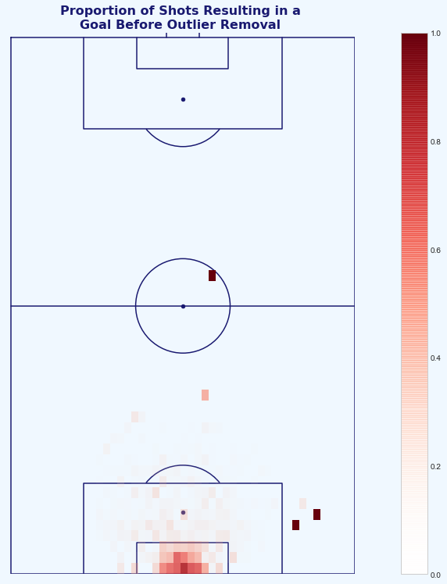
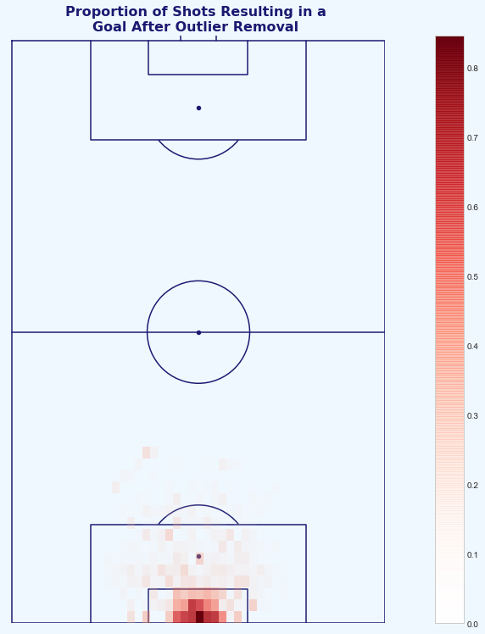
Treating Outliers
Finding and handling unlikely and irregular shots in the dataset that could have an impact on the Chance Quality model
A
B
The provided data included a number of examples of Open-Play shots taken and subsequently scored from improbable locations on the pitch (Fig. A).
These goals are most likely due to uncharacteristic errors from the goalkeeper and/or poor positioning from the keeper in that current moment in the match i.e. keeper up for a last minute corner and conceding a goal from 50+ meters into an empty goal (see example of Xavi Alonso against Luton [link]).
These shots took place, but we do not want the model to learn that there is a chance to score from this area in our limited dataset (can be approached using more detailed Event and/or Tracking data).
For now, these shots are excluded changing the result of all shots with distance >35m and all shots from >18m with shot angle >35 degrees removed from the data.
This results in 33 Open Play shots values changing from goal (1) to no goal (0) (0.27% of the Open Play shots changed). This is quite an arbitrary rule, with full Event data, more sophisticated outlier removal can take place such as setting the outcome of all shots taking place from areas of the pitch where shots take place >1% of the time, setting these to no goal (Fig. B). More information for such methods can be found in Treating Outliers section (section 7) of the Chance Quality Model notebook [link] and in the appendix.
Fig. A: Heatmap of the proportions of shots to goals in the dataset (goals divided by shots). This visualisation flags some of the outlier shots scored from inside the attacking teams half, and at acute angles to the left of the keepers left post.
Fig. B: Heatmap of the proportions of shots to goals in the dataset post-outlier treatment. These outliers have now been removed to prevent this affecting the Chance Quality model.
Xavi Alonso’s 70-yard goal against Luton in the FA Cup is a great example of a player scoring an unlikely goal from their own half with the goalkeeper out of position: https://youtu.be/4OTQwuAc4HU.
Notebook to create the Chance Quality Model from the shots data: https://github.com/eddwebster/mcfc_submission/blob/main/notebooks/chance_quality_modelling/Creating%20a%20Chance%20Quality%20Model%20from%20Shots%20Data.ipynb.

Slide 13
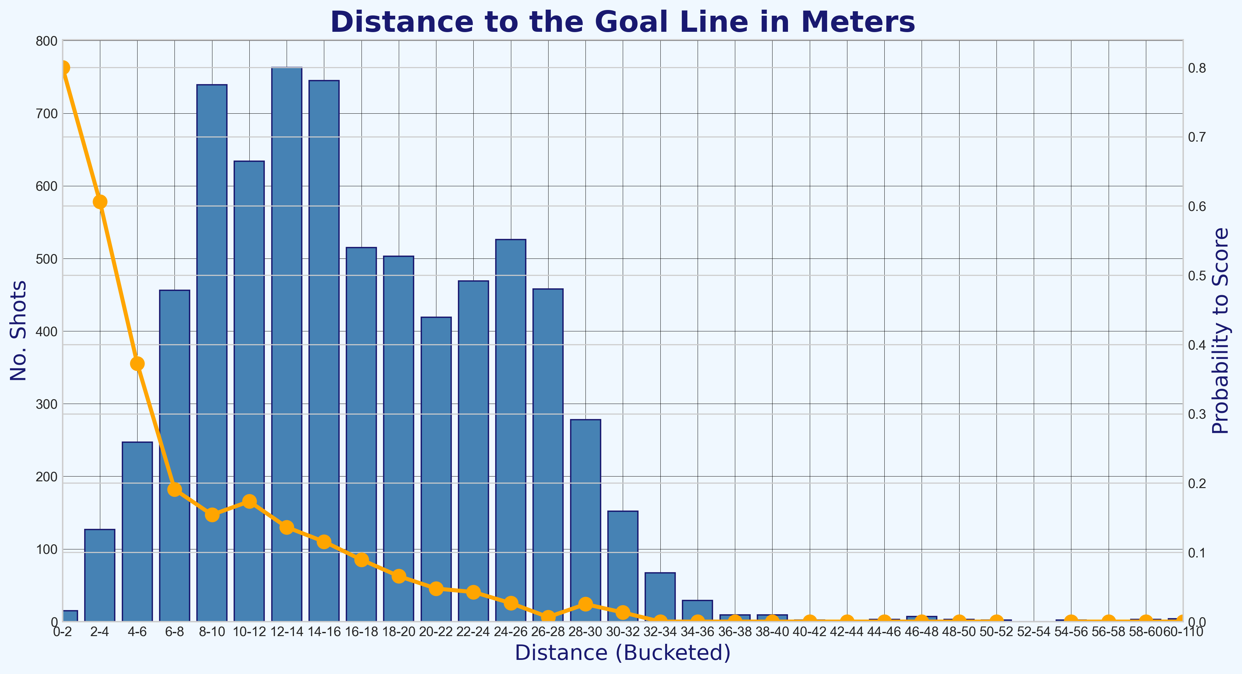
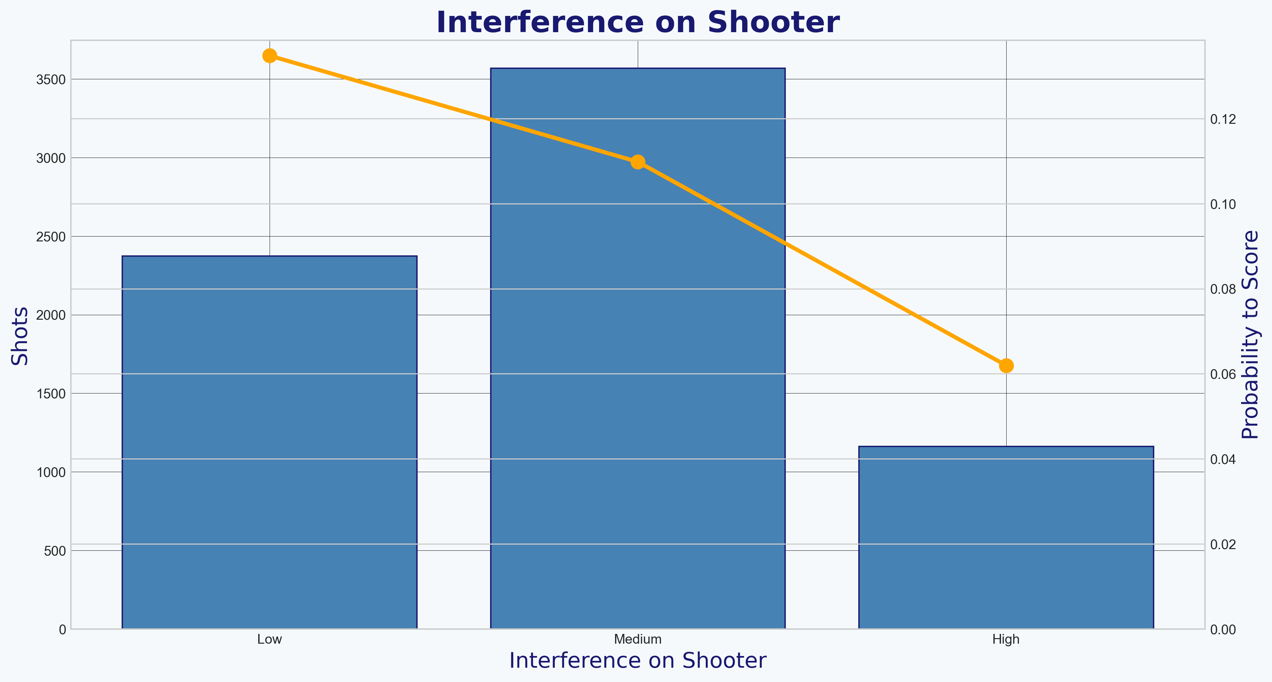
Feature Engineering and Univariate Analysis
Creating and analysing the features used in the improved Chance Quality Model
When selecting features to use for the Chance Quality model, a number of considerations needed to be taken, including:
The feature can be found or engineered in both the Shot data provided and the Metrica Event/Tracking data for which the predictions of chance created are to be made;
The continuous and discrete features selected are monotonic in nature. A monotonic model is an ML model that has some set of features (monotonic features) whose increase always leads the model to increase its output e.g. increasing the distance to the goal reduces the probability of the goal being scored, increasing the number of intervening opponents between the shot-taker and the goal reduces the probability of the goal being scored line, etc. This was tested for all available features.
Categorical features are required to be one-hot (dummy) encoded (e.g. interference on the shooter), where each category is assigned a single feature. If the one-hot encoded feature is 1 then it implies that the observation belongs to this category.
The features in the data that require no engineering including:
Number of Intervening Opponents (taking values between 0 and 11); and
Number Intervening Teammates (taking values between 0 and 7).
Features engineered from the data available to be Logistic Regression friendly:
Distance from goal – engineered from both the x and y coordinates coordinate;
Distance from the centre of the pitch – engineered from the y coordinate;
Angle to the goal – determined using the distance from the goal and centre of the pitch; and
Dummy encoding of categorical features including Body Part to is_foot and is_head, and Interference on the Shooter to Low, Medium and High.
The visualisations on the right show features that demonstrate monotonic relationships. The further a shot is away from the goal line, the less likely the shot taker is to score. (Fig. A) and the lower the interference level on the shooter, the higher the probability that they are to score from the shot (Fig. B).
Much more information about analysis each feature for their monotonic relationship can be found in Univariate Analysis (section 8) of the Chance Quality Model notebook [link]. Further details of the all the features engineered with the available data, and features that I would hypothetically engineer from a full Event dataset can be found in the appendix.
Include a bit here about the different angles – angle and distance to the mid-goal and visible angle to the goal posts (pg. 9 rowlinson thesis)
Notebook to create the Chance Quality Model from the shots data: https://github.com/eddwebster/mcfc_submission/blob/main/notebooks/chance_quality_modelling/Creating%20a%20Chance%20Quality%20Model%20from%20Shots%20Data.ipynb

Slide 14
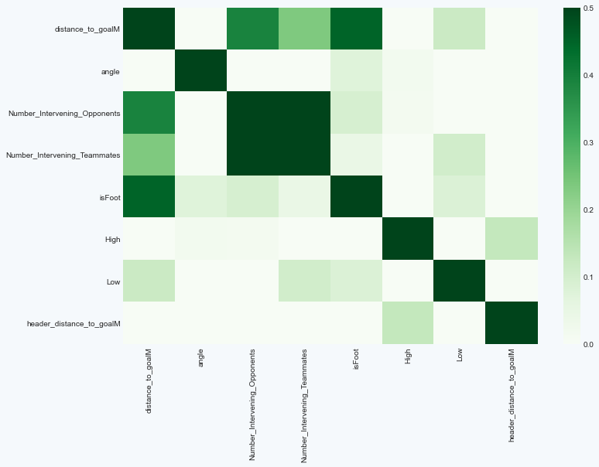
Multivariate Analysis
Dealing with highly correlated features
At this stage in the analysis, it’s important to not just look at each feature individually, but how they interact with each other. Multivariate analysis is all about finding highly correlated features and thinking about how to deal with them. This is important for two reasons:
Highly correlated features might lead to overfitting and have a negative effect on results; and
Highly correlated features can very easily mess with the feature interpretation and importance.
The visualisation on the right is a final heat map correlation matrix, with the features that were used in the final model. Highly correlated features such as angle and distance_to_centerM, and isHead and header_distance_to_goalM were treated appropriately, remove one of each. Medium_Interference_on_the_Shooter was also dropped from the final model, as when one-hot encoding a categorical column, you should always delete one of the created columns.
The Number of Intervening Opponents and the Number of Intervening Teammates are highly correlated features, but are features that were provided in the raw dataset that I have assumed are not derivatives of each other and not correlated, and will therefore be left untouched in this exercise.
The performance of the final Logistic Regression model was the following:
Log Loss: 0.289 (reduction from 0.332)
ROC AUC: 80.7% (increase from 72.8%)
As we can see, incorporation of the the defensive metrics (interference on the shooter, number of intervening opponents), the number of intervening teammates, and angle of the shot, all reduced the Log Loss of the model substantially, relative to the initial model. The ROC AUC also increased.
More information about the Multivariate analysis and can be found in section 10 of the Chance Quality Model notebook [link].
Decide whether ‘final model performance’ stats should stay on this slide or the next one
Notebook to create the Chance Quality Model from the shots data: https://github.com/eddwebster/mcfc_submission/blob/main/notebooks/chance_quality_modelling/Creating%20a%20Chance%20Quality%20Model%20from%20Shots%20Data.ipynb

Slide 15
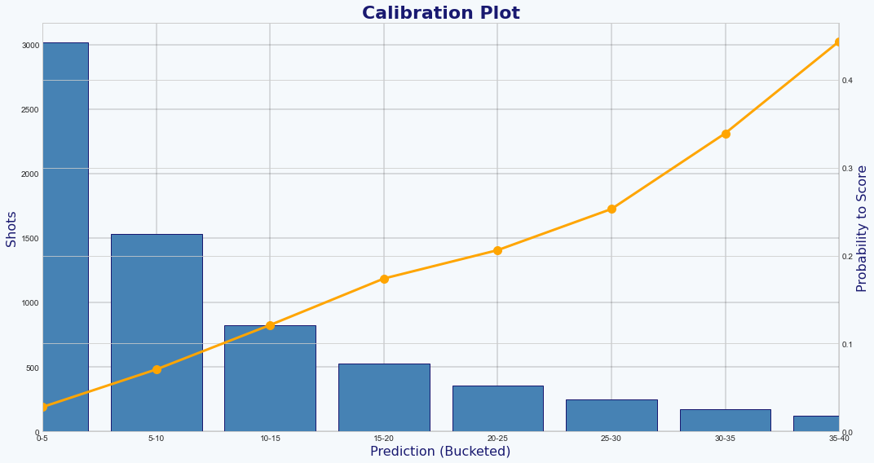
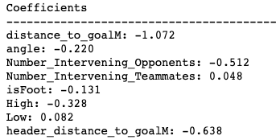
Final Model Evaluation and Feature Interpretation
Analysis of the final model before being used for prediction on the Metrica Sports data
For some reason, the angle to the goal is not as significant effect on the chance of a goal as expected (see coefficients) . Investigate this.
Phrase to include: as you’d expect, the coefficients for position and angle are both highly significant for both headed and non-headed chances.
The purpose of this Chance Quality Model is to calculate probability of a shot resulting in a goal (i.e. P[goal|shot,situation]). From this, it is possible to determine the probability that a shot results in a goal.
The main focus of optimising the model was to focus on minimising the Log Loss, but the important outcome is to see if the model probabilities correctly. This can be visualised through Calibration Plots (Fig. A).
The observed likelihood of the shots in the dataset resulting in goals is between the 0% and 5% bucket. The model is well-calibrated and ready to use with the Metrica Sports shot data.
Through the Feature Interpretation, it is possible to analyse the coefficients of the features, by both sign and magnitude (Fig. B). The take home messages from the model are:
As expected, the position on the field is extremely important when shooting. The further away the shot for both headed and non-headed chances. The further away you are from the goal, the less likely the shot is to result in a goal;
The further you are from the centre of the field, the more unlikely to score; and
The number of intervening opponents also plays a significant factor in the
More information about the Final Model and Feature Interpretation can be found in sections 12 and 13 respectively of the Chance Quality Model notebook.
A
B
Notebook to create the Chance Quality Model from the shots data: https://github.com/eddwebster/mcfc_submission/blob/main/notebooks/chance_quality_modelling/Creating%20a%20Chance%20Quality%20Model%20from%20Shots%20Data.ipynb

Slide 16
Part 2: Application of Metrica Sports Data
Using Metrica Sports Tracking and corresponding
Event data with sample game 2

Slide 17
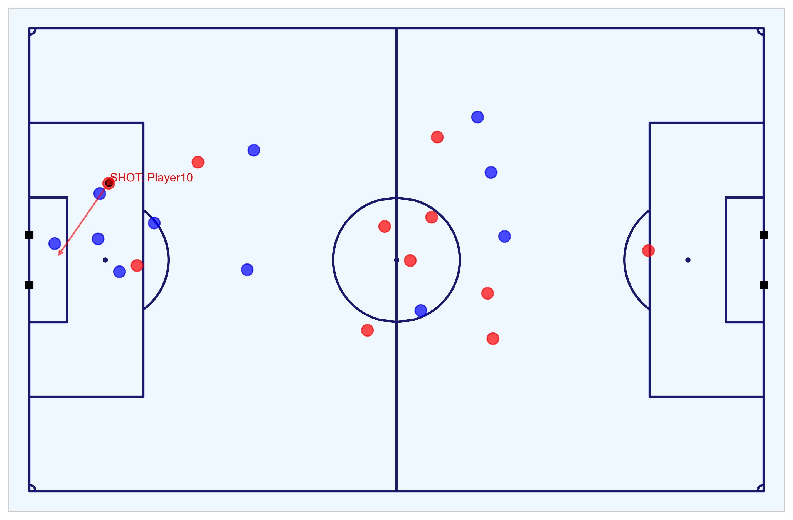

Metrica Sports Tracking and Event Data
Key objectives achieved with this data, explained further in this section
1
Data Engineering
Including converting the pitch coordinates to a standardised coordinate system, subsetting home and away DataFrames, reversing the direction of players to ensure each team is in the same direction for the full 90 minutes, and determining each of the player’s positions, speed, acceleration, and movement at a defined moment, using the timestep and distance travelled to calculate the the relative positions, speed, and acceleration of players for a given moment/sequence in play.
Exploratory Data Analysis of the match
Visualisation of the 24 shots taken during the match by the home and away teams, including Tracking data visualisation to conduct an eye test of the key chances and goals.
Create features required for predictions to be made for the data using the trained Chance Quality model
These features include: distance to the goal; distance to the centre of the pitch; angle to the goal; number of intervening opponents; number of intervening team mates; interference on the shooter; whether the shot resulted in a goal; whether the shots was a penalty or direct free kick; and whether the shot was taken with the player’s foot or head. This data is then exported.
Export data
Data converted to a format that matches the provided Shots data and exported, ready to be analysed and predicted upon for an assessment of the attacking chances during the match.
2
3
4
Notebook to work with the Metrica Sports Event and Tracking data: https://nbviewer.jupyter.org/github/eddwebster/mcfc_submission/blob/main/notebooks/metrica-sports/Metrica%20Sports.ipynb

Slide 18
Initial Data Engineering
Required adjustment made to the data before modeling
As per the shots Data, the Metrica Sports Event and Tracking data required some steps of Data Engineering before being in a state ready for analysis.
Pitch dimension conversion
Converted Metrica's 0-1 coordinate system to a standardised 106 by 86 coordinate system, as previously conducted with the Shots data, using the to_metric_coordinates function from the Metrica IO (mio) library created by Laurie Shaw [link]. This is done for both the Event and Tracking data.
Reverse player direction
Reversal of the direction of the home and away players to ensure that each team players in the same direction for the full 90 minutes, Home team right-to-left and the away team left-to-right.
Determine each of the player’s speed, acceleration, and movement from position and time step
With very little data engineering, it is possible to determine the position, speed, acceleration, and direction for all of the players on the field at any given moment.
Metrica Sports Tracking data is collected at twenty five frames s⁻¹. Therefore, a player’s speed can be calculated by dividing the distance a player has covered between two frames by 0.04and using a Savitzky-Golay filter. The acceleration is calculated as the 2nd order derivative i.e. speed divided by dt = 0.04 again.
Velocities and accelerations determined using the Metrica Velocity (mvel) library by Laurie Shaw [link].
Subset DataFrames
Separate Home and Away DataFrames and also create a separate shots DataFrame.
Notebook to work with the Metrica Sports Event and Tracking data: https://nbviewer.jupyter.org/github/eddwebster/mcfc_submission/blob/main/notebooks/metrica-sports/Metrica%20Sports.ipynb
Sample Tracking data provided by Metrica Sports: https://github.com/metrica-sports/sample-data
Diagram credit to Laurie Shaw.

Slide 19
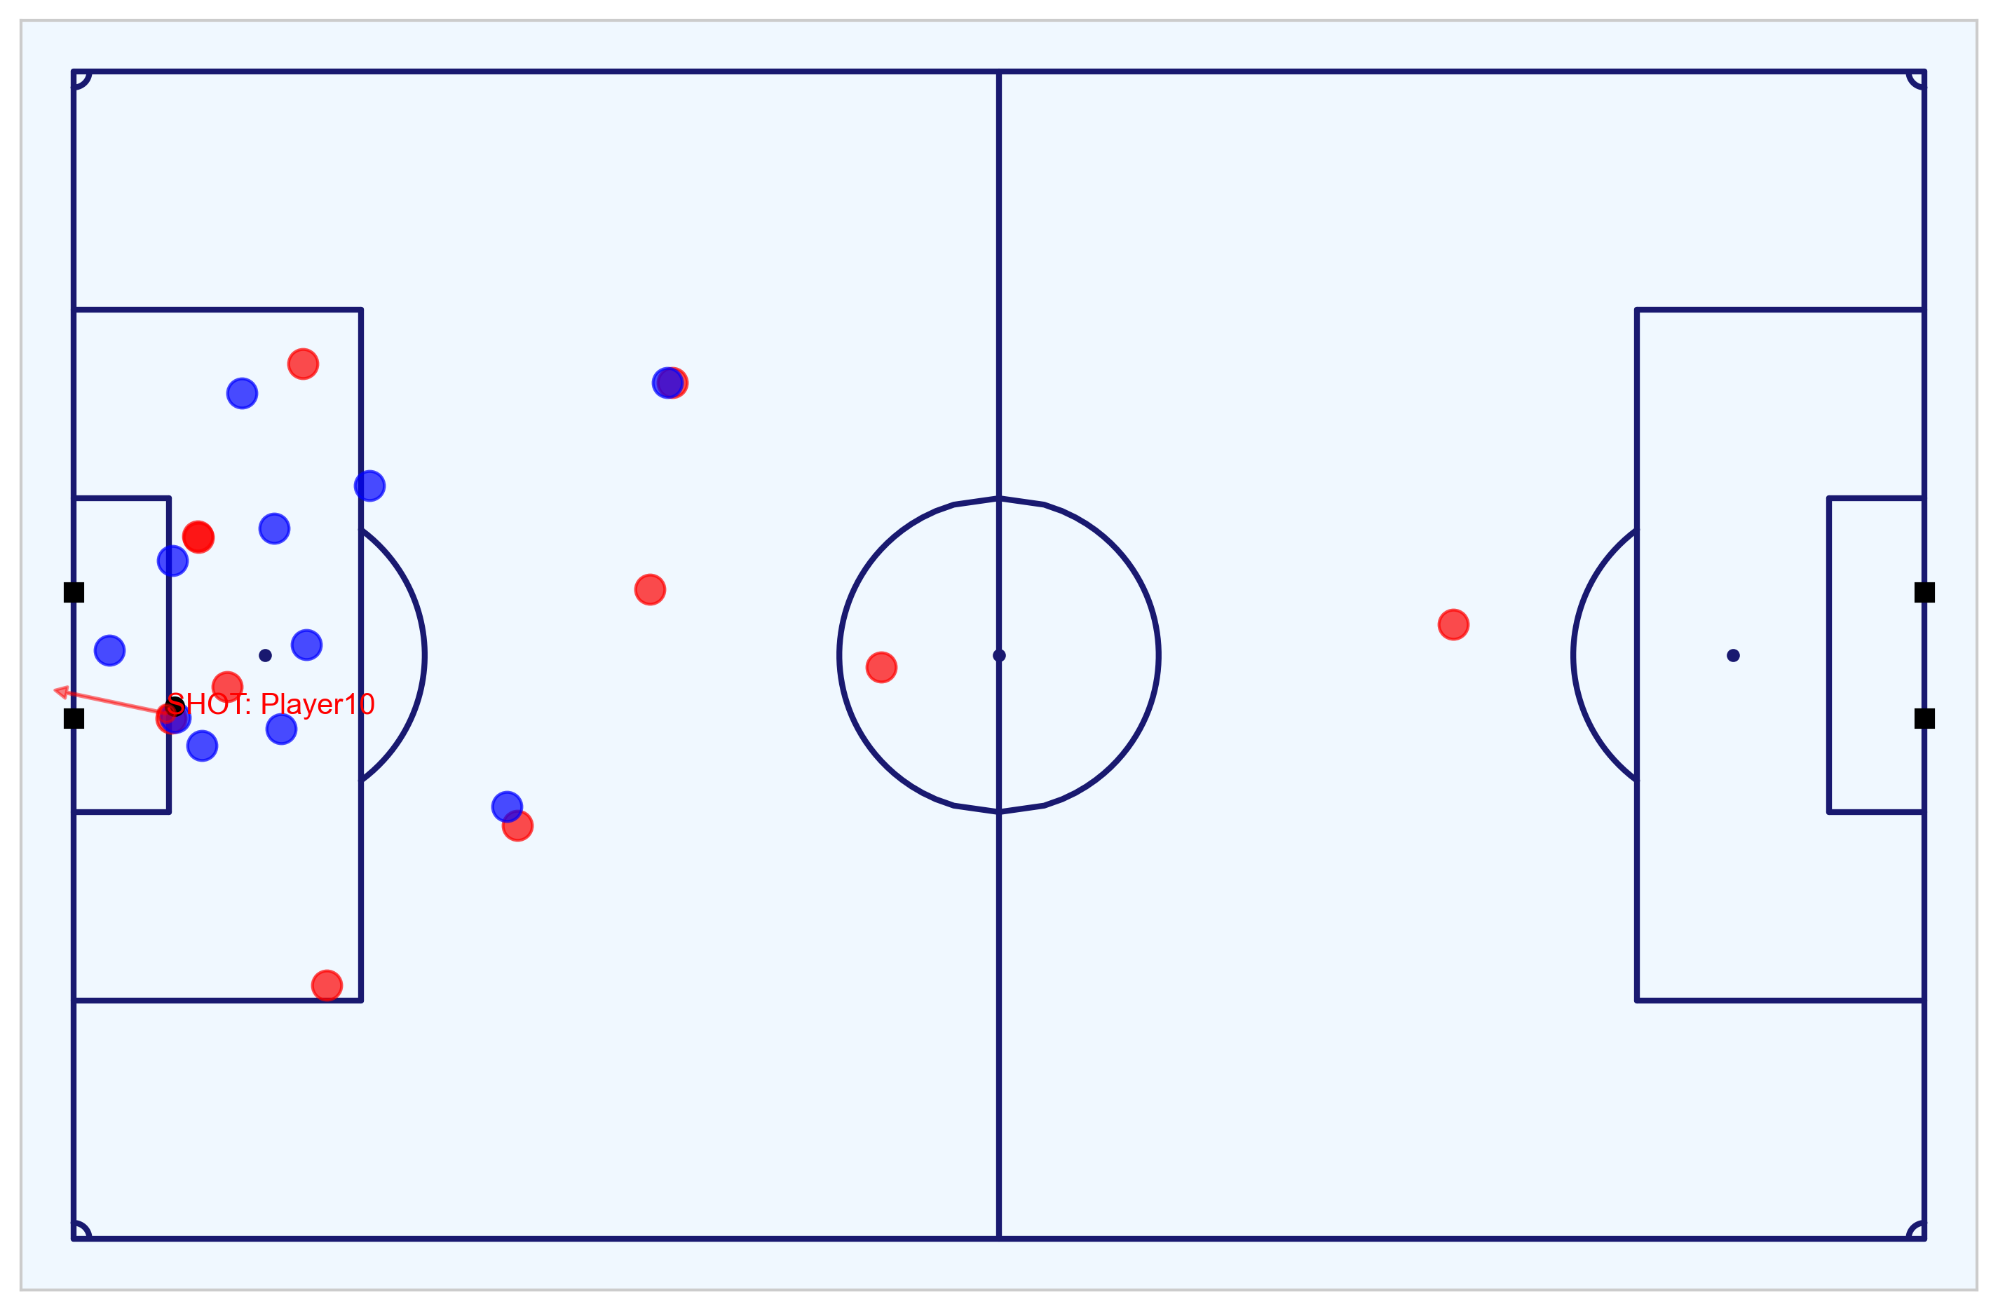
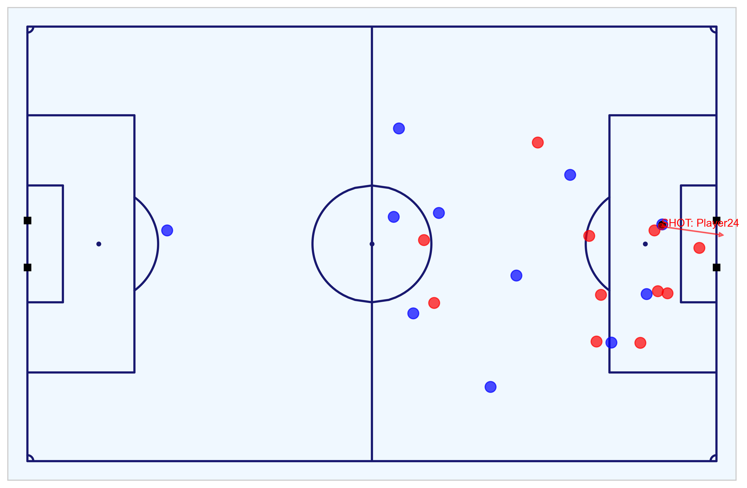
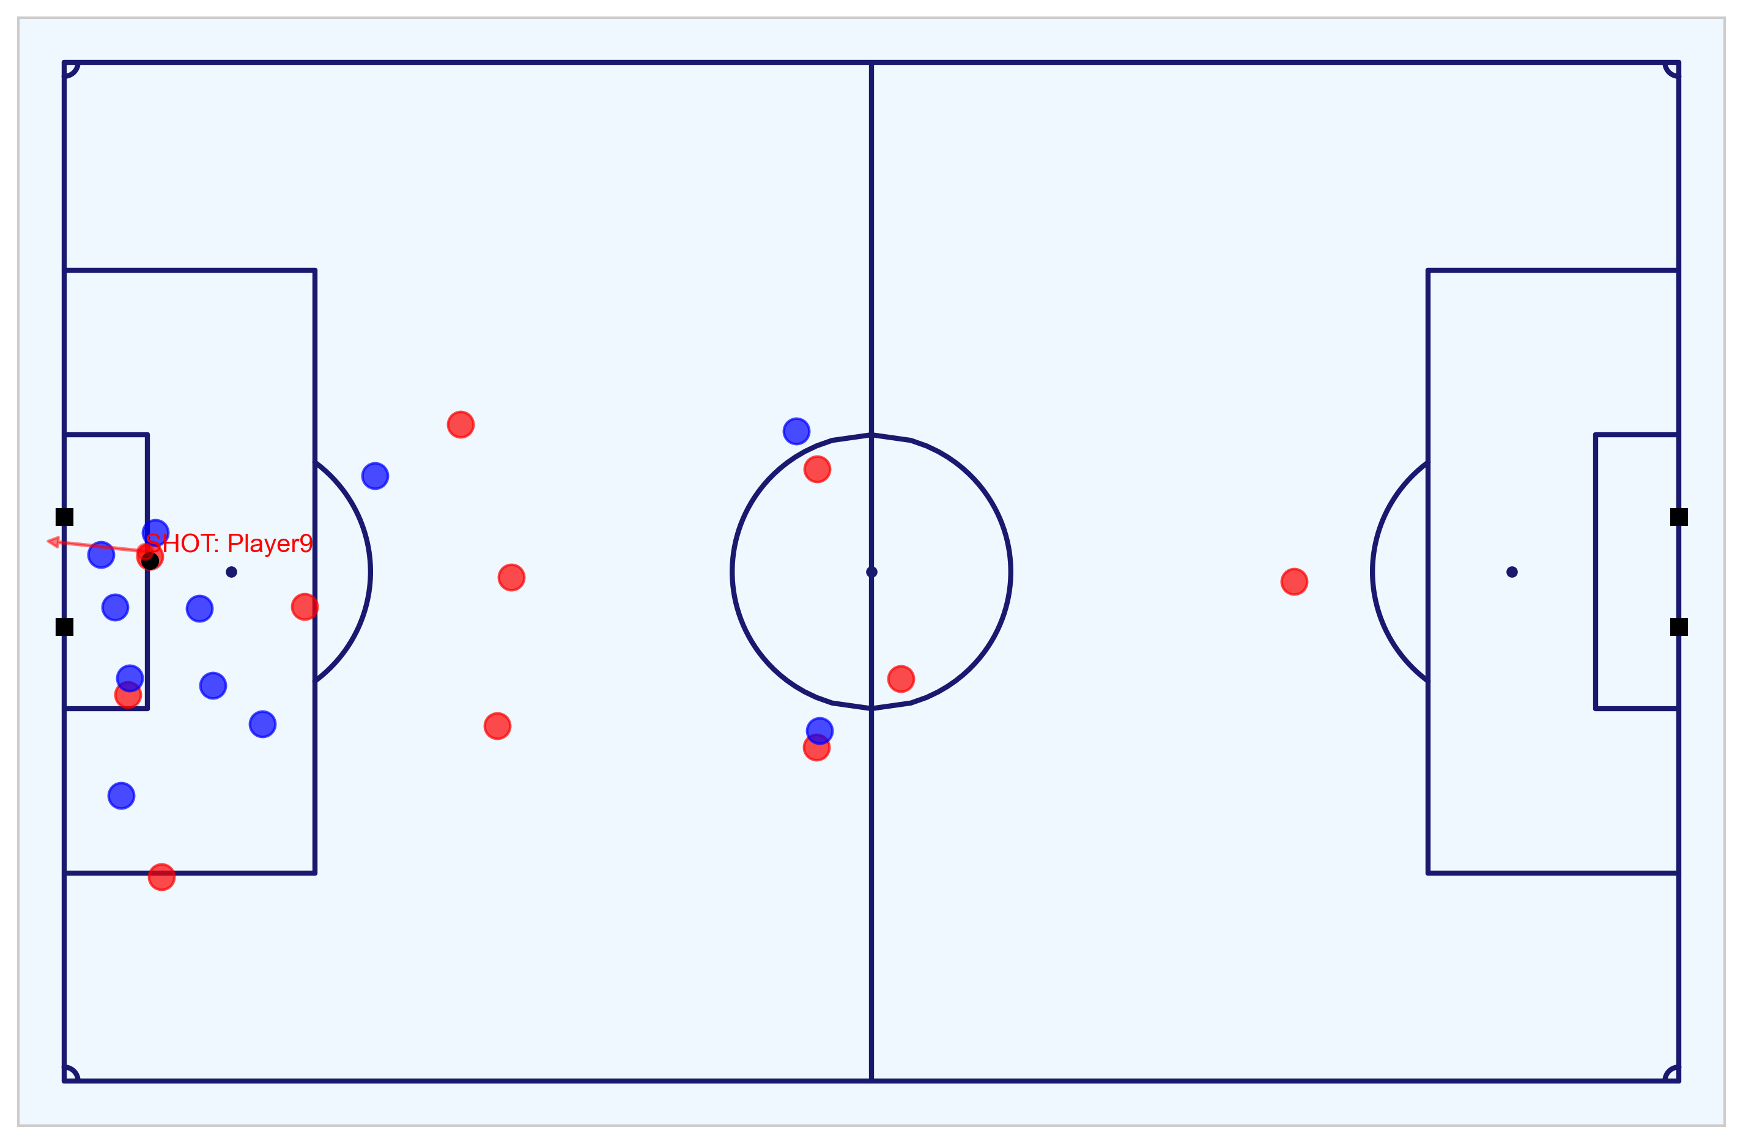
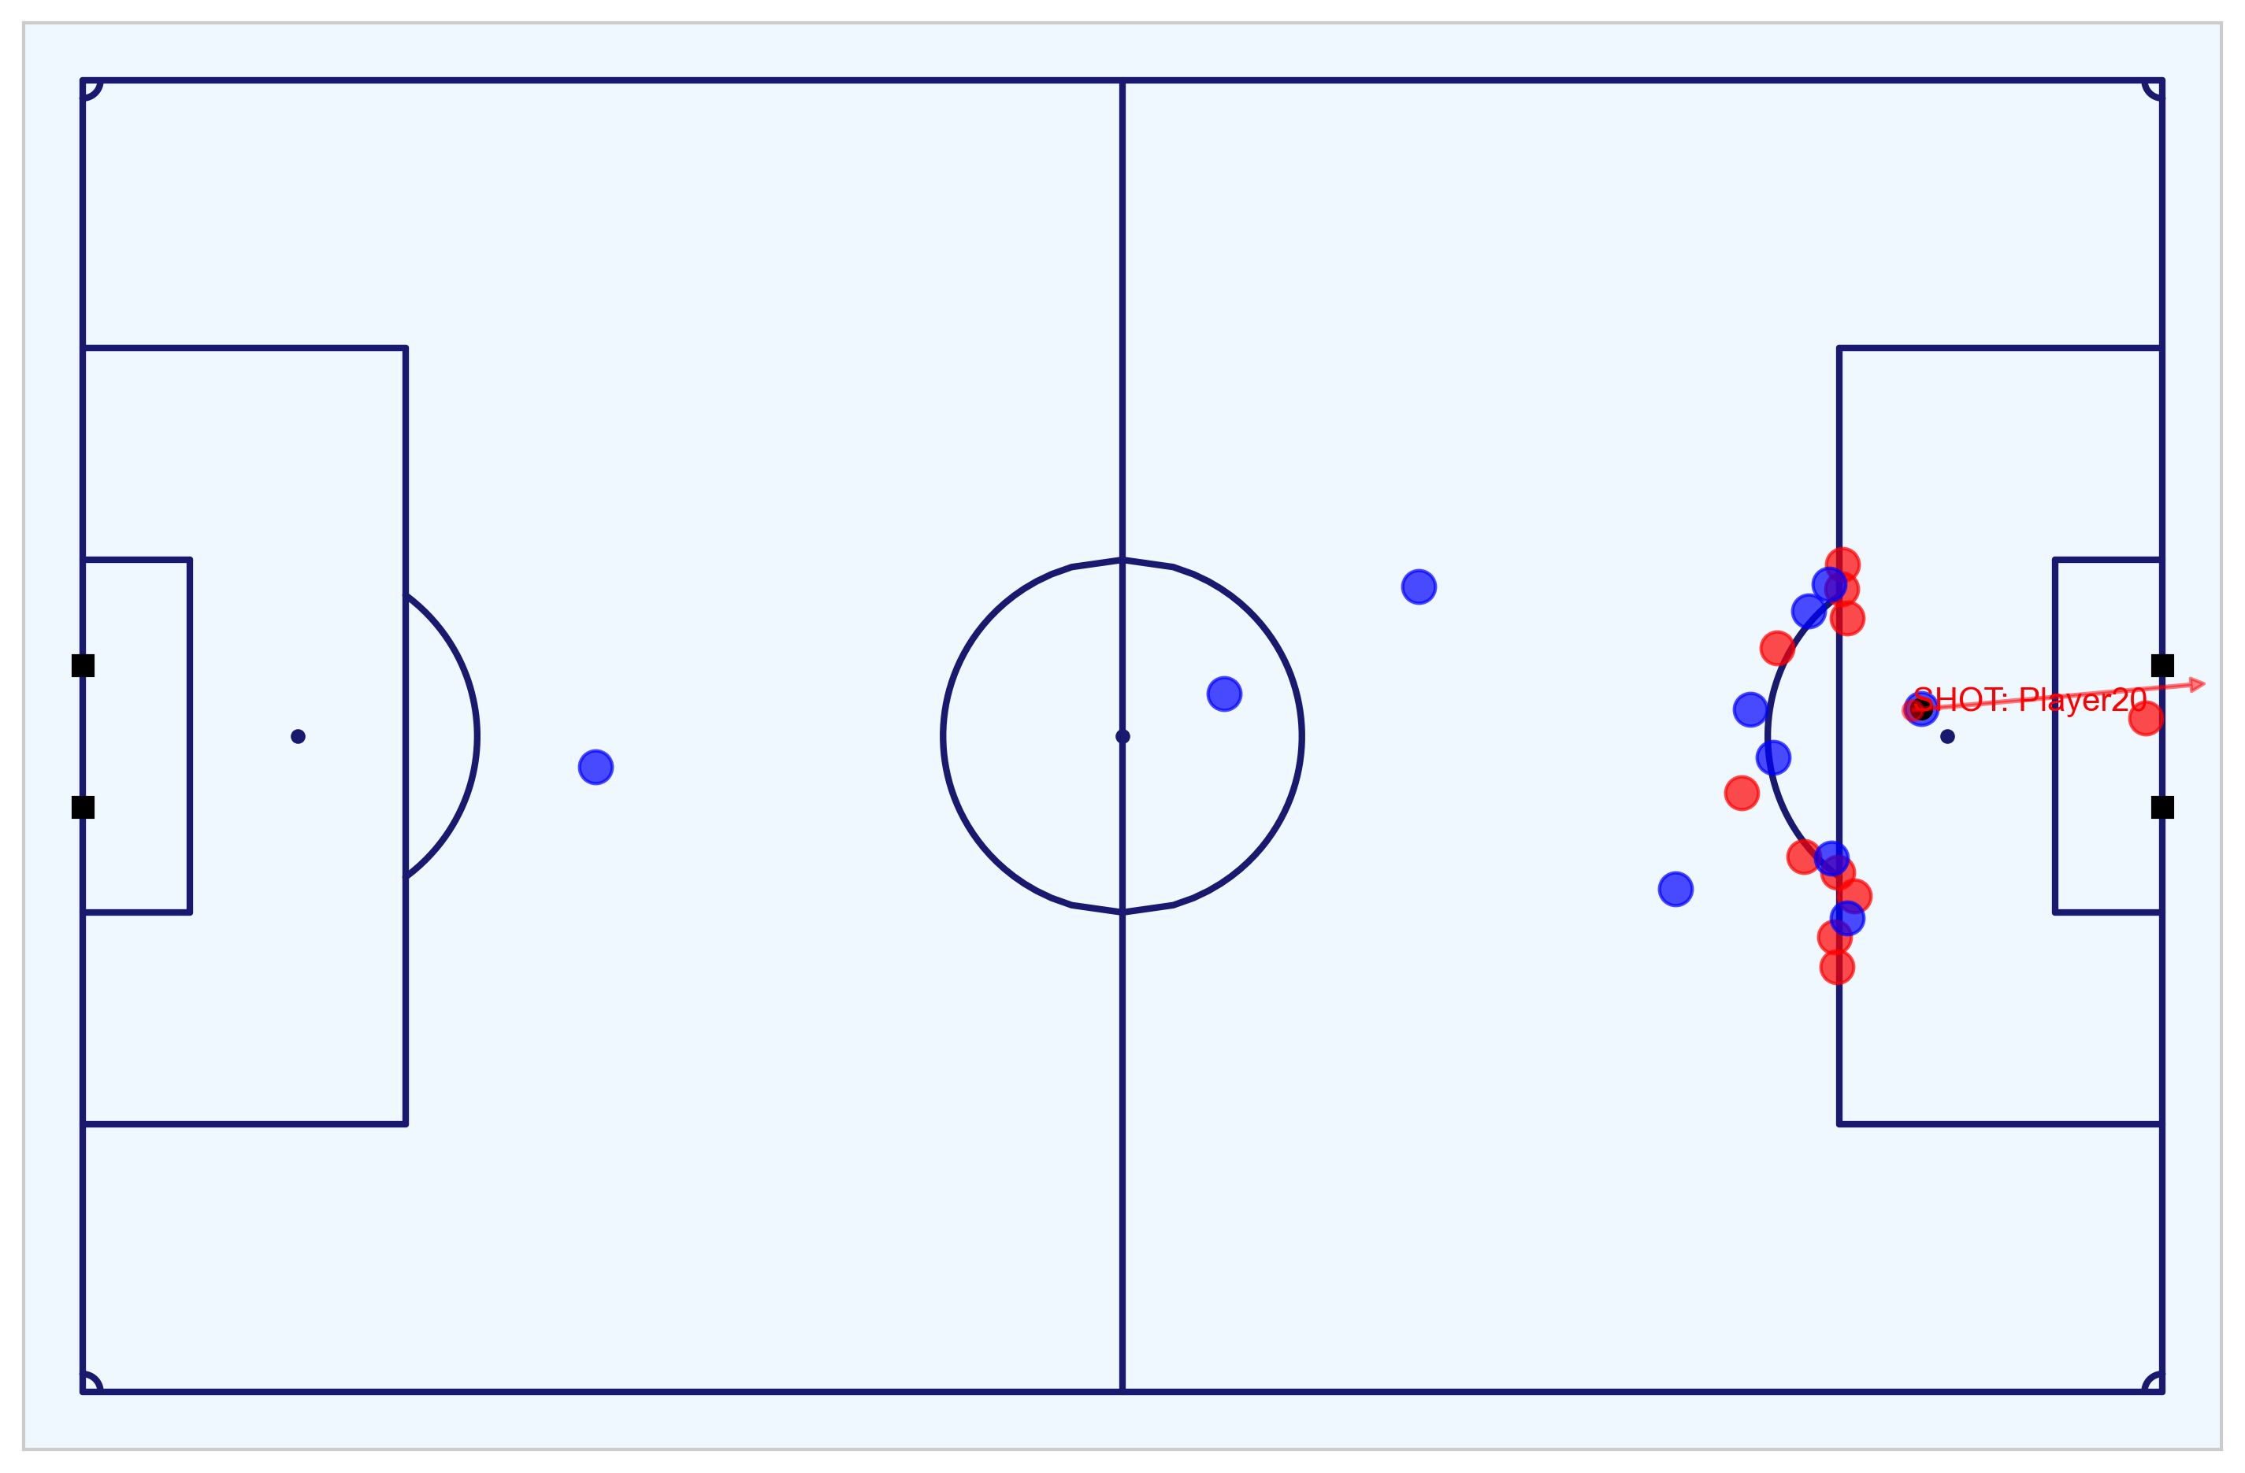
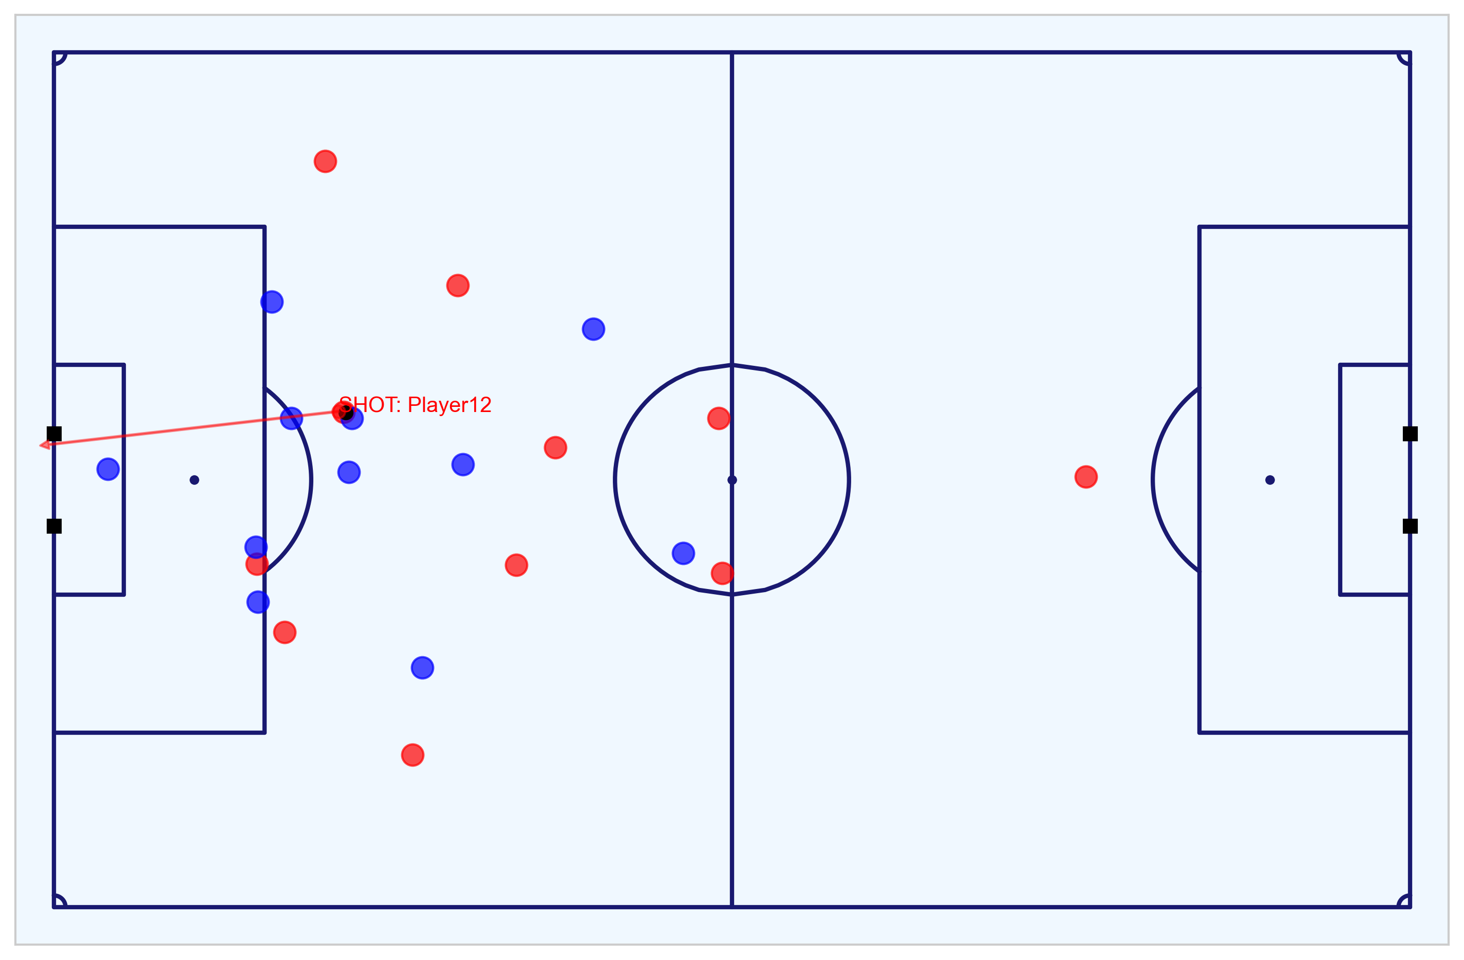
Exploratory Data Analysis of the Match
Determine the outcome of the match from the Event data and visualise the goals scored from the Tracking data
From both the Event and Tracking data, the following shots and goals can be observed:
Fig. A visualises all the shots and goals for both the Home (red) and Away (blue teams). The shots are in the respective team colours and chances that resulted in a goal are in yellow.
Fig. B visualises the first goal scored by the Home team at 8m8s (1-0).
Fig. C visualises the second goal scored by the Away team at 35m22s (1-1).
Fig. D visualises the third goal (header) scored by the Home team at 49m19s (2-1).
Fig. E visualises the forth goal (penalty) scored by the Away team at 76m40s (2-2).
Fig. F visualises the fifth goal scored by the Home team at 80m41s to win the game (3-2).
From the data, we can see that the Home team won the match 3-2.
More information about each goal and the key chances can be found in the appendix (one slide per goal) or in the Metrica Sports notebook [link].
Fig. A: All shots and goals
Fig. B: 1-0 Home goal (8m8s)
Fig. C: 1-1 Away goal (35m22s)
Fig. D: 2-1 Home goal (49m19s)
Fig. E: 2-2 Away penalty goal (76m40s)
Fig. F: 3-2 Home goal (80m41s)
Notebook to work with the Metrica Sports Event and Tracking data: https://nbviewer.jupyter.org/github/eddwebster/mcfc_submission/blob/main/notebooks/metrica-sports/Metrica%20Sports.ipynb.
Sample Tracking data provided by Metrica Sports: https://github.com/metrica-sports/sample-data.
All PNG figures produced from Tracking data: https://github.com/eddwebster/mcfc_submission/tree/master/img/fig/metrica-sports.
All MP4 videos produced from Tracking data: https://github.com/eddwebster/mcfc_submission/tree/main/video/fig/metrica-sports.

Slide 20
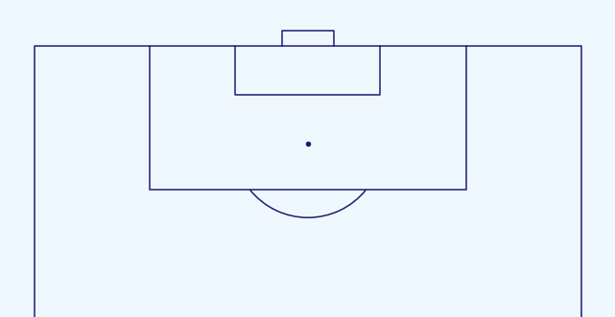
Creating Additional Features From Tracking Data
Features for compatibility with the CQM
The be fully compatible with the trained Expected Goals model from the Shots data, a number of key features were required to be derived from the Metrica Sports Event and Tracking data including: distance to the goal; distance to the centre of the pitch; angle to the goal; whether the shot resulted in a goal; whether the shots was a penalty or direct free kick; whether the shot was taken with the player’s foot or head; the interference on the shooter; and the number of intervening opponents and team mates.
From the Tracking data, it was possible to derive both the interference on the shooter and the number of intervening opponents and team mates:
The interference on the shooter can be determined by calculating the the distance between all the players and the ball and whether or not this is less than the defined radius. For this analysis, a radius of 5-yards (4.572m) as is used by StatsBomb to define pressure events [link]¹.
The number of intervening opponents and team mates can be determined by calculating the area of the four triangles alternating between the player, the ball, and each post (Fig. B). When the area of the triangle between both posts and the ball is equal the three triangles between the player-ball-left post, player-ball-right post and player-left post-right post, the observed player lies within this triangle and is therefore intervening in play. The number of players can then be summated.
The number of players determined as interfering or interfering is then summated at a team level and included in the subsetted Metrica Sports Shots DataFrame. This DataFrame is the filtered for just the shots is the ready to export and application of the trained Chance Quality Model to predict the outcome of each shot.
A
Fig. A: A player is defined as interfering with the shooter if they are within a defined radius of the ball, in this case 5m (not to scale). This can be determined mathematical by observing whether the distance between the player and the ball is less than the defined radius, or not.
B
¹How StatsBomb Data Helps Measure Counter-Pressing: https://statsbomb.com/2018/05/how-statsbomb-data-helps-measure-counter-pressing/
Sample Tracking data provided by Metrica Sports: https://github.com/metrica-sports/sample-data
Notebook to work with the Metrica Sports Event and Tracking data: https://nbviewer.jupyter.org/github/eddwebster/mcfc_submission/blob/main/notebooks/metrica-sports/Metrica%20Sports.ipynb
Fig. B: The number of intervening team mates and opponents can be visualised as a triangle between the ball and the posts of the goal at the moment the shot is taken. This interference can be determined mathematical by summating the areas of each triangle.

Slide 21
Part 3: Application of the Trained Chance Quality Model with the Metrica Sports Shot Data
Finalised dataset ready for analysis

Slide 22
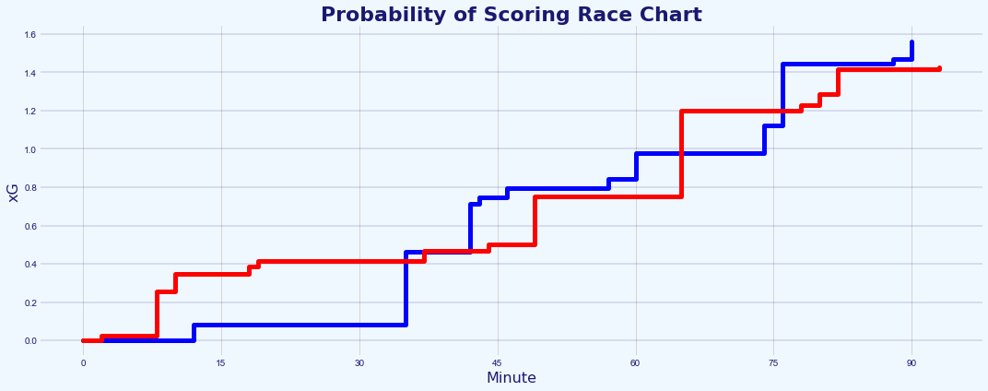
Which Team Deserved to Win the Game?
Assessment of the chances in the match through the application of the Chance Quality Model
The Chance Quality Model was trained with just Open Play (OP) shots, however, game 2 of the Metrica Sports data includes a penalty in the 76th minute. To deal with this, any penalty shots in the Metrica Sports data are assigned the value of 0.76 xG. as per the value used by StatsBomb/FBref [link]. StatsBomb models penalty kicks as all sharing the same characteristics and this assumption is made in this model. This amendment changes what is a very tight contest regarding cumulative xG (Fig. A) into a clearer projected win for the Away team (blue), once assigned this new xG value for the penalty.
Match assessment:
The winning goal scored by the Home team in the 80th minute was a shot from distance with an xG value of just 0.054 (ranked 13th out of 24 in terms of xG). This goal went on to be the deciding goal in the game, resulting in the Home team winning the game 3-2 despite having less accumulated xG than the Away team - 1.43 (from 13 shots) to 2.00 (from 11 shots) respectively, taking into account the Away team’s penalty which has an assigned xG of 0.76.
Before recalibrating the model for the penalty, the accumulative xG for each team was close to equal, 1.43 to the Home side and 1.39 to the Away side, showing the importance of the penalty.
I would therefore say that in a one-off game, the Away team was arguable are more deserving of winning the match, when considering only the quality of chances that each team created using the Chance Quality Model, largely because of the awarded penalty that was scored. However, the Home team capitalised on a low-xG chance in the 80th minute and were therefore able to win a very tight game.
More information the key chances can be found in the appendix.
A
Fig. A: Probability of Scoring race chart before any amendments to xG values.
B
Fig. B: xG race chart with amended xG value for the penalty.
`xG explained by FBref (include penalty xG of 0.76): https://fbref.com/en/expected-goals-model-explained/
Analysis of game 2 of the Metrica Sports sample data can be found in section 14 and 15 of the Chance Quality Model notebook: https://github.com/eddwebster/mcfc_submission/blob/main/notebooks/chance_quality_modelling/Creating%20a%20Chance%20Quality%20Model%20from%20Shots%20Data.ipynb
For more examples of visualising xG Race Charts in Tableau, please see slide 23 the Football Intelligence pack: https://docs.google.com/presentation/d/1uT6vT1J_FS10hW3hvWQx9ofqHUq8mT-kUbDRMrrUqH8/edit?usp=sharing
Visualisations inspired by Ben Mayhew’s Match Timelines, see: https://experimental361.com/explanations/match-timelines/
How to Create xG Flow Charts in Python by McKay Johns: https://www.youtube.com/watch?v=bvoOOYMQkac&list=PL10a1_q15HwqVEcnqt3tXs1bgvawjsQNW

Slide 23
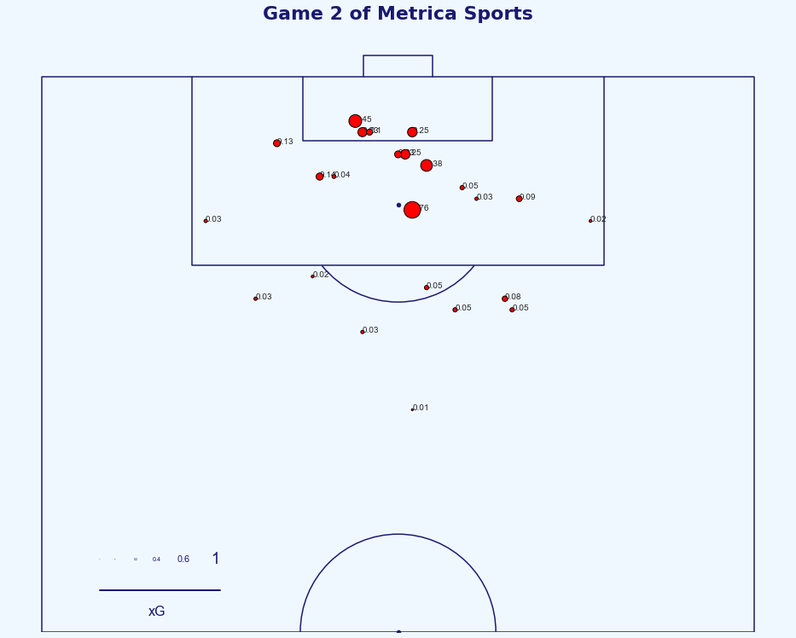
Visualisation of the Chances
Finish this slide
…
…
Penalty looks slightly off
Fig. A: …
Analysis of game 2 of the Metrica Sports sample data can be found in section 14 and 15 of the Chance Quality Model notebook: https://github.com/eddwebster/mcfc_submission/blob/main/notebooks/chance_quality_modelling/Creating%20a%20Chance%20Quality%20Model%20from%20Shots%20Data.ipynb
xG explained by FBref (include penalty xG of 0.76): https://fbref.com/en/expected-goals-model-explained/

Slide 24
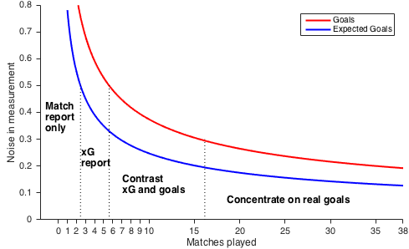
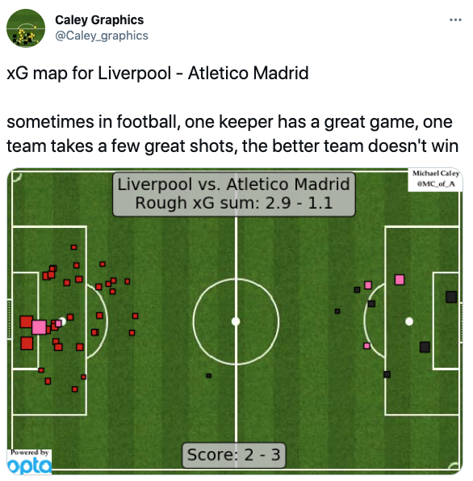
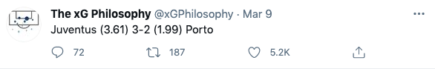
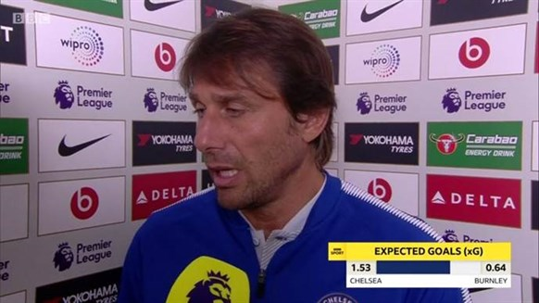
With Great Power Comes Great Responsibility
Expected Goals are useful, but when used incorrectly or in isolation, can also be useless
The concept of Expected Goals is a very useful concept because football is a low-scoring game. Subsequently, it has now entered the mainstream media lexicon¹.
In his piece ‘Should you write about real goals or expected goals?’, David Sumpter demonstrates how regarding Expected Goals, how the magnitude of the noise in the measurement performance decreases with the number of matches played in season (Fig. A)².
Between 1 and 2 matches, the noise is high for both Expected Goals and real goals. Between 3 to 6 matches, the noise is less than 0.5 goals per match, making an xG report quite functional. Between 7 to 16 matches, both goals and xG have only between 0.3-0.5 goals of noise which allows for comparison. After 16 matches, the difference between the noise in xG and the noise in real goals is only 0.1 goal per match. At this point, real goals are better than Expected Goals².
For this reason, even though the Chance Quality Model suggests that the Away team is a slightly more deserving winner of the match by proxy of a greater accumulation of xG, any analytical insights and conclusions based over a single 90 minute period should be made with caution.
This poor usage of Expected Goals can be found in a variety of forms of media (Fig. B, C, and D), where there has been an unfortunate tendency to misuse the metric over individual matches, instead of over several games. I would therefore conclude this analysis to say that predictions of any one team’s performance over a single 90 minutes is difficult and will be in most cases, inconclusive at best.
A
B
C
D
¹See Laurie Shaw’s article: Bodies on the Line: Quantifying how defenders affect chances: http://eightyfivepoints.blogspot.com/2017/09/bodies-on-line-quantifying-how.html.
²See David Sumpter’s article: Should you write about real goals or expected goals? A guide for journalists: https://soccermatics.medium.com/should-you-write-about-real-goals-or-expected-goals-a-guide-for-journalists-2cf0c7ec6bb6.
Caley graphic for Liverpool vs. Athletico Madrid (12/03/2020): https://twitter.com/Caley_graphics/status/1237870631024095234.
The xG Philosophy tweet for Juventus vs. Porto (09/03/2021): https://twitter.com/xGPhilosophy/status/1369418380642549762.

Slide 25
Limitations of Chance Quality Models
Some of the known problems and issues with current modeling
Chance Quality models, such as the one submitted for this data challenge, typically do not include information on the player taking the shot. As defined by FBref, Expected Goals does not take into account the quality of player(s) involved in a particular player and is therefore an estimate of how the average player or team would perform in a similar situation¹. Expected Goals, therefore, provide a baseline for measuring the amount a player outperforms the average player a shot of defined circumstances but does not account for a player’s skill or shot selection. The main reason for this is due to the amount of data required to created an Expected Goals model. It would be very unfeasible to create separate Expected Goals models per player from the data available. For reference, currently in the 20/21 season after 30 matches, Harry Kane, a player who takes a lot more shots than nearly all players, has had 117 shots (45 on target, 21 goals), 3.9 shots a game. Over a 20 year career with 38 games per season, this would result in just under 3,000 shots. At this point it may be possible to create a model, but I think this quick calculation demonstrates how it is not a good approach using match Event data.
The data provided to Chance Quality models is also incomplete. As discussed throughout this deck, the dataset of Shots provided to train the Chance Quality Model was only shots, not a full Event dataset. With a full Event dataset, it is possible to include new features such as whether a goal was scored with the player’s strongest foot, whether the shot was from a counter attack or fast break, whether the assist was a smart pass, whether the shot was from a cross, what the team’s current game state is (winning/drawing/losing). As demonstrated a full Event dataset is incomplete, which is why Tracking data can be used to bring new features, including some that were made available in this dataset such as pressure the player experience (player interference) or the number of team mates and opponents obstructing the goal. However, despite being the state-of-the-art dataset, Tracking data is still missing significant datapoints including the body pose position (i.e. are they open to receive a pass) and the spin of the ball (therefore need to build in uncertainties when determining ball trajectory). More details about the advantages and disadvantages of using Event and Tracking data has been including in the appendix of this revised deck.
Chance Quality models also typically do not use data from after the point the player strikes the ball. This means the model does not include information after the shot, such as the direction, speed, and angle the ball is heading.
Garry Gelade also states in his article Assessing Expected Goals Models. Part 1: Shots that Expected Goals are better predictors of goals scored than goals conceded². To measure a goalkeepers’ ability, the Post-Shot Expected Goals metrics is more appropriate and includes information after the shot is taken and helps to evaluate the probability of a goal given a shot’s placement, an important factor for evaluating goalkeepers³.
¹FBref Expected Goals Explained: https://fbref.com/en/expected-goals-model-explained.
²Assessing Expected Goals Models. Part 1: Shots by Garry Gelade: https://web.archive.org/web/20200724125157/http://business-analytic.co.uk/blog/evaluating-expected-goals-models/ (using Wayback Machine).
³A new way to measure keepers shot stopping: post-shot expected goals by Mike Goodman: https://statsbomb.com/2018/11/a-new-way-to-measure-keepers-shot-stopping-post-shot-expected-goals/.
Notebook to create the Chance Quality Model from the shots data: https://github.com/eddwebster/mcfc_submission/blob/main/notebooks/chance_quality_modelling/Creating%20a%20Chance%20Quality%20Model%20from%20Shots%20Data.ipynb

Slide 26
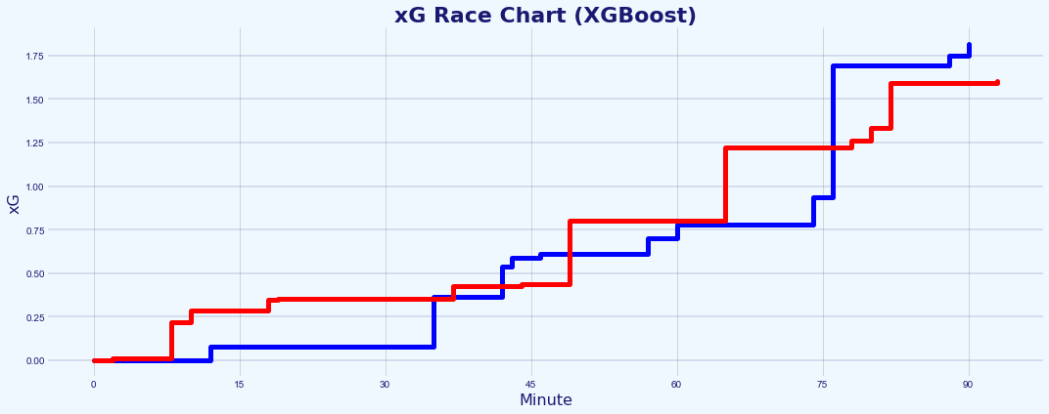
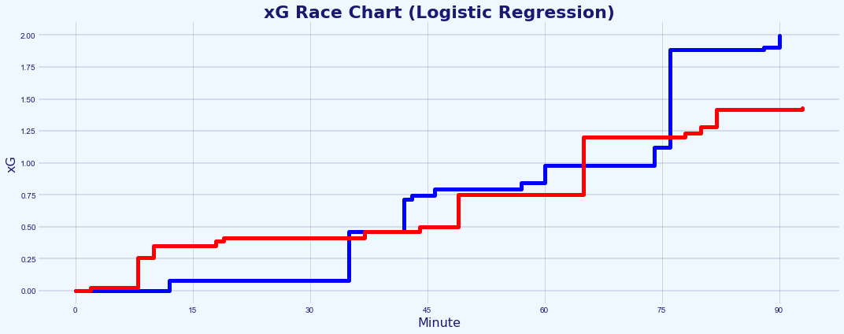
Comparison of Logistic Regression Model with XGBoost Model
Assessment of the chances in the match through the application of the Chance Quality Model
Due to time constraints and because model performance was not the absolute priority of this data challenge, the Chance Quality Model created as part of the initial submission was trained using only a Logistic Regression model.
In an attempt to improve the performance of the model and test for its robustness, a second model has been created that applies the Gradient Boosting Algorithm – XGBoost.
XGBoost stands for eXtreme Gradient Boosting and is a performant Machine Learning algorithm based on decision trees. XGBoost has a great track record of high performances on modeling structure data due to its performance, flexibility and speed, and is regularly the algorithm that wins Kaggle competitions.
More details about the performance of the model can be found in the appendix, but in summary, the current XGBoost model performs slightly better than the final submitted Logistic Regression model, as can be found in their respective Log Losses.
When visually comparing the xG race charts of the two models, the predicted outcome of the winning team based on Expected Goals varies, but in both cases, the Away team is expected to win. As per the Logistic Regression model, a value of 0.76 xG for the penalty to the Away team. However, the variances in the predictions raises questions about the robustness of both models, which I personally believe would both require further testing before being ready for production and/or publication of results. It is important however to bare in mind that these are simple models and may it’s just the case that there are limitations in how much they can be trusted.
Much more information about how this second model was trained using XGBoost can be found in the separate Gradient Boosted Chance Quality Model notebook [link].
A
Fig. A: xG race chart for Chance Quality Model created using XGBoost.
B
Fig. A: xG race chart for Chance Quality Model created using Logistic Regression.
Secondary model created using XGBoost in a separate notebook: https://github.com/eddwebster/mcfc_submission/blob/main/notebooks/chance_quality_modelling/2)%20Gradient%20Boosted%20Chance%20Quality%20Model%20from%20Shots%20Data.ipynb
Analysis of game 2 of the Metrica Sports sample data can be found in section 14 and 15 of the Chance Quality Model notebook: https://github.com/eddwebster/mcfc_submission/blob/main/notebooks/chance_quality_modelling/Creating%20a%20Chance%20Quality%20Model%20from%20Shots%20Data.ipynb

Slide 27
Next Steps and Conclusion

Slide 28
Next Steps to Improve the Chance Quality Models
Some of the steps I plan/wish to take in the near future
The focus of my approach to answer this data challenge was to not build the absolute best performing ML model, with the best performance metrics and fanciest algorithm. My objective was to conduct and end-to-end process for building a model, including all the key stages such as feature engineering, univariate and multivariate analysis, and iterated performance assessment and improvement – for this reason, a simple Chance Quality Model was built using Logistic Regression. However, Gradient Boosting algorithms lead to improved performance and for this reason, a second model was made after the initial submission, creating a Chance Quality Model using XGBoost. Potential further models that can be deployed to try and further improve the performance of the Chance Quality model include other Gradient Boosting algorithms, such as LightGBM, and CatBoost. More detail about these modeling approaches can be found in my the Data Science pack that I submitted as part of my initial application (see: https://docs.google.com/presentation/d/16stYbJoI8aYqtn_grJHSdTbMA1xwo-Iy9g9JJruMOBQ/edit?usp=sharing).
Application of a full Event data set, such as those from StatsBomb and Wyscout, to create an Expected Goals model with more features. Such features that were not possible to include in this model but that could be added with Event and/or Tracking data include: strong/weak foot, flag for counter attack, flag for smart pass, determine whether a shot had been immediately taken before, whether the shot was from a cross. This is discussed in more detail in the Feature Engineering section (section 9) of the Chance Quality Model notebook [link]. A comparison of the features used in the respected xG models by Sam Green and Michael Caley can be found in the index.
The interference of the shot-taker in the provided dataset of shots was not defined in the documentation. For the Metrica Sports data, I have used the same definition that StatsBomb uses in their for their interpretation of a pressured player, in which an opposing player enters the 5-yard-radius of the player with the ball. However, I do not know how this stacks up to what a pressured player is in the Shots dataset and this will almost certainly be affecting the calibration of this feature in the dataset.
To see really test the performance of this model, it would be great to quality test performance and xG prediction with those of other providers such as StatsBomb and observe the level of variance in predictions between this basic model and a professional one created using a much larger dataset with much more features.
The model created only considers Open-Play shots. As per Michael Caley’s model, it would be interesting to create Expected Goals models that also include Direct Free Kicks and Corners. In Caley’s model, he creates six models for different match situations to reflect the varying difficult of shots in certain scenarios, these include: regular shots, shots from a direct free kick, headed shots from a cross, headed shots not from a cross, non-headed shots from a cross, shots following a dribble from the keeper thus the goalkeeper is not in goal when the shot is taken. Currently the xG value for penalties was taken from StatsBomb/FBref [link].
Consider including more football knowledge in the model by adding fake shots to the dataset. As David Sumpter explains in the following tweet [link], adding fake data can improve the performance of the model and the limitations of Event data for two reasons – 1) it allows you to include things you know that are impossible (put players never do because its impossible) and 2) you can push the non-linear terms to really understand how the probability of success is shaped. For example, this could be done by adding in data which says it is impossible to score from the goal line or from more than 45m.
Caley (2015) creates separate models for different match situations to reflect the varying difficulty of taking shots. This allows the significant features in each model to be studied. Caley creates six models for:
regular shots
shots from a direct free kick
headed shots from a cross
headed shots not from a cross
non-headed shots from a cross
shots following a dribble from the keeper thus the goalkeeper is not in goal when the shot is taken
Michael Caley’s xG model: https://cartilagefreecaptain.sbnation.com/2014/9/11/6131661/premier-league-projections-2014#methoderology
All code for this challenge: https://github.com/eddwebster/mcfc_submission/tree/master/notebooks/.
Notebook to create the Chance Quality Model from the shots data: https://github.com/eddwebster/mcfc_submission/blob/main/notebooks/chance_quality_modelling/Creating%20a%20Chance%20Quality%20Model%20from%20Shots%20Data.ipynb

Slide 29
Next Steps to Improve the Tracking Data Analysis
Some of the steps I plan/wish to take in the near future
This current analysis only focuses on the shots taken by the teams. The next stage of this analysis would be to apply this Tracking data, not to just a Shots dataset, but to a full Events dataset, taking the basic concepts of analysis and feature extraction observed in this submission and then start to apply more sophisticated modeling approaches such as Pitch Control or Expected Possession Value (EPV) models such as the VAEP model by SciSports and KULeuven, or the Expected Threat (xT) model by Karun Singh. This can be taken on further, by combining these two modelling approaches to analyse value that certain actions of interest brought to the team during a particular play in the match and determine the Expected Value-Added. This was unfortunately not possible to do in this analysis as the Event data provided only included Shot data, but it would be something I would like to take on and do in the future, using publicly available Event data from StatsBomb and Wyscout, with the sample Tracking data from Metrica Sports. More detail about these models can be found in my the Data Science pack that I submitted in my initial application (see: https://docs.google.com/presentation/d/16stYbJoI8aYqtn_grJHSdTbMA1xwo-Iy9g9JJruMOBQ/edit?usp=sharing).
Further enrich the Event data through Tracking data, adding further detail and specificity, which again can be used to further improve the Expected Goals model. This was observed in this analysis with addition of the Intervening and Interfering teammates and opponents. Features that were not considered in this analysis, include aspects such as the goalkeeper and defender positions in the moment of the shot e.g.: how much of the goal was covered by the goalkeeper? are the defenders in position? These are attributes that can be derived from the Tracking data to gain additional insight previously not possible.
All code for this challenge: https://github.com/eddwebster/mcfc_submission/tree/master/notebooks/.
Notebook to work with the Metrica Sports Event and Tracking data: https://nbviewer.jupyter.org/github/eddwebster/mcfc_submission/blob/main/notebooks/metrica-sports/Metrica%20Sports.ipynb
Sample Tracking data provided by Metrica Sports: https://github.com/metrica-sports/sample-data

Slide 30
Conclusion
Summary of this data challenge submission
1
Defined, built, trained, and evaluated two Chance Quality Models from Shots data through the application of both Logistic Regression and XGBoost, where Expected Goals was the KPI used to interpret model predictions and assess shot quality.
Determined the shots from game 2 of the sample Metrica Sports Tracking and Event data, and made these available for predictions using the Chance Quality Models in an appropriate format, deriving additional features from the Tracking data to further enrich the provided Event data, to be used in the Chance Quality Model predictions.
Assessed the performance of the two teams in game 2 of the sample Metrica Sports data through application of the Chance Quality Model (derived in step 1) and exported Metrica Sports shot data (derived in step 2), to determine that based on chances created and the Expected Goals predicted, the Away team was more deserving of being the winner of the match, despite losing the game three goals to two to the Home team. However, as this is over just a 90 minute period, this analysis should be treated with caution.
2
3

Slide 31


For More Information
If you would like to find out more…
GitHub:
General: github.com/eddwebster
Manchester City Junior Data Scientist submission: github.com/eddwebster/mcfc_submission
Chance Quality Model notebook (Logistic Regression):
Chance Quality Model notebook (XGBoost):
Football analytics: github.com/eddwebster/football_analytics
Google Drive of all code, data, visualisations, and analysis in this pack: https://drive.google.com/drive/folders/1Ts_5YOL8JpVpRcaEhqmcTCceLmcBRY3L?usp=sharing
Slide decks:
Junior Data Science Challenge pack (this one): https://docs.google.com/presentation/d/116D0U_ue2sv6hgLBgHniI228cRhph0qfMuOFA4uuxhs/edit?usp=sharing
Data Science pack (as part of the initial submission for Junior Data Scientist position): https://docs.google.com/presentation/d/16stYbJoI8aYqtn_grJHSdTbMA1xwo-Iy9g9JJruMOBQ/edit?usp=sharing
Football Intelligence pack (previously submitted for Football Intelligence Analyst position, focussing on Tableau): https://docs.google.com/presentation/d/1uT6vT1J_FS10hW3hvWQx9ofqHUq8mT-kUbDRMrrUqH8/edit?usp=sharing
Tableau Public profile: public.tableau.com/profile/edd.webster.
Website: eddwebster.com
LinkedIn: linkedin.com/in/eddwebster
Twitter: @eddwebster
Email: edward.webster@cityfootball.com and edd.j.webster@gmail.com

Slide 32

Further Work

Slide 33
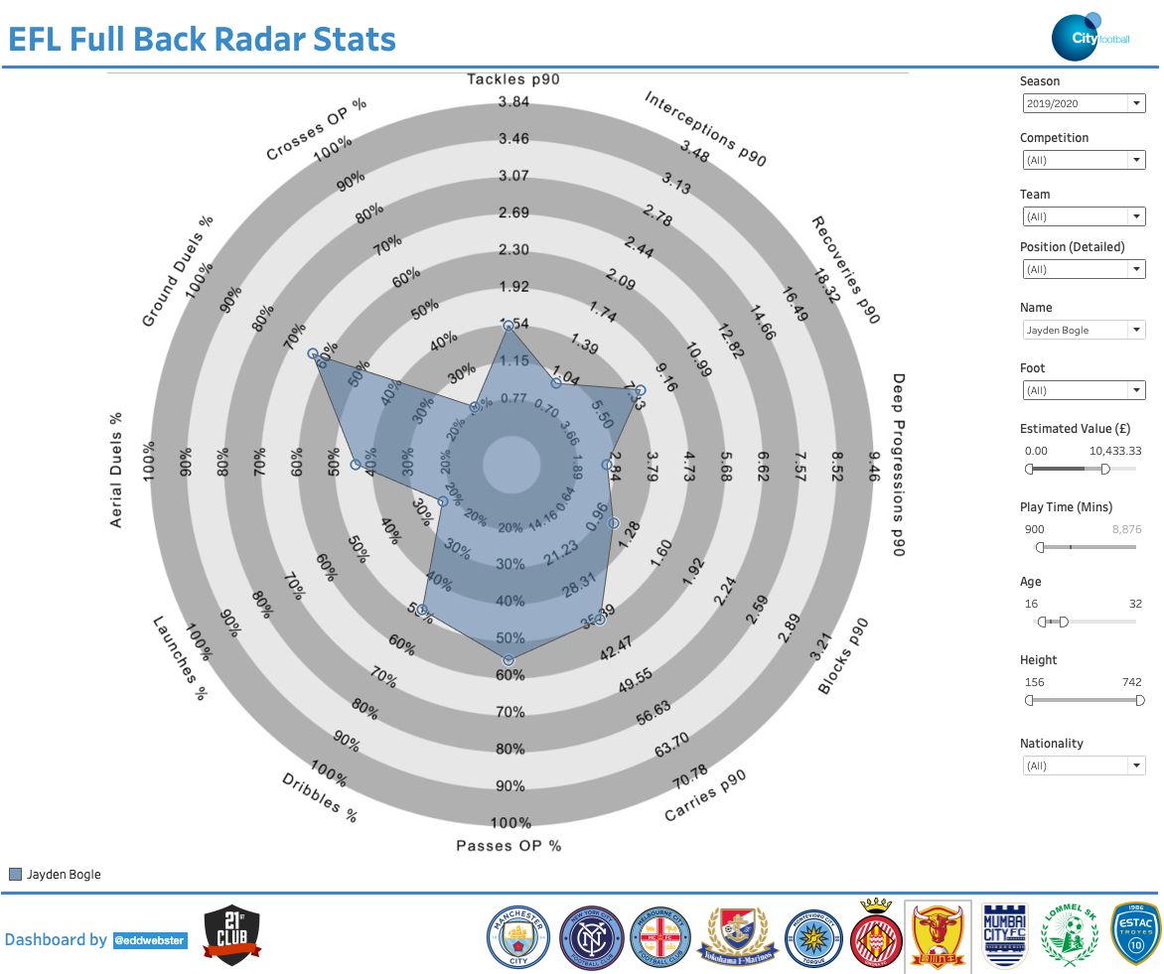
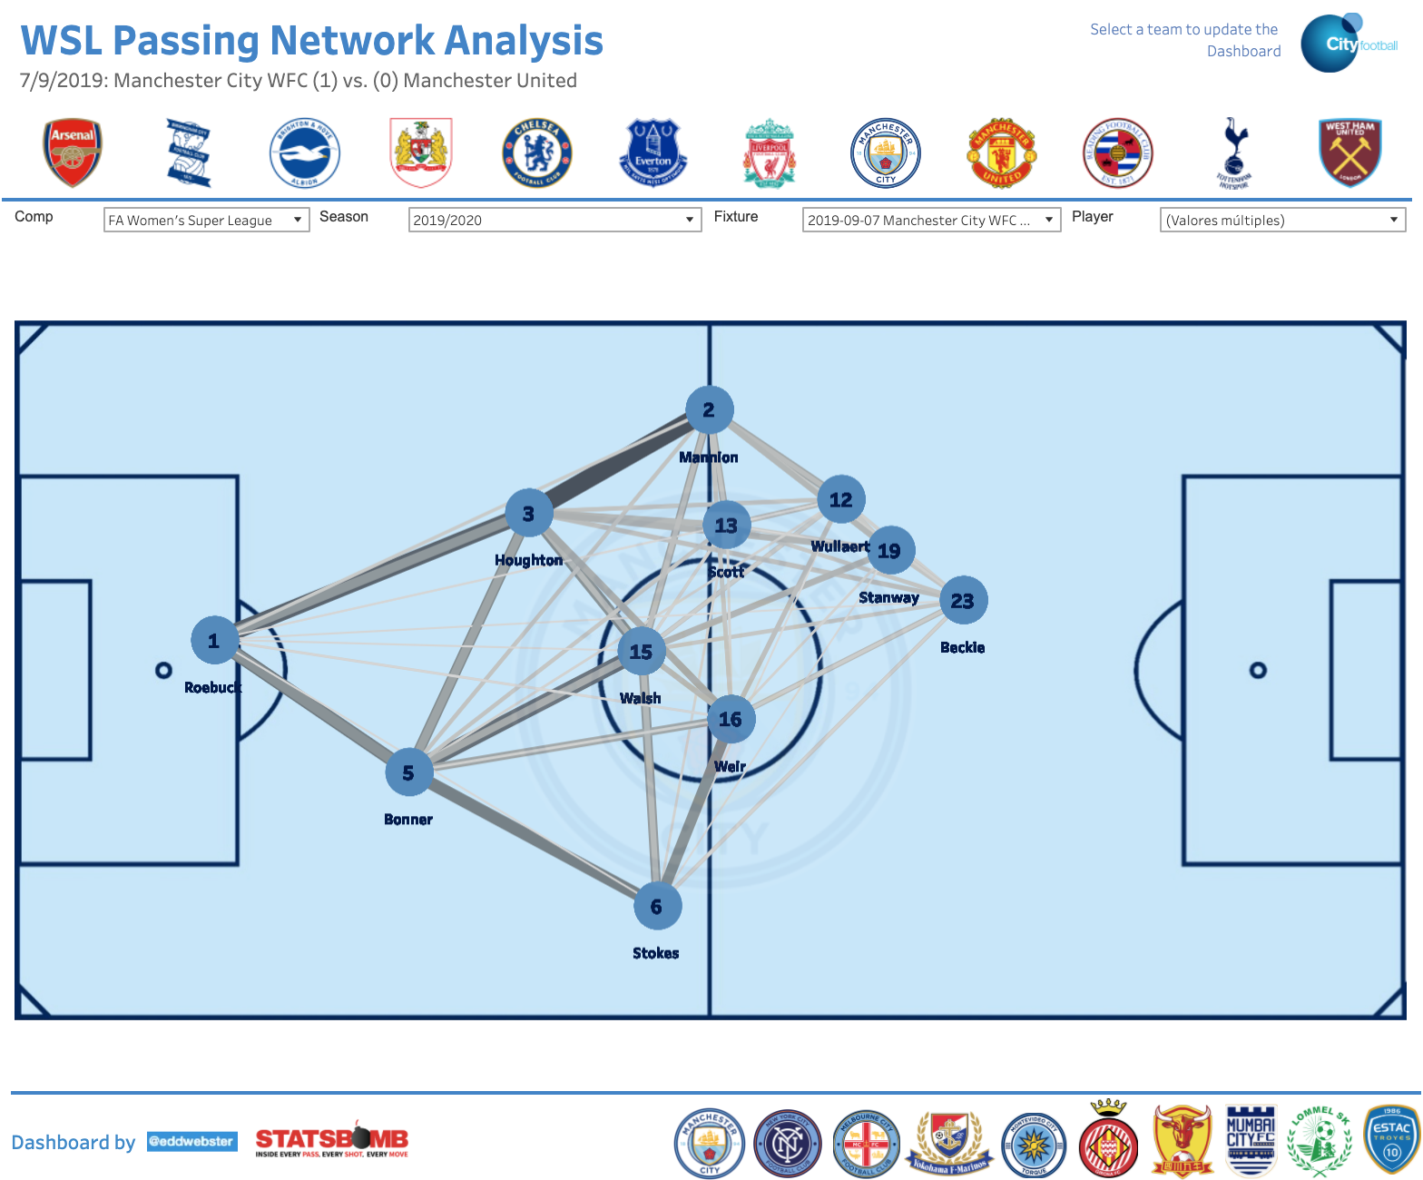
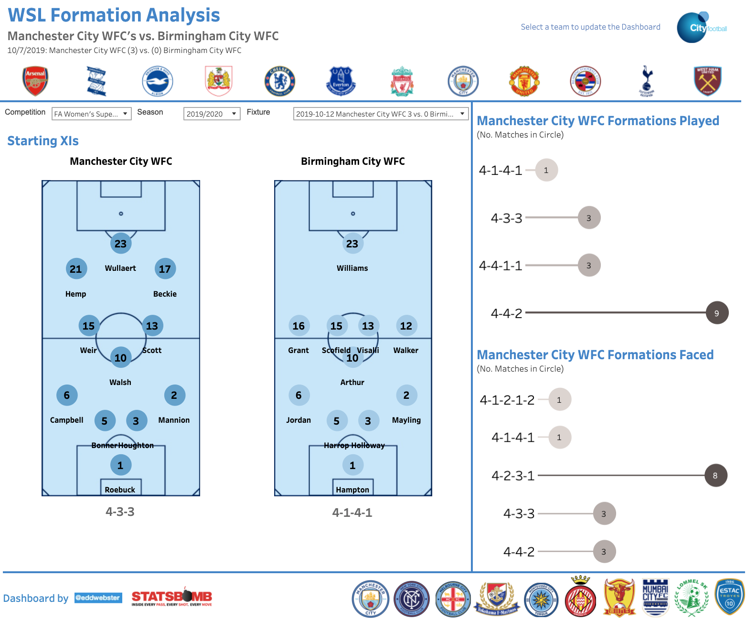
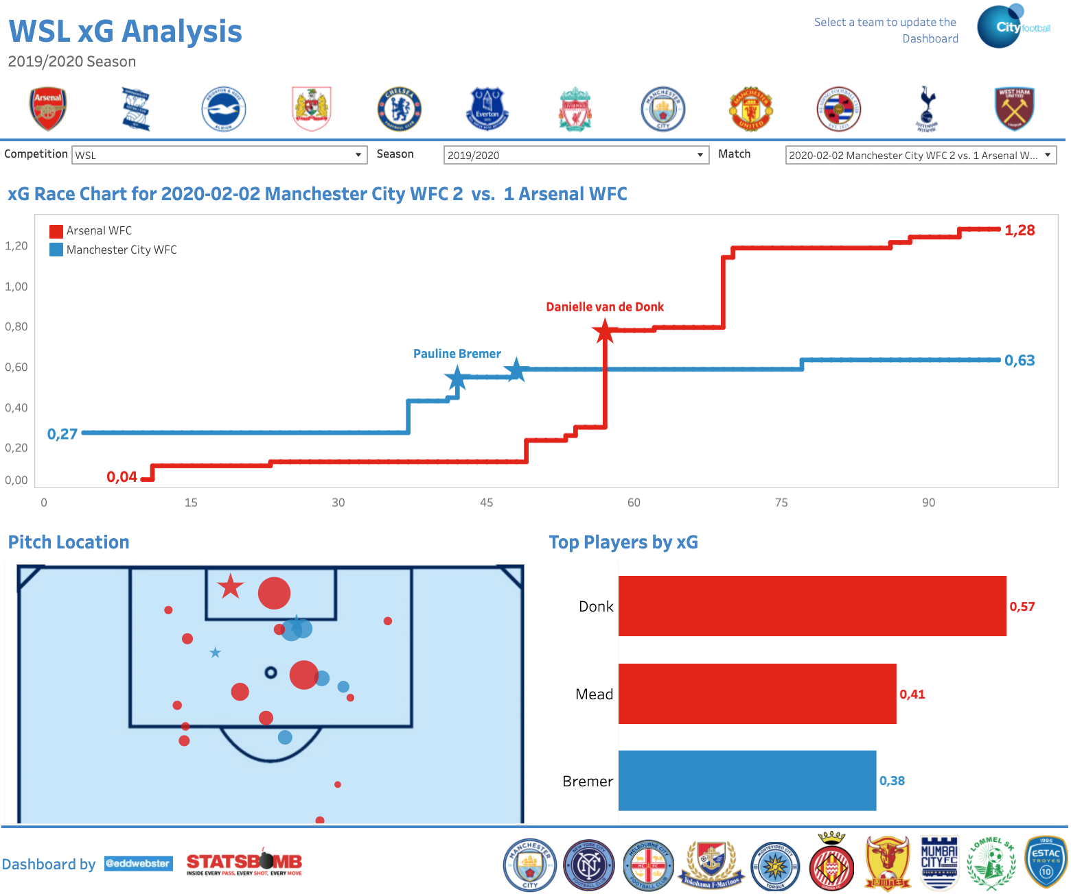
Additional Projects Regarding Football Analysis 1/3
Democratisation of data using Tableau to build tools for football practitioners at all levels of the club
Dashboards available @ public.tableau.com/profile/edd.webster.
WSL dashboards and analysis [link] ;
‘Big 5’ European leagues dashboards and analysis [link];
EFL dashboards and analysis [link];
StrataBet European Leagues Chance analysis [link]; and
Opta #mcfcanalytics dashboards and analysis [link].
Notable examples of reporting tools include:
Position-specific Radar dashboards to visualise a large number of player statistics at one time (Fig. A);
Passing Network analysis to observe the ball exchange between players (Fig. B);
Formation analysis based on most historically used formations and average position of players (Fig. C); and
Individual match xG visualisations to see the chances created and most impactful players through an xG race chart and on-pitch shooting positions (Fig. D).
To see the full portfolio of data reporting tools, please see the following link for a full PowerPoint presentation in which each tool and the build process is explained in detail: https://docs.google.com/presentation/d/1uT6vT1J_FS10hW3hvWQx9ofqHUq8mT-kUbDRMrrUqH8/edit?usp=sharing.
For the notebooks that scrape, parse, engineer and unify the datasets used in these visualisations, see: github.com/eddwebster/football_analytics/tree/master/notebooks.
A
B
C
D

Slide 34
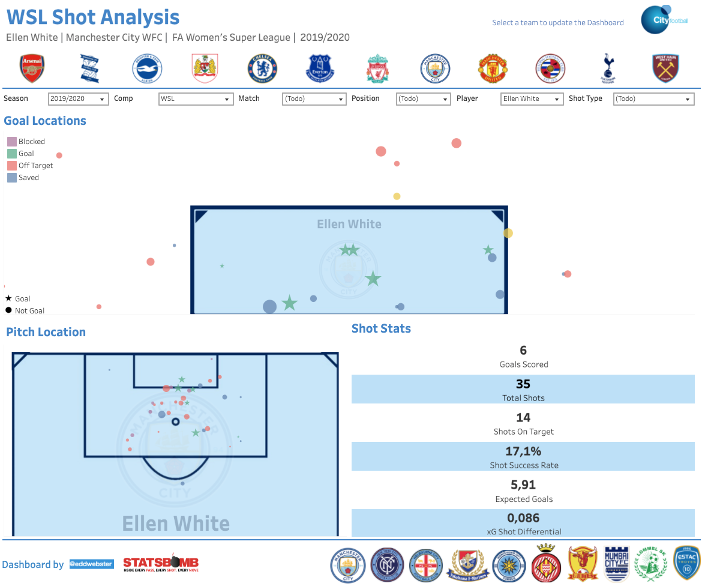
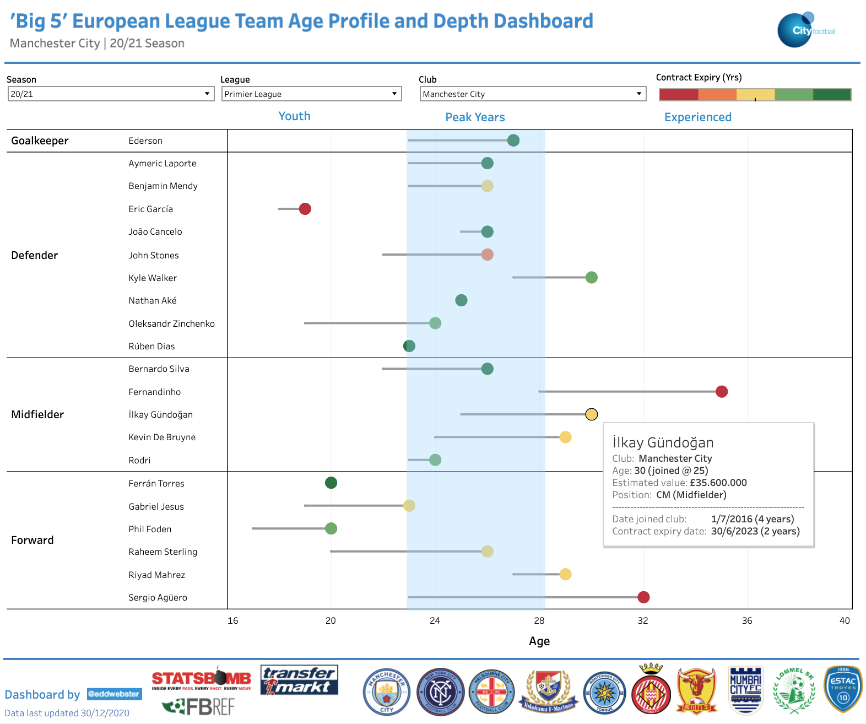
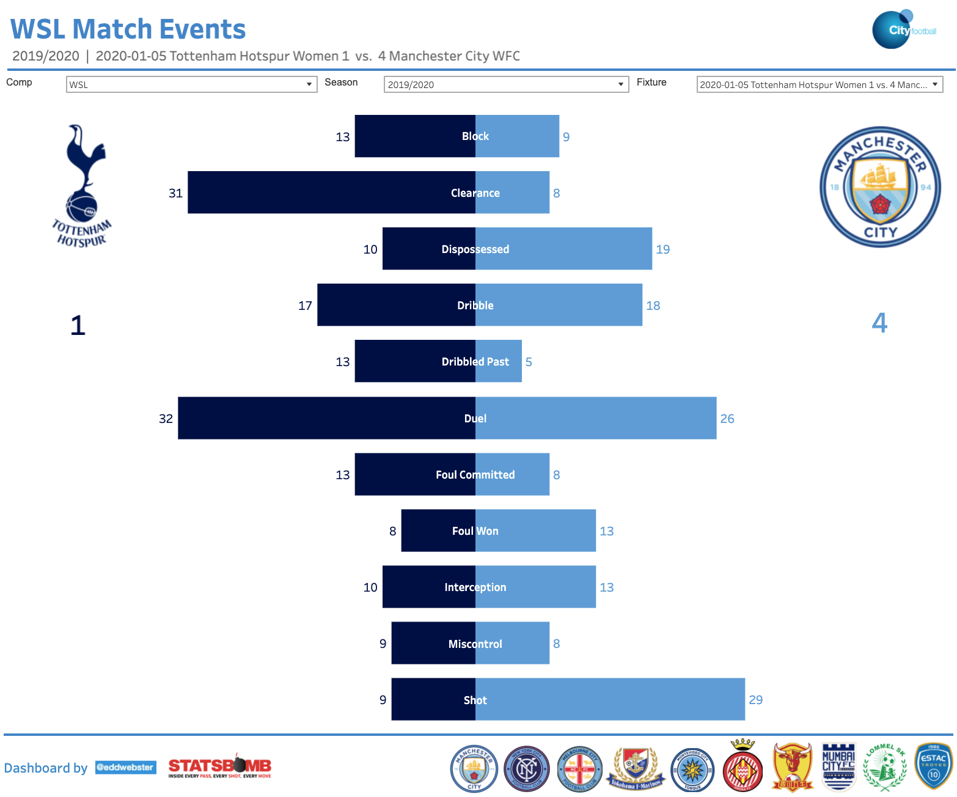
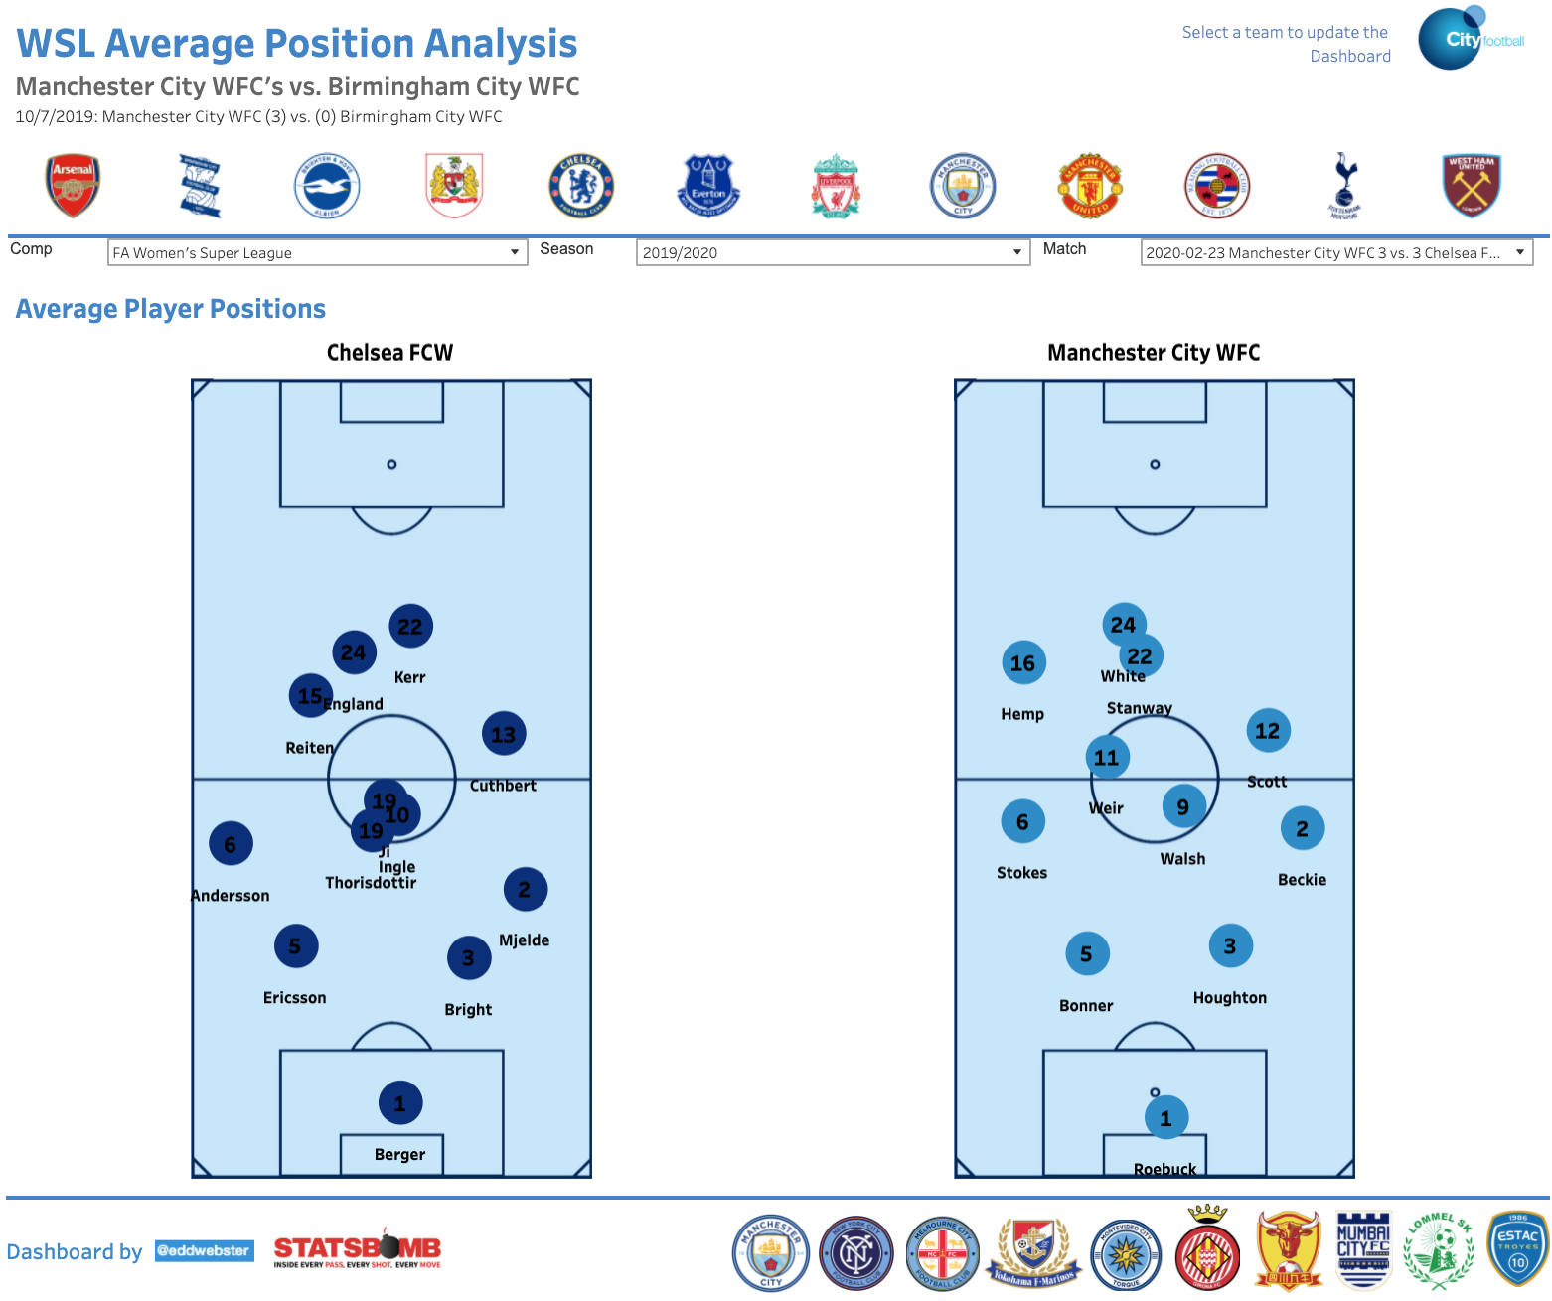
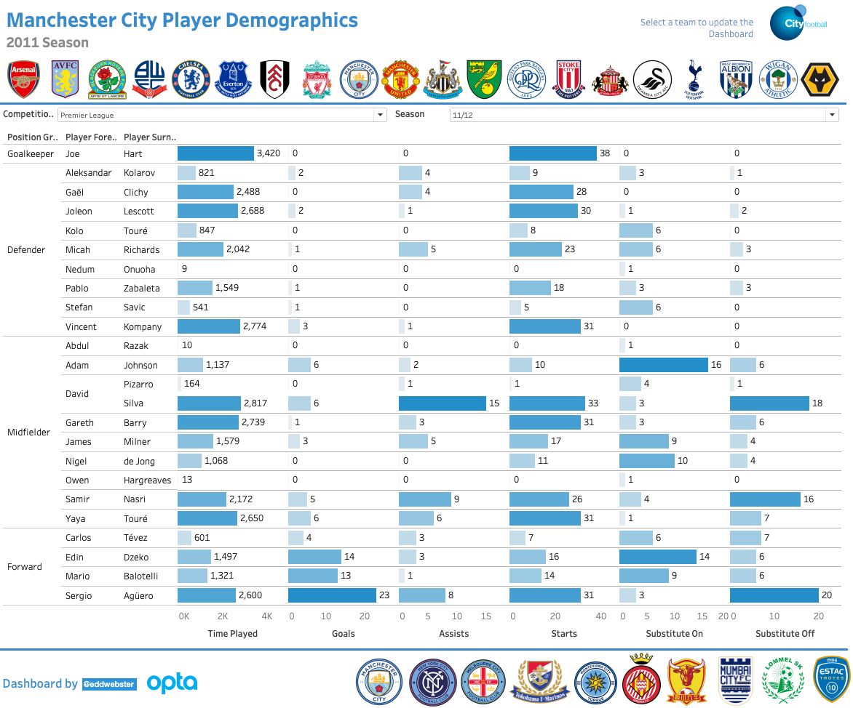
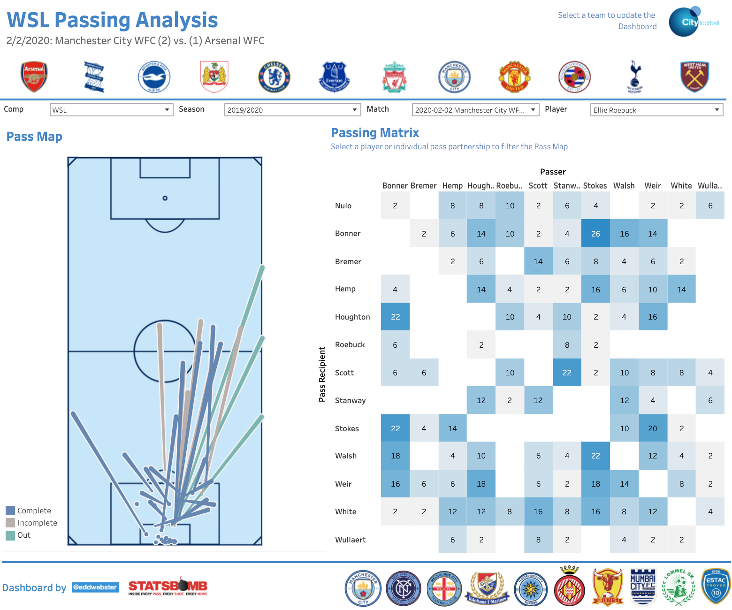
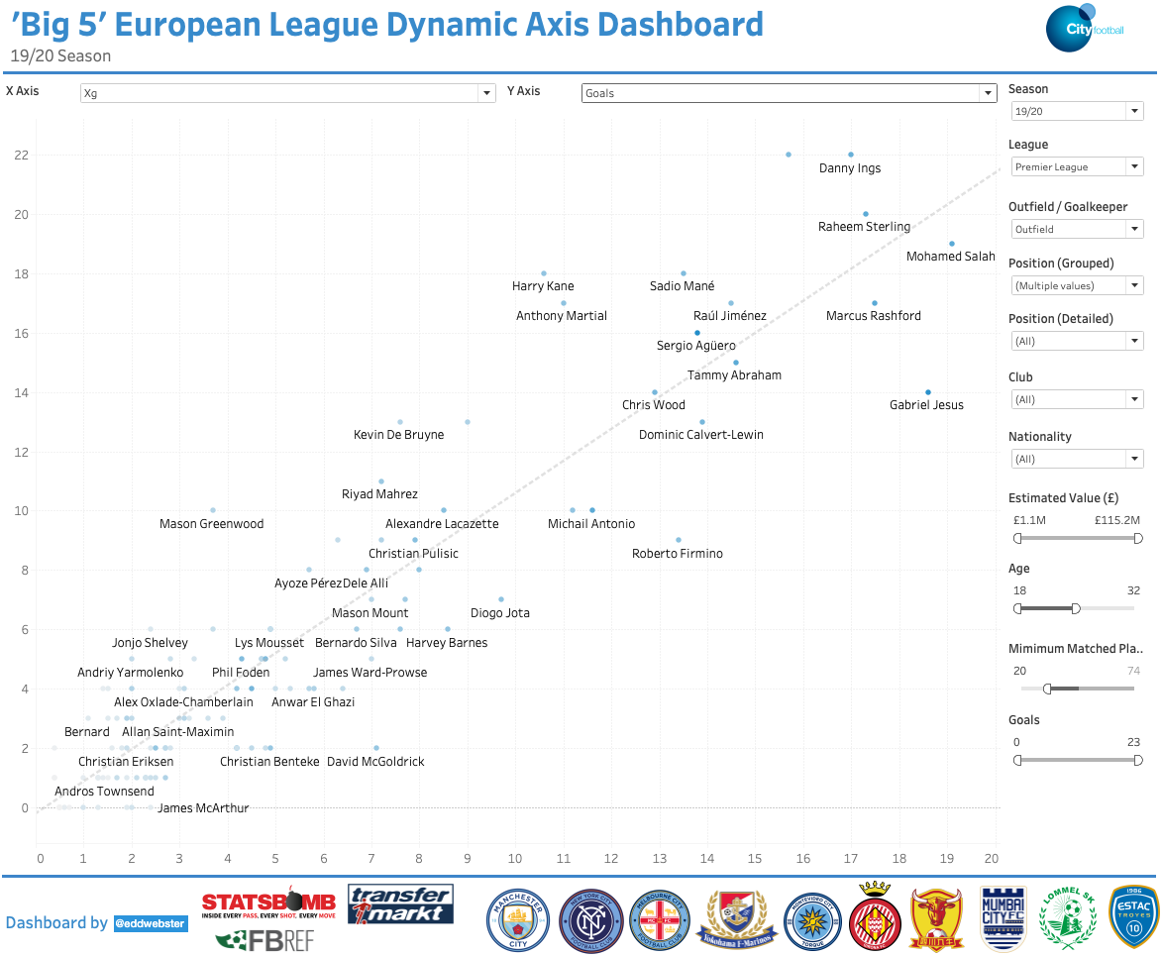
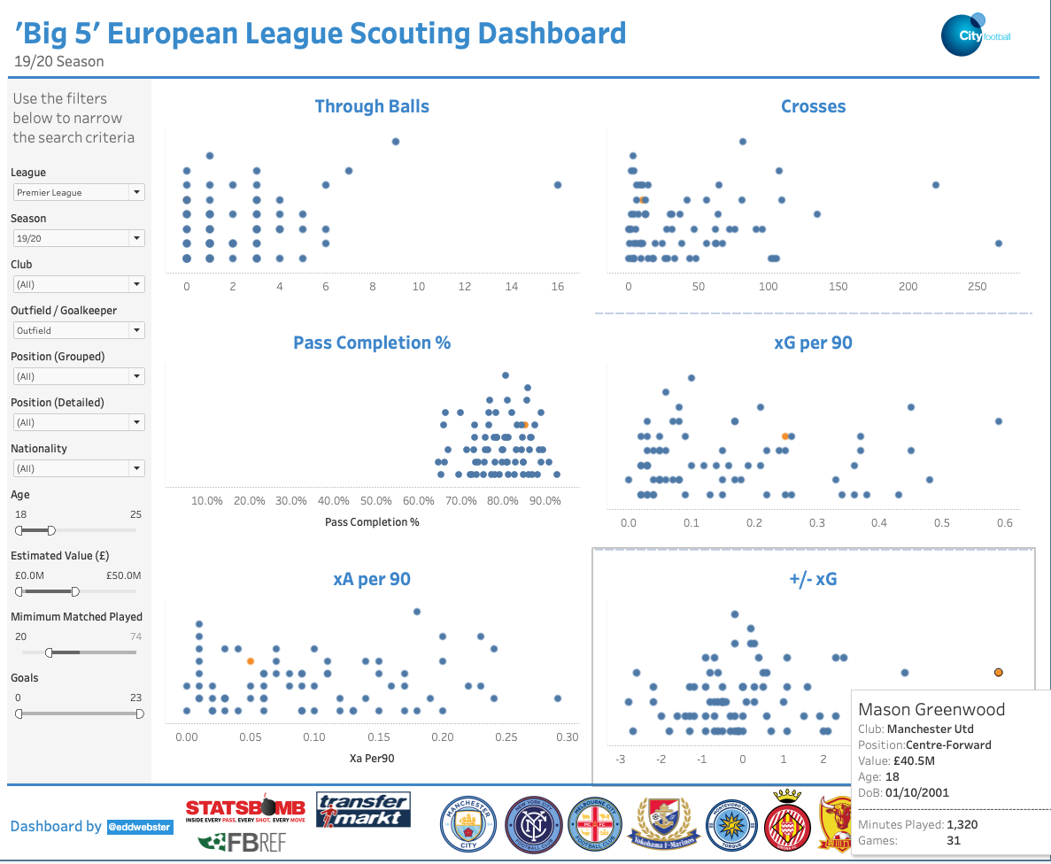
Additional Projects Regarding Football Analysis 2/3
More Tableau reporting tools

Slide 35
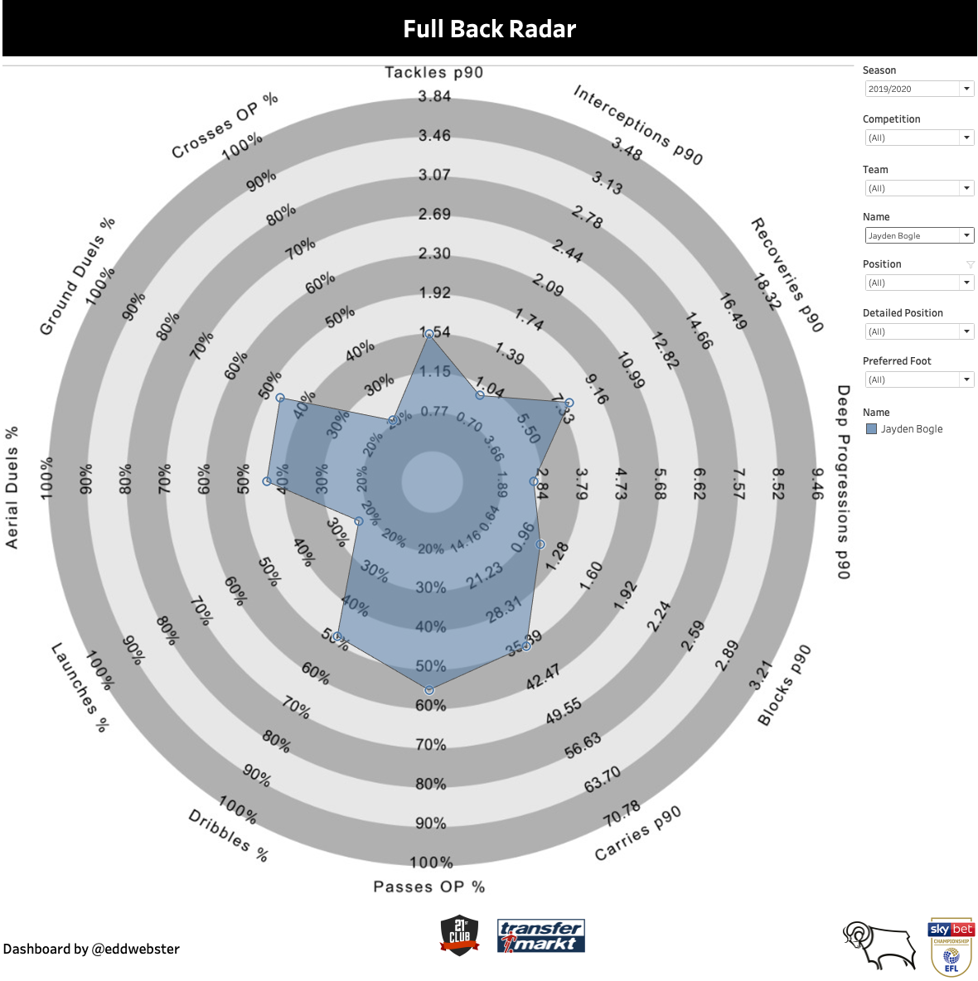
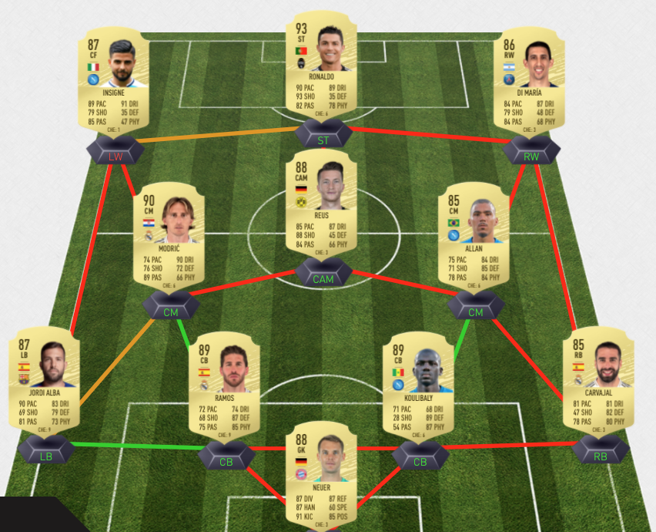
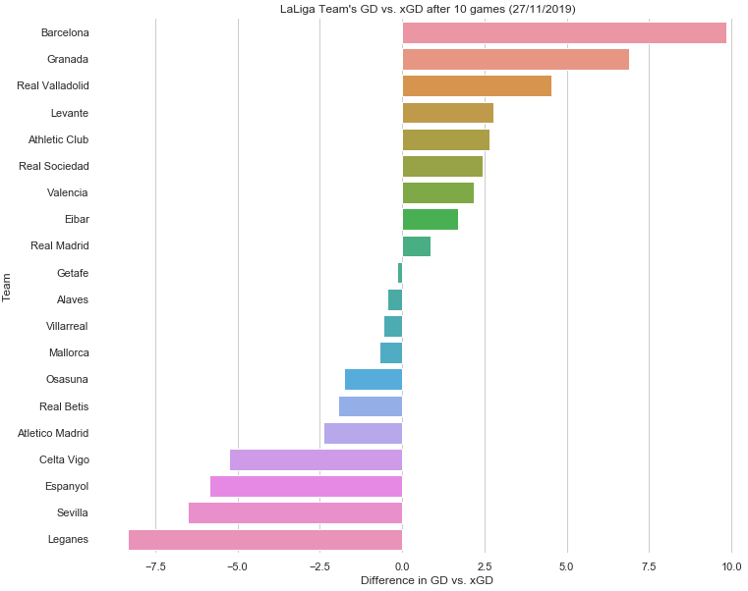
Additional Projects Regarding Football Analysis 3/3
Links to additional projects that demonstrate a broad range of tools, skills and analysis when working with football data
Derby County recruitment analysis
This project uses a data-driven approach to provide a number of specified recommendations for replacements of Derby County’s right-back Jayden Bogle and right-winger Tom Lawrence. This project uses aggregated player performance data provided by 21st Club matched against estimated player valuation data scraped from TransferMarkt
Slides: https://docs.google.com/presentation/d/1qLdXpcO7tYPIojHmDXny3hFAPw1h7q2-FbNCZuq46ls/edit?usp=sharing
Tableau: https://public.tableau.com/views/EddWebsterDerbyCountyDataAnalysis/RBDemographicsDashboard?:language=es&:display_count=y&:origin=viz_share_link
Main notebook (several can be found in the GitHub repo): https://github.com/eddwebster/derby_county_data_task/blob/master/notebooks/B)%20Data%20Engineering/Data%20Engineering%20of%2021st%20Club%20and%20TransferMarkt%20Datasets.ipynb
GitHub: https://github.com/eddwebster/derby_county_data_task/
FIFA-TransferMarkt fantasy football league
This project scrapes data for 40+ leagues on TransferMarkt using Beautifulsoup and matches it to the 18,000 players in the FIFA 20 database, using the record linkage library, as part of a data-driven approach of £/attribute metrics for a hypothetical recruitment scenario. This data is then exported to Excel as part of a playable fantasy football league.
Notebook: https://nbviewer.jupyter.org/github/eddwebster/fifa-league/blob/master/FIFA%2020%20Fantasy%20Football%20League%20using%20TransferMarkt%20Player%20Valuations.ipynb
Functioning Microsoft Excel league spreadsheet for player draft and match result data entry: https://github.com/eddwebster/fifa-league/blob/master/excel/fifa_20_fantasy_football_league.xlsm
GitHub: https://github.com/eddwebster/fifa-league
Granada 19/20 xG analysis
Exploratory Data Analysis (EDA) of scraped xG data from the first ten games of the 19/20 season of La Liga, analysing Granada’s overachieving performance after promotion to Spain’s top flight.
Notebook: https://nbviewer.jupyter.org/github/eddwebster/granada1920/blob/master/Granada%202019-20%20Web%20Scraping%20and%20pandas%20-%2012012020.ipynb
GitHub: https://github.com/eddwebster/granada1920

Slide 36
References

Slide 37
References and Further Reading 1/3
Tracking data
Data Sources:
Metrica Sports Tracking and correspond Event data: github.com/metrica-sports/sample-data
Vender Documentation
Metrica Sports documentation: github.com/metrica-sports/sample-data/blob/master/documentation/events-definitions.pdf
Tutorials
Friends of Tracking Tracking data tutorials by Laurie Shaw:
Part 1 – Introduction to analysing tracking data in Python: https://www.youtube.com/watch?v=8TrleFklEsE
Part 2 - Measuring the physical performance of players: https://www.youtube.com/watch?v=VX3T-4lB2o0
Part 3 – Advanced metrics: Pitch Control: https://www.youtube.com/watch?v=5X1cSehLg6s
Part 4 – Evaluating player actions and passing options: https://www.youtube.com/watch?v=KXSLKwADXKI
GitHub Repositories
LaurieOnTracking by Laurie Shaw for Tracking data implementation
Seminars and Videos
How Tracking Data is Used in Football and What are the Future Challenges with Javier Fernández, Sudarshan 'Suds' Gopaladesikan, Laurie Shaw, Will Spearman and David Sumpter for Friends of Tracking: https://www.youtube.com/watch?v=kHTq9cwdkGA
‘Demystifying Tracking Data’ by Sam Gregory (Inter Miami) and Devin Pleuler (Toronto FC): https://www.youtube.com/watch?v=miEWHSTYvX4
‘Classifying and Analysing Team Strategy in Professional Soccer Matches’ by Laurie Shaw (City Football Group) at the 2019 Sports Analytics Lab at Harvard University/American Statistical Association Section on Statistics in Sports on 3rd October 2019: https://www.youtube.com/watch?v=VU4BOu6VfbU. Paper: https://static.capabiliaserver.com/frontend/clients/barca/wp_prod/wp-content/uploads/2020/01/56ce723e-barca-conference-paper-laurie-shaw.pdf. Blog: https://eightyfivepoints.blogspot.com/2019/11/using-data-to-analyse-team-formations.html.
‘Routine Inspection: Measuring Playbooks for Corner Kicks’ by Laurie Shaw at the 2020 Sports Analytics Lab at Harvard University/American Statistical Association Section on Statistics in Sports on 23rd October 2020: https://www.youtube.com/watch?v=yfPC1O_g-I8. Paper: https://www.springerprofessional.de/en/routine-inspection-a-playbook-for-corner-kicks/18671052.
Masterclass in Pitch Control by Will Spearman for Friends of Tracking: https://www.youtube.com/watch?v=X9PrwPyolyU.
‘A framework for tactical analysis and individual offensive production assessment in soccer using Markov chains’ by Sarah Rudd (Arsenal FC) at the 2011 Sports Analytics Lab at Harvard University/American Statistical Association Section on Statistics in Sports on 3rd October 2019 [link].

Slide 38
References and Further Reading 2/3
Chance Quality/Expected Goals modeling
Seminars and videos
The Ultimate Guide to Expected Goals by David Sumpter (@Soccermatics) (Hammarby) for Friends of Tracking: https://www.youtube.com/watch?v=310_eW0hUqQ
How to explain Expected Goals to a football player by David Sumpter (@Soccermatics): https://www.youtube.com/watch?v=Xc6IG9-Dt18
What is xG? by Alex Stewart for Tifo Football: https://www.youtube.com/watch?v=zSaeaFcm1SY
Opta Expected Goals presented by Duncan Alexander (@oilysailor): https://www.youtube.com/watch?v=w7zPZsLGK18
Sam Green OptaPro Interview: https://www.youtube.com/watch?v=gHIY-MgDh_o
Anatomy of a Goal (with Sam Green) for Numberphile: https://www.youtube.com/watch?v=YJuHC7xXsGA
Tutorials
Friends of Tracking Expected Goals tutorials by David Sumpter (@Soccermatics):
Part 1 – How to build an Expected Goals model 1 – Data and model: https://www.youtube.com/watch?v=bpjLyFyLlXs. See GitHub: xG model: github.com/Friends-of-Tracking-Data-FoTD/SoccermaticsForPython/blob/master/3xGModel.py
Part 2 – How to build an Expected Goals model 2 – Statistical fitting: https://www.youtube.com/watch?v=wHOgINJ5g54. See GitHub: Linear regression: github.com/Friends-of-Tracking-Data-FoTD/SoccermaticsForPython/blob/master/4LinearRegression.py, xG model fit: github.com/Friends-of-Tracking-Data-FoTD/SoccermaticsForPython/blob/master/5xGModelFit.py
Notable xG models
Sam Green: https://www.optasportspro.com/news-analysis/assessing-the-performance-of- premier-league-goalscorers/
Michael Caley: https://cartilagefreecaptain.sbnation.com/2014/9/11/6131661/premier-league-projections-2014#methoderology
Professional and Fanalyst examples:
An xG Model for Everyone in 20 minutes (ish) by Paul Riley (@footballfactman): https://differentgame.wordpress.com/2017/04/29/an-xg-model-for-everyone-in-20-minutes-ish/
Tech how-to: build your own Expected Goals model by Jan Van Haaren and SciSports: https://www.scisports.com/tech-how-to-build-your-own-expected-goals-model/. For code, see: https://bitbucket.org/scisports/ssda-how-to-expected-goals/src/master/
soccer_analytics repository by Kraus Clemens (@CleRraus): github.com/CleKraus/soccer_analytics/
Expected goal model using Logistic Regression: github.com/CleKraus/soccer_analytics/blob/master/notebooks/expected_goal_model_lr.ipynb
Challenges using Gradient Boosters: github.com/CleKraus/soccer_analytics/blob/master/notebooks/challenges_with_gradient_boosters.ipynb
Expected Goals thesis by Andrew Rowlinson (@numberstorm): github.com/andrewRowlinson/expected-goals-thesis
Expected Goals deep dive by Andrew Puopolo: github.com/andrewsimplebet/expected_goals_deep_dive
Fitting your own football xG model by Ismael Gomez: https://www.datofutbol.cl/xg-model/
Python for Fantasy Football by Fantasy Futopia (Thomas Whelan): http://www.fantasyfutopia.com/python-for-fantasy-football-introduction-to-machine-learning/
Articles:
xG explained by FBref: https://fbref.com/en/expected-goals-model-explained/
Bodies on the Line: Quantifying how defenders affect chances by Laurie Shaw: http://eightyfivepoints.blogspot.com/2017/09/bodies-on-line-quantifying-how.html.
Should you write about real goals or expected goals? A guide for journalists by David Sumpter: https://soccermatics.medium.com/should-you-write-about-real-goals-or-expected-goals-a-guide-for-journalists-2cf0c7ec6bb6
How data availability affects the ability to learn good xG models by Jesse Davis and Pieter Robberechts: https://dtai.cs.kuleuven.be/sports/blog/how-data-availability-affects-the-ability-to-learn-good-xg-models
Expected Goals and Unexpected Goals by Garry Gelade: https://web.archive.org/web/20200724125157/http://business-analytic.co.uk/blog/expected-goals-and-unexpected-goals/
Assessing Expected Goals Models. Part 1: Shots by Garry Gelade: https://web.archive.org/web/20200724125157/http://business-analytic.co.uk/blog/evaluating-expected-goals-models/
Assessing Expected Goals Models. Part 2: Anatomy of a Big Chance by Garry Gelade: https://web.archive.org/web/20200724125157/http://business-analytic.co.uk/blog/assessing-expected-goals-models-part-2-anatomy-of-a-big-chance/
Literature:
Expected Goals literature: https://docs.google.com/document/d/1OY0dxqXIBgncj0UDgb97zOtczC-b6JUknPFWgD77ng4/edit

Slide 39
References and Further Reading 3/3
Miscellaneous
Data visualisation
How to Draw a Football Pitch by Peter McKeever: http://petermckeever.com/2020/10/how-to-draw-a-football-pitch/
Match Timelines by Ben Mayhew: https://experimental361.com/explanations/match-timelines/
How To Create xG flow charts in Python by McKay Johns: https://www.youtube.com/watch?v=bvoOOYMQkac
Dimension of a standard football pitch: https://en.wikipedia.org/wiki/Football_pitch
Official documentation
scikit-learn documentation for Logistic Regression: https://scikit-learn.org/stable/modules/generated/sklearn.linear_model.LogisticRegression.html
scikit-learn documentation for Decision Trees: https://scikit-learn.org/stable/modules/generated/sklearn.tree.DecisionTreeClassifier.html
scikit-learn documentation for Random Forests: https://scikit-learn.org/stable/modules/generated/sklearn.ensemble.RandomForestClassifier.html?highlight=random%20forest#sklearn.ensemble.RandomForestClassifier
Libraries:
mplsoccer by Andrew Rowlinson: https://github.com/andrewRowlinson/mplsoccer
SoccermaticsForPython by David Sumpter: https://github.com/Friends-of-Tracking-Data-FoTD/SoccermaticsForPython
LaurieOnTracking by Laurie Shaw: https://github.com/Friends-of-Tracking-Data-FoTD/LaurieOnTracking
Books:
The Numbers Game by Chris Anderson and David Sally
Soccermatics by David Sumpter
Vender Documentation
Metrica Sports documentation: github.com/metrica-sports/sample-data/blob/master/documentation/events-definitions.pdf
Key Python libraries used:
pandas
Matplotlib
scikit-learn
Resources:
Concise list of publicly available Football Analytics resources by Edd Webster: github.com/eddwebster/football_analytics
YouTube playlists by Edd Webster:
Sports Analytics / Data Science: https://www.youtube.com/playlist?list=PL38nJNjpNpH9OSeTgnnVeKkzHsQUJDb70
xG: https://www.youtube.com/playlist?list=PL38nJNjpNpH_VPRZJrkaPZOJfyuIaZHUY
Tracking data: https://www.youtube.com/playlist?list=PL38nJNjpNpH-UX0YVNu7oN5gAWQc2hq8F

Slide 40
Appendix

Slide 41
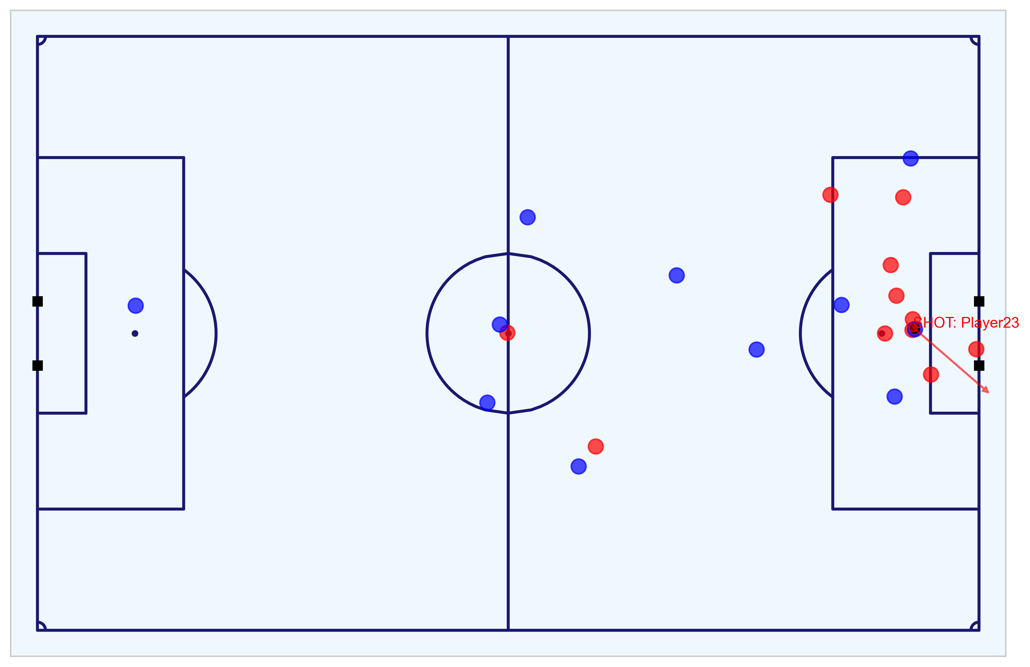
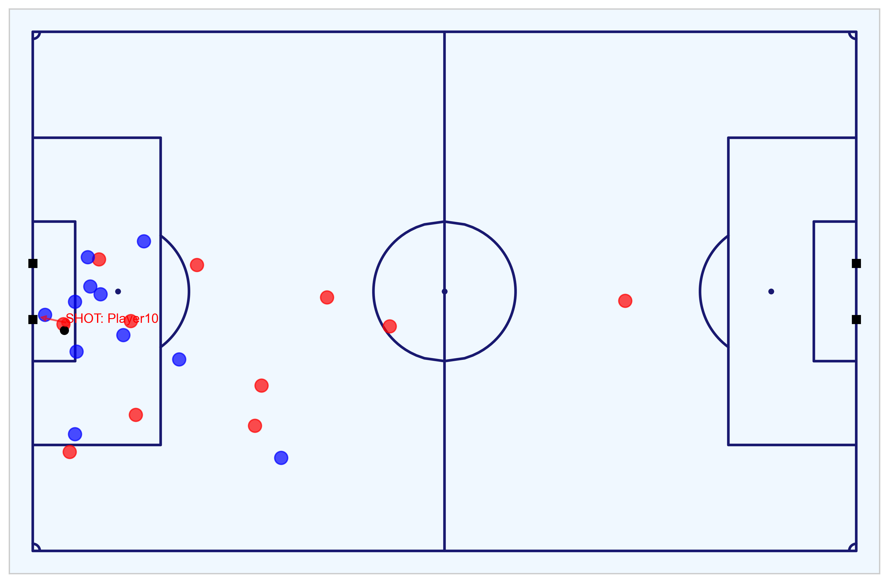
Key Chances Analysis 1/8 – Highest Quality Chances and All Goals Scored
Isolating the seven shots that make up the the five shots with the highest probability and the two goals outside that
As per the submitted, Logistic Regression model, the five best chances in the game in terms of xG are the following:
Shot 18 - penalty to the Away team with xG of 0.760 (goal)
Shot 16 - shot by the Home team with xG of 0.450 (saved)
Shot 7 - shot by the Away team with xG of 0.379 (goal)
Shot 9 – headed shot by the Away team with xG of 0.232 (missed)
Shot 13 – headed shot by the Home team with xG of 0.251 (goal)
Two of the goals scored were not in the top five chances in terms of xG:
Shot 2 - shot by the Home team with xG of 0.235 – ranked 6th for xG
Shot 20 - shot by the Home team with xG of 0.054 – ranked 13th for xG
This selection of shots includes all the chances with a 20% or greater chance of resulting in a goal.
The following slides go through each of these seven chances, one-by-one, used as part of the analysis to assess which team was the more deserving to win the match, when considering xG for a single game.
Fig. A: 8m8s - Shot 2 (Home) - goal
Fig. B: 35m22s - Shot 7 (Away) - goal
Fig. C: 37m39s - Shot 9 (Away) – no goal
Fig. D: 49m19s - Shot 13 (Home) - goal
Fig. E: 65m93s - Shot 16 (Away) – no goal
Fig. F: 76m40s - Shot 18 (Away) - goal
All GIF figures produced from Tracking data: https://github.com/eddwebster/mcfc_submission/tree/main/gif/fig/metrica-sports.
All MP4 figures produced from Tracking data: https://github.com/eddwebster/mcfc_submission/tree/main/video/fig/metrica-sports.
Notebook to work with the Metrica Sports Event and Tracking data: https://nbviewer.jupyter.org/github/eddwebster/mcfc_submission/blob/main/notebooks/metrica-sports/Metrica%20Sports.ipynb.
Sample Tracking data provided by Metrica Sports: https://github.com/metrica-sports/sample-data.
Fig. G: 80m41s - Shot 20 (Home) – goal

Slide 42

Key Chances Analysis 2/8 - Goal 1 of 5 (Shot 2)
Still of shot and the player positions for the first of the five goals scored
Shot details:
Shot no. (of 24): 2
Time: 8m8s
Index (Frame): 198 (12,202)
Team: Home
Shot-taker: Player 10
Head or foot: Foot
Number of intervening opponents: 1
Number of intervening teammates: 0
Interference on shooter (players): High (2)
Subtype: On target-goal
Outcome: Goal
Penalty?: No
Direct Freekick: No
xG (LR): 0.235 (rank 6 of 24)
xG (XGB): 0.210 (rank 6 of 24)
Video: [link]
Analysis:
Cross from outside the box on the right hand side cuts out all the defending player, to leave a tap-in from 6-yards-out with only the goalkeeper between the ball and the goal.
Notebook that analyses the Metrica Sports Event and Tracking data: https://nbviewer.jupyter.org/github/eddwebster/mcfc_submission/blob/main/notebooks/metrica-sports/Metrica%20Sports.ipynb.
Notebook to create the Chance Quality Model from the sample shots data: https://github.com/eddwebster/mcfc_submission/blob/main/notebooks/chance_quality_modelling/Creating%20a%20Chance%20Quality%20Model%20from%20Shots%20Data.ipynb
Sample Tracking data provided by Metrica Sports: https://github.com/metrica-sports/sample-data.
All PNG figures produced from Tracking data: https://github.com/eddwebster/mcfc_submission/tree/master/img/fig/metrica-sports.
All MP4 videos produced from Tracking data: https://github.com/eddwebster/mcfc_submission/tree/main/video/fig/metrica-sports.

Slide 43

Key Chances Analysis 3/8 - Goal 2 of 5 (Shot 7)
Still of shot and the player positions for the second of the five goals scored
Shot details:
Shot no. (of 24): 7
Time: 35m22s
Index (Frame): 823 (53,049)
Team: Away
Shot-taker: Player 24
Head or foot: Foot
Number of intervening opponents: 1
Number of intervening teammates: 0
Interference on shooter (players): Low (1)
Subtype: On target-goal
Outcome: Goal
Penalty?: No
Direct Freekick: No
xG (LR): 0.379 (rank 3 of 24)
xG (XGB): 0.282 (rank 4 of 24)
Video: [link]
Analysis:
Cross around 12-yards-out inside the right-hand side of the box cuts out all the defending player, to leave a tap-in from 8-9-yards-out with only the goalkeeper between the ball and the goal.
Notebook that analyses the Metrica Sports Event and Tracking data: https://nbviewer.jupyter.org/github/eddwebster/mcfc_submission/blob/main/notebooks/metrica-sports/Metrica%20Sports.ipynb.
Notebook to create the Chance Quality Model from the sample shots data: https://github.com/eddwebster/mcfc_submission/blob/main/notebooks/chance_quality_modelling/Creating%20a%20Chance%20Quality%20Model%20from%20Shots%20Data.ipynb
Sample Tracking data provided by Metrica Sports: https://github.com/metrica-sports/sample-data.
All PNG figures produced from Tracking data: https://github.com/eddwebster/mcfc_submission/tree/master/img/fig/metrica-sports.
All MP4 videos produced from Tracking data: https://github.com/eddwebster/mcfc_submission/tree/main/video/fig/metrica-sports.

Slide 44

Key Chances Analysis 4/8 - Goal 3 of 5 (Shot 13)
Still of shot and the player positions for the third of the five goals scored
Shot details:
Shot no. (of 24): 13
Time: 49m19s
Index (Frame): 1,118 (73,983)
Team: Home
Shot-taker: Player 9
Head or foot: Head
Number of intervening opponents: 2
Number of intervening teammates: 0
Interference on shooter (players): Medium (2)
Subtype: On target-goal
Outcome: Goal
Penalty?: No
Direct Freekick: No
xG (LR): 0.251 (rank 5 of 24)
xG (XGB): 0.363 (rank 3 of 24)
Video: [link]
Analysis:
…
Notebook that analyses the Metrica Sports Event and Tracking data: https://nbviewer.jupyter.org/github/eddwebster/mcfc_submission/blob/main/notebooks/metrica-sports/Metrica%20Sports.ipynb.
Notebook to create the Chance Quality Model from the sample shots data: https://github.com/eddwebster/mcfc_submission/blob/main/notebooks/chance_quality_modelling/Creating%20a%20Chance%20Quality%20Model%20from%20Shots%20Data.ipynb
Sample Tracking data provided by Metrica Sports: https://github.com/metrica-sports/sample-data.
All PNG figures produced from Tracking data: https://github.com/eddwebster/mcfc_submission/tree/master/img/fig/metrica-sports.
All MP4 videos produced from Tracking data: https://github.com/eddwebster/mcfc_submission/tree/main/video/fig/metrica-sports.

Slide 45

Key Chances Analysis 5/8 - Goal 4 of 5 (Shot 18)
Still of shot and the player positions for the forth of the five goals scored
Shot details:
Shot no. (of 24): 18
Time: 76m40s
Index (Frame): 1,671 (115,009)
Team: Away
Shot-taker: Player 20
Head or foot: Foot
Number of intervening opponents: 1
Number of intervening teammates: 0
Interference on shooter (players): Low (0)
Subtype: On target-goal
Outcome: Goal
Penalty?: Yes
Direct Freekick: No
xG (LR): 0.760 (as defined by StatsBomb) (rank 1 of 24)
xG (XGB): 0.760 (as defined by StatsBomb) (rank 1 of 24)
Video: [link]
Analysis:
...
Notebook that analyses the Metrica Sports Event and Tracking data: https://nbviewer.jupyter.org/github/eddwebster/mcfc_submission/blob/main/notebooks/metrica-sports/Metrica%20Sports.ipynb.
Notebook to create the Chance Quality Model from the sample shots data: https://github.com/eddwebster/mcfc_submission/blob/main/notebooks/chance_quality_modelling/Creating%20a%20Chance%20Quality%20Model%20from%20Shots%20Data.ipynb
Sample Tracking data provided by Metrica Sports: https://github.com/metrica-sports/sample-data.
All PNG figures produced from Tracking data: https://github.com/eddwebster/mcfc_submission/tree/master/img/fig/metrica-sports.
All MP4 videos produced from Tracking data: https://github.com/eddwebster/mcfc_submission/tree/main/video/fig/metrica-sports.

Slide 46

Key Chances Analysis 6/8 - Goal 5 of 5 (Shot 20)
Still of shot and the player positions for the fifth of the five goals scored
Shot details:
Shot no. (of 24): 20
Time: 80m41s
Index (Frame): 1,723 (121,027)
Team: Home
Shot-taker: Player 12
Head or foot: Foot
Number of intervening opponents: 2
Number of intervening teammates: 0
Interference on shooter (players): High (2)
Subtype: On target-goal
Outcome: Goal
Penalty?: No
Direct Freekick: No
xG (LR): 0.054 (rank 13 of 24)
xG (XGB): 0.074 (rank 13 of 24)
Video: [link]
Analysis:
…
Notebook that analyses the Metrica Sports Event and Tracking data: https://nbviewer.jupyter.org/github/eddwebster/mcfc_submission/blob/main/notebooks/metrica-sports/Metrica%20Sports.ipynb.
Notebook to create the Chance Quality Model from the sample shots data: https://github.com/eddwebster/mcfc_submission/blob/main/notebooks/chance_quality_modelling/Creating%20a%20Chance%20Quality%20Model%20from%20Shots%20Data.ipynb
Sample Tracking data provided by Metrica Sports: https://github.com/metrica-sports/sample-data.
All PNG figures produced from Tracking data: https://github.com/eddwebster/mcfc_submission/tree/master/img/fig/metrica-sports.
All MP4 videos produced from Tracking data: https://github.com/eddwebster/mcfc_submission/tree/main/video/fig/metrica-sports.

Slide 47

Key Chances Analysis 7/8 - Shot 9
Still of shot and the player positions for the 9th shot (no goal)
Shot details:
Shot no. (of 24): 9
Time: 37m39s
Index (Frame): 962 (63,362)
Team: Away
Shot-taker: Player 23
Head or foot: Foot
Number of intervening opponents: 1
Number of intervening teammates: 0
Interference on shooter (players): Medium (1)
Subtype: Off target-head-out
Outcome: No-goal
Penalty?: No
Direct Freekick: No
xG (LR): 0.450 (rank 4 of 24)
xG (XGB): 0.419 (rank 7 of 24)
Video: [link]
Analysis:
…
Notebook that analyses the Metrica Sports Event and Tracking data: https://nbviewer.jupyter.org/github/eddwebster/mcfc_submission/blob/main/notebooks/metrica-sports/Metrica%20Sports.ipynb.
Notebook to create the Chance Quality Model from the sample shots data: https://github.com/eddwebster/mcfc_submission/blob/main/notebooks/chance_quality_modelling/Creating%20a%20Chance%20Quality%20Model%20from%20Shots%20Data.ipynb
Sample Tracking data provided by Metrica Sports: https://github.com/metrica-sports/sample-data.
All PNG figures produced from Tracking data: https://github.com/eddwebster/mcfc_submission/tree/master/img/fig/metrica-sports.
All MP4 videos produced from Tracking data: https://github.com/eddwebster/mcfc_submission/tree/main/video/fig/metrica-sports.

Slide 48

Key Chances Analysis 8/8 - Shot 16
Still of shot and the player positions for the 16th shot (no goal)
Shot details:
Shot no. (of 24): 16
Time: 65m93s
Index (Frame): 1,479 (98,880)
Team: Home
Shot-taker: Player 10
Head or foot: Head
Number of intervening opponents: 1
Number of intervening teammates: 0
Interference on shooter (players): Low (0)
Subtype: On target-saved
Outcome: No-goal
Penalty?: No
Direct Freekick: No
xG (LR): 0.252 (rank 2 of 24)
xG (XGB): 0.176 (rank 2 of 24)
Video: [link]
Analysis:
…
Notebook that analyses the Metrica Sports Event and Tracking data: https://nbviewer.jupyter.org/github/eddwebster/mcfc_submission/blob/main/notebooks/metrica-sports/Metrica%20Sports.ipynb.
Notebook to create the Chance Quality Model from the sample shots data: https://github.com/eddwebster/mcfc_submission/blob/main/notebooks/chance_quality_modelling/Creating%20a%20Chance%20Quality%20Model%20from%20Shots%20Data.ipynb
Sample Tracking data provided by Metrica Sports: https://github.com/metrica-sports/sample-data.
All PNG figures produced from Tracking data: https://github.com/eddwebster/mcfc_submission/tree/master/img/fig/metrica-sports.
All MP4 videos produced from Tracking data: https://github.com/eddwebster/mcfc_submission/tree/main/video/fig/metrica-sports.

Slide 49


Model Selection 1/4: Algorithms Used - Logistic Regression...and then XGBoost
Background information about how Logistic Regression works
Creating a Chance Quality model is a classic classic supervised learning problem. A classification model is tasked with drawing some conclusion from the input values. It will predict the class labels/categories for the new data. In the case of a Chance Quality model, whether a shot results in a goal or not.
The initial model model (submitted for initial task deadline) was a Logistic Regression model. A subsequent Gradient Boosted Decision Trees model, using the XGBoost algorithm was used as a secondary model (see next slide and the separate Gradient Boosted Chance Quality Model notebook [link] for more information)¹.
Logistic regression is a simple linear classifier that takes a weighted combination of the input features, and passes it through a function such as a sigmoid function², that maps any real number to a number between 0 and 1. Mathematically the equation for the sigmoid function can be represented as:
where e is Euler’s number.
The mathematical representation of the Logistic Regression function can be represented as:
where:
- w is a D-dimensional vector of parameters
- b is bias (a real number)
- f_{w,b} means that the model is parametrised by two values, w and b
A Logistic classifier generally predicts the positive class if the sigmoid output is greater than 0.5, and the negative class otherwise. The Machine Learning problem is to find a weight combination that minimises the error, which in the case of Logistic Regression is the Logistic Loss.
The optimisation criterion in Logistic Regression is called the maximum likelihood. Instead of minimising the average loss like in Linear Regression, Logistic Regression looks to maximise the likelihood of the training data according to the model.
$$f(x)=\frac{1}{1+e^{−x}}$$
$$f_{w, b}(x)≝\frac{1}{1+e^{−(wx+b)}}$$
¹Logistic Regression wiki: https://en.wikipedia.org/wiki/Logistic_regression.
²Sigmoid function wiki: https://en.wikipedia.org/wiki/Sigmoid_function.
Notebook to create the Chance Quality Model from the shots data: https://github.com/eddwebster/mcfc_submission/blob/main/notebooks/chance_quality_modelling/Creating%20a%20Chance%20Quality%20Model%20from%20Shots%20Data.ipynb

Slide 50
Model Selection 2/4: Algorithms Used - XGBoost
Background information about how XGBoost works
The alternative to a Logistic Regression model is to use a Decision Tree-based method. Before defining Gradient Boosted Trees, it is first necessary to define a Decision Tree. A Decision Tree is an acyclic graph that can be used to make decision. Decision trees essentially learn a hierarchy of if/else question, leading to a decision. In each branching node of the graph, a specific feature, of the feature vector is examined. If the value of a feature is below a specific threshold, the the left branch is followed; otherwise, the right branch is follow. As the leaf node is reached, the decision is made about the class to which the example belongs.
Gradient boosting produces a prediction model in the form of an ensemble of weak prediction models, typically decision trees. It builds the model in a stage-wise fashion like other boosting methods do and it generalises them by allowing optimisation of an arbitrary differentiable loss function. The objective of any supervised learning algorithm is to define a loss function and minimize it and this is the case for for Gradient Boosting algorithms.
XGBoost is an implementation of Gradient Boosted Trees, popular in applied Machine Learning such as Kaggle competitions due to the algorithms execution speed and and model performance.
XGBoost works by implementing the Gradient Boosting Tree algorithm:
Boosting is an ensemble technique where new models are added to correct the errors made by existing models. Models are added sequentially until no further improvements can be made; and
Gradient Boosting is an approach where new models are created that predict the residuals or errors of prior models and then added together to make the final prediction. It is called Gradient Boosting because it uses a gradient descent algorithm to minimise the loss when adding new models.
Consider the case where there are thousands of features, and therefore thousands of possible splits. Now, if we consider the potential loss for all possible splits to create a new branch we have thousands of potential splits and losses. XGBoost tackles the inefficiency of single Decision Trees by looking at the distribution of features across all data points in a leaf and using this information to reduce the search space of possible feature splits. Although XGBoost implements a few regularisation tricks, this speed up is by far the most useful feature of the library, allowing many hyperparameter settings to be investigated quickly. This is helpful because there are many hyperparameters to tune which are designed to limit overfitting.
The reason for creating an additional, Gradient Boosted Decision Tree-based model using XGBoost was to build a Chance Quality model using raw shot location data (x and y coordinates), rather than engineered features such as angle and distance to the goal. This means that the Expected Goals predictions can be interpreted by referencing real positions on the pitch, rather than the more abstract distances and angles. This is not possible with logistic regression models without losing accuracy as logistic regression predictions are a linear combination of weights so factors with interactions, such as x and y coordinates, are more difficult to encode with linear weights.
The most common argument against using Gradient Boosting algorithms such as XGBoost is, that it is a ”black box”. However, as with Decision Trees, the model’s features can be interpreted by packages such as the SHAP package to determine which are the most important features.
¹XGBoost official documentation: https://xgboost.readthedocs.io/en/latest/
Notebook to create the Chance Quality Model from the shots data: https://github.com/eddwebster/mcfc_submission/blob/main/notebooks/chance_quality_modelling/Creating%20a%20Chance%20Quality%20Model%20from%20Shots%20Data.ipynb

Slide 51
Model Selection 3/4 – Advantages of Logistic Regression
Strengths and weakness of using Logistic Regression for classification
Advantages
Limitations
Logistic Regression is very easy to implement.
Logistic Regression is easier to interpret than XGBoost. The model coefficients of Logistic Regression can be used to indicate the importance of the features – no need for extra libraries such as SHAP.
Fast training speed - faster than XGBoost.
More stable model than XGBoost.
Logistic Regression is already well calibrated i.e. when the probability of classification is 0.3, that represents a 30% chance of a goal being scored. Unlike Logistic Regression, XGBoost requires calibration after training.
Logistic Regression is less inclined to overfit than Decision Trees and Gradient Boosting algorithms.
A well-tuned Logistic Regression model can perform nearly as well as a model created using Decision Trees or Gradient Boosting algorithms such as XGBoost.
Logistic Regression regression doesn’t deal well with non-linearities unless you add higher order terms. For this reason, domain knowledge and feature engineering is required to encode non-linear relationship. In the case of a Chance Quality Model, instead of using the x and y location on the pitch, the distance from the goal was determined and used as the feature to determine the shot-taker’s location on the field.
Less accurate than XGBoost. Many Kaggle competitions are won using XGBoost, not Logistic Regression. However, XGBoost is not guaranteed to be better than Logistic Regression in every setting.
Logistic Regression wiki: https://en.wikipedia.org/wiki/Logistic_regression.
Notebook to create the Chance Quality Model from the shots data using Logistic Regression (initial model): https://github.com/eddwebster/mcfc_submission/blob/main/notebooks/chance_quality_modelling/Creating%20a%20Chance%20Quality%20Model%20from%20Shots%20Data.ipynb

Slide 52
Model Selection 4/4 – Advantages of XGBoost
Strengths and weakness of using XGBoost for classification
Advantages
Limitations
XGBoost is more accurate than Logistic Regression. Many Kaggle competitions are won using XGBoost, not Logistic Regression. However, XGBoost is not guaranteed to be better than Logistic Regression in every setting.
XGBoost handles no linear non-linearities better than Logistic Regression. In the case of a Chance Quality Model, XGBoost doesn’t require that x and y location on the pitch are converted to a distance from the goal when determining the shot-takers position.
XGBoost can handle categorical features without using one-hot encoding to encode features since several tests can combine to split a categorical feature.
Implementation of XGBoost is also relatively easy and it’s easy to get a good performance with little tuning.
XGBoost is designed to handle missing data with its in-build features (sparse-aware). In the case of this Chance Quality Model, all missing values were treated and this was not a requirement from the chosen algorithm.
Interpretation of the features is possible with external libraries such as SHAP.
The user can run a cross-validation after each iteration.
It supports regularisation.
It works well in small to medium dataset.
XGBoost requires to be calibrated once the model is trained. i.e. in the case of a Chance Quality Model, when the probability of classification is 0.3, that represents a 30% chance of a goal being scored in a Logistic Regression model. However, in the case of XGBoost, without classification, this is not the case.
Decision Trees generally don’t extrapolate well to factors in the modelling that are hidden or not available in the dataset. Logistic Regression however is better at handling this.
Decision Trees and Gradient Boosting algorithms are more inclined to overfit.
Less easy to interpret than Logistic Regression (an extremely important aspect of football data analytics is interpreting the model results to football practitioners). While Decision Trees are also interpretable because of their strict if/else tests, the ensemble methods, which have higher generalisation ability, do not have a straightforward interpretation.
Slower training speed than Logistic Regression Tuning hyperparameters using search functions such as Grid Search can take some time.
XGBoost official documentation: https://xgboost.readthedocs.io/en/latest/.
Notebook to create the secondary Chance Quality Model using XGBoost (separate notebook to Logistic Regression: https://github.com/eddwebster/mcfc_submission/blob/main/notebooks/chance_quality_modelling/2)%20Gradient%20Boosted%20Chance%20Quality%20Model%20from%20Shots%20Data.ipynb

Slide 53
Metric Selection 1/2 – All Available Metrics
There is an array of metrics available for classification model for which Log Loss is used in this model
This Chance Quality Model is required to calculate the probability of a shot resulting in a goal (i.e. P[goal|shot,situation]) given a certain state e.g. position of the shot, left foot, number of defenders, etc. Therefore, the a loss function used needs to be appropriate for measuring the probability of a binary classifier.
There is an array of model evaluation metrics at the disposal of a classification algorithm. Notable metrics include the: Accuracy, Precision, F1-score, ROC AUC, Brier Score, and the Log Loss. A brief description for each metric is described below but for more information and for all available metrics, see the scikit-learn documentation [link].
In the following definitions, the following terminology is used:
True Positive (TP): Prediction is +ve and X is +ve
True Negative (TN): Prediction is -ve and X is -ve
False Positive (FP): Prediction is +ve and X is -ve
False Negative (FN): Prediction is -ve and X is +ve
Metric | Description
Accuracy | Accuracy is the ratio of the correctly labeled examples in the whole dataset of examples. Accuracy = (TP+TN)/(TP+FP+FN+TN).
Precision | Precision is the ratio of the correctly +ve labeled all +ve examples. Precision = TP/(TP+FP)
Recall (Sensitivity) | Recall is the ratio of the correctly +ve labeled out of all Recall = TP/(TP+FN).
F1-score | F1-score considers both Precision and Recall. It is the harmonic mean(average) of the precision and recall. F1-score = 2*(Recall * Precision) / (Recall + Precision).
Specificity | Specificity is the correctly -ve labeled that are actually -ve. Specificity = TN/(TN+FP)
ROC AUC | The ROC AUC of a model is the probability that the model ranks a random +ve example more highly than a random -ve negative example.
Brier Score | The Brier score, calculates the mean squared error between predicted probabilities and the expected values. The score summarises the magnitude of the error in the probability forecasts.
Log Loss (Binary Cross Entropy) | Log Loss or Binary Cross Entropy compares each of the predicted probabilities to actual class output which can be either 0 or 1. It then calculates the score that penalises the probabilities based on the distance from the expected value. That means how close or far from the actual value.
scikit-learn model evaluation metrics: https://scikit-learn.org/stable/modules/model_evaluation.html
Notebook to create the Chance Quality Model from the shots data: https://github.com/eddwebster/mcfc_submission/blob/main/notebooks/chance_quality_modelling/Creating%20a%20Chance%20Quality%20Model%20from%20Shots%20Data.ipynb

Slide 54



Metric Selection 2/2 – Log Loss
Double check this slide, I don’t actually say why the Log Loss is the most suitable function
Background information and mathematics to the Likelihood Function and the Log Loss
This performance of the Chance Quality Model was assessed using the Log Loss, or the Binary Cross Entropy.
The Log Loss is a take on the Likelihood Function (-1× the log of the Likelihood Function). The Likelihood Function answers the question of how likely did a model think the actually observed set of outcomes was. For example, if you have a labelled example in the training data and the model has found some values for the parameters, $\hat{w}$, and the bias (real number), $\hat{b}$ , you then apply the model f_{w,b} to x_{i} and a value of 0 < p < 1 will be returned. If y_{i} is the positive class, the likelihood of y_{i} being the positive class, according to the model, is given by p. Similarly, if y_{i} is the negative class, the likelihood of it being the negative class is given by 1 – p.
The optimisation criterion in Logistic Regression is called maximum likelihood. Instead of minimising the average loss, like in Linear Regression, Logistic Regression maximises the likelihood of the training data according to the model, represented mathematically as as:
where:
- w is a D-dimensional vector of parameters
- b is bias (a real number)
- f_{w,b} means that the model is parametrised by two values, w and b
As Log Loss is -1× the log of the Likelihood Function, it can be formally defined as the negative average of the log of corrected predicted probabilities, and can be represented mathematically as follows:
Data Scientists used the Log Loss because for each prediction is between 0 and 1, ifyou multiply enough numbers in this range, the result gets so small that computers can't keep track of it. By taking the log of the Likelihood and multiplying it by negative 1, it is easy to keep track of and maintains a common convention that lower loss scores are better.
$L_{w, b}≝\prod_{i=1…N}{f_{w, b}(x_{i})^{y_{i}}(1 −f_{w, b}\left(x_{i}\right))^{(1−y_{i})}}$
$Log Loss≝\frac{1}{N}\sum_{i=1}^{N}{− (y_{i}∗\log\left(p_{i}\right)+(1−}$ $y_{i})$ × $\log\left({1−p}_{i}\right)$
What is Log Loss by Dan Becker: https://www.kaggle.com/dansbecker/what-is-log-loss
scikit-learn model evaluation metrics: https://scikit-learn.org/stable/modules/model_evaluation.html
Notebook to create the Chance Quality Model from the shots data: https://github.com/eddwebster/mcfc_submission/blob/main/notebooks/chance_quality_modelling/Creating%20a%20Chance%20Quality%20Model%20from%20Shots%20Data.ipynb

Slide 55


Treatment of Outliers
Full progression of handling unlikely and irregular shots in the dataset
A
B
C
D
Fig. A: Heatmap of shots in the dataset, the center of the goal outside the 6-yard-box the most frequent.
Fig. B: Heatmap of goals in the dataset, most scored within the 6-yard/18-yard box.
Fig. C: Heatmap of the proportions of shots to goals in the dataset (goals divided by shots). This visualisation flags some of the outlier shots scored from inside the attacking teams half, and at acute angles to the left of the keepers left post.
Fig. D: Heatmap of the proportions of shots to goals in the dataset post-outlier treatment. These outliers have now been removed to prevent this affecting the Chance Quality model.
Notebook to create the Chance Quality Model from the shots data: https://github.com/eddwebster/mcfc_submission/blob/main/notebooks/chance_quality_modelling/Creating%20a%20Chance%20Quality%20Model%20from%20Shots%20Data.ipynb

Slide 56
Features Selection 1/3 – Selected Features for the Final Model
Description and status of features in the Chance Quality model from which predictions of the Metrica Shot data were made
Feature | Used in Final Model | Description
distance_to_goalM | Yes | Continuous feature that determines the distance the shot was taken along the y-axis in relation to the goal, in meters.
distance_to_centerM | No | Continuous feature that determines the distance the shot was taken along the x-axis in relation to the center of the pitch, in meters.
angle | Yes | Continuous feature that determines the angle in which the shot was taken to the goal.
number_intervening_opponents | Yes | Continuous feature that determines the number of opposing players that were obscuring the goal at the instant of the shot (from the perspective of the shot-taker).
number_intervening_teammates | Yes | Continuous feature that determines the number of teammates that are obscuring the goal at the instant of the shot (from the perspective of the shot-taker).
is_foot | Yes | Boolean feature that indicates whether the shot was taken with the player’s foot, or not.
is_head | No | Boolean feature that indicates whether the shot was taken with the player’s head, or not.
is_high_interference | Yes | Boolean feature that indicates whether the shooter experience a High level of interference (multiple defenders in close proximity and interfering with the shot).
is_medium_interference | No | Boolean feature that indicates whether the shooter experience a Medium level of interference (a single defender was in close proximity to the shot-taker).
is_low_interference | Yes | Boolean feature that indicates whether the shooter experience a High level of interference (no or minimal interference).
header_distance_to_goalM | Yes | Continuous feature that determines the distance that a headed chance was taken from.
Notebook to create the Chance Quality Model from the shots data: https://github.com/eddwebster/mcfc_submission/blob/main/notebooks/chance_quality_modelling/Creating%20a%20Chance%20Quality%20Model%20from%20Shots%20Data.ipynb

Slide 57
Features Selection 2/3 – Wishlist Features with Complete Event Data
Selected of key features I would like to include in an a Chance Quality Model given a full Event dataset
Reference Sam Green and Michael Caley’s models here.
Double check and see if there’s some more potential features to including:
‘League’
‘Big Chance’ (Opta speciality)
Post take-on/dribble
Fast break (different to counterattack)
Establish possession
Relative angle to the goal – the angle to the nearest post
Interaction between the distance and angle
Dribble distance
Error – whether the shot follows an error
Feature | Description
is_strong_foot | Categorical feature that determines whether or not the shot was taken with the player’s preferred foot. This can be determined from player bio data, or, it by taking a full set of Event data, analysing how many actions were done per foot in a match, per player, and assigning the most used foot as the preferred foot. From the data, we can then compare that player's preferred foot to the foot with which each shot was taken and determine whether it was taken with their strongest foot, using a Boolean is_strong_foot attribute, and also a is_weak_foot attribute.
is_counter_attack | Boolean feature to indicate if the shoot was part of a counter attack or not. This can be determined using the position on the pitch from which a ball was won and the number of opposing defenders behind the ball, relative to the attack team.
is_smart_pass | Boolean feature to indicate whether the assist for the shot broken through the opponents line. This can be used as part of determining the assist type.
is_from_cross | Boolean feature to indicate whether a goal was scored from a cross. This can be used as part of determining the assist type.
time_from_previous_shot | Time in seconds from the last shot of the same team in the same half of the same game. This can be taken on further to determine whether a shot was taken from before and is likely a rebound i.e. is_shot_before or is_rebound. This is of interest as it can determine whether the goalkeeper is out of position and making a reflex save, with the subsequent shot being in a state different to that of a normal shot in that position.
is_1_on_1 | Boolean feature to indicate whether the shot was taken from a 1-on-1 situation i.e. the shot taker just has the goalkeeper to beat.
game_state | Categorical feature to indicate whether the shooting team is winning, drawing, or losing. As Michael Caley noted in his Expected Goals model, features for the game state (e.g. winning) appear be capturing latent factors that cannot be observed in the event data, such as the amount of defensive pressure asserted at the time the shot is taken.
Notebook to create the Chance Quality Model from the shots data: https://github.com/eddwebster/mcfc_submission/blob/main/notebooks/chance_quality_modelling/Creating%20a%20Chance%20Quality%20Model%20from%20Shots%20Data.ipynb

Slide 58
Features Selection 3/3 – Features Used in Notable Expected Goals Models
Key features as used in the highly regarded xG models by Sam Green and Michael Caley
Sam Green’s original model with Opta:
Distance - distance to the middle of the goal (the mid-point between the goalposts).
Visible angle of the goal - the angle formed between the shot location and the two goal posts.
Passage of play - one of open play, direct free kick, set play, corner kick, assisted, and throw-in.
Assist type - one of a long ball, cross, through ball, danger-zone pass, and pull-back.
Post take-on/ dribble - whether the shot follows a previous attempt to beat a player.
Rebound - whether the shot follows a previous shot that has rebounded.
Header - whether the shot came off the attacking player’s head.
1 versus 1 - a shot where there is just one defensive player to score past.
Big chance - a situation where a player should reasonably be expected to score, usually in a one on one scenario or from very close range when the ball has a clear path to goal and there is low to moderate pressure on the shooter (Opta specific).
Caley’s model:
Fast break - an attempt created after the defensive quickly turn defence into attack winning the ball in their own half.
Counterattack – an engineered feature to capture counterattacks that are not marked as fast breaks by Opta’s coders. Defined as actions that begin with an open play turnover of possession, in which the attacking team moves steadily forward to the goal without recirculating the ball.
Established possession - an engineered feature that is defined as “an attack that involves at least five completed passes in the attacking half without the ball being forced back into the defensive zone.”
Relative angle to the goal - the angle to the nearest post. If a player is in a central position, the angle is 1. If a player is at a 45-degree angle to the nearest post, the angle is 0.5.
Interaction between the distance and angle - an interaction that captures interactions between distance and angle to the goal. The distance to the goal multiplied by the relative angle to the goal.
Dribble distance – the distance a player has dribbled before taking the shot.
Error - whether the shot follows an error by another player.
Body part - the body part used to take the shot.
Game state – the game state is a feature that describes whether the team taking the shot is losing, drawing, or winning the match at the time of the shot.
League - a feature for the league, for example, the Bundesliga or the English Premier League.
Sam Green’s xG model: https://www.optasportspro.com/news-analysis/assessing-the-performance-of- premier-league-goalscorers/
Michael Caley’s xG model: https://cartilagefreecaptain.sbnation.com/2014/9/11/6131661/premier-league-projections-2014#methoderology

Slide 59
Model Calibration
Finish this slide off
…
To be of any use to football practitioners the Expected Goals model must be well calibrated.
A well calibrated model is one in which a prediction giving an Expected Goal value of 30% likely must result in a goal 30% of the time. This is of absolute importance when working with football practitioners, who most likely have limited-to-no knowledge of data science and will trust the results from the model only if the model output matches the reality.
The main advantage of using Logistic Regression for a Chance Quality model is that, by default, returns well-calibrated predictions.
However, unlike Logistic Regression, Decision Tree and Gradient Boost Decision Trees have difficulty making predictions near 0 and 1. This means that an extra step is often required to calibrate the model, so it returns the expected probabilities.
The Brier score is a metric typically used to measure how well the model is calibrated. The score ranges between 0 and 1 with lower values representing better-calibrated models. It measures the mean squared difference between the predicted probability and the actual outcome.
Notebook to create the Chance Quality Model from the shots data: https://github.com/eddwebster/mcfc_submission/blob/main/notebooks/chance_quality_modelling/Creating%20a%20Chance%20Quality%20Model%20from%20Shots%20Data.ipynb

Slide 60
XGBoost Modeling
Finish this section off
Brief Summary of the steps taken in the XGBoost modeling
Hyperparameter Optimisation
The optimum hyperparameters for the XGBoost model can be determined in several ways, two of the most common being Random Search and Grid Search. The parameters that this model focussed are were the ‘n_estimated’ (no. of Decision Trees used to train the model), the ‘max depth’ (maximum depth allowed for any individual tree), the ‘min_samples_split’ (the minimum number of samples allow to split a leaf into a new leaf), the ‘criterion’ (used to measure the quality of the split), and the ‘max_features’ (the maximum number of features allowed to use when determining how to split a node). For more information of XGBoost hyperparameters in scikit-learn, see [link].
Cross Validation
Cross Validation is a method to ensure that the model finds the optimal set of parameters allowing for the model to fit the data as well of possible and generalise well to new data in the test set.
A commonly used form of cross validation is k-fold cross-validation, used in this model, that splits the model k times with the relevant hyperparameters. For each run, one fold is set aside for a test set and k-1 folds are used for training the data, This prevents the overfitting of the test set by repeatedly training on the same data, The k results are averaged to produce a single estimation.
Feature Importance and Interpretation
As previously mentioned, feature importance is extremely important in football analytics as just creating a model with a low Log Loss is no use when explaining the models to football practitioners. Clear, interpretable features are vital so that football can believe the results of the model.
Feature importance in Gradient Boosted Decision Trees can be determined using the shap library or using Permutation Importance in the scikit-learn library. Using this, it was observed that the features that were most important to the model were the distance in which the shot was taken, the shot angle, and whether the shot was a header or not, as was observed in the Logistic Regression model.
This is just a brief summary of what was done in the secondary model. For more information about the Gradient Boosted Chance Quality Model and how the modeling took place, see the separate notebook [link].
XGBoost official documentation: https://xgboost.readthedocs.io/en/latest/.
SHAP library: https://github.com/slundberg/shap.
Permutation Importance in scikit-learn: https://scikit-learn.org/.
Notebook to create the secondary Chance Quality Model using XGBoost (separate notebook to Logistic Regression: https://github.com/eddwebster/mcfc_submission/blob/main/notebooks/chance_quality_modelling/2)%20Gradient%20Boosted%20Chance%20Quality%20Model%20from%20Shots%20Data.ipynb.

Slide 61
Model Performance
Iterations of the model during the modeling process
Model | Log Loss | ROC AUC | Accuracy*
Initial | 0.33182 | 72.8% | 88.5%¹
Outlier Removal | 0.32670 | 72.8% | -
Univariate Analysis | 0.28979 | 80.7% | -
Multivariate Analysis | 0.28892 | 80.7% | -
Final Model LR | 0.28924 | 80.6% | -
Secondary Model (XGBoost) | 0.28600² | - | -
¹The Accuracy metric not included most the initial model as it is explained in further detail in the Chance Quality Model notebook, that this is not an appropriate metric to measure performance of a probability model.
Notebook to create the Chance Quality Model from the shots data: https://github.com/eddwebster/mcfc_submission/blob/main/notebooks/chance_quality_modelling/Creating%20a%20Chance%20Quality%20Model%20from%20Shots%20Data.ipynb
²After the initial submission, a secondary model has created, this time using XGBoost. See the following notebook: https://github.com/eddwebster/mcfc_submission/blob/main/notebooks/chance_quality_modelling/2)%20Gradient%20Boosted%20Chance%20Quality%20Model%20from%20Shots%20Data.ipynb

Slide 62
Exported Metrica Sports Shots Data
If predictions and feature calculation is rerun, update these values
Extract of the 24 shots exported from game 2 of the Metrica Sports data, including added features
match_minute | match_second | outcome | position_xM | position_yM | distance | angle | distance_to_centerM | isGoal | isFoot | isHeader | team | period | start_frame | end_frame | Number_Intervening_Opponents | Number_Intervening_Teammates | Interference_on_Shooter | interference_on_shooter_number_players | subtype | isPen | isDirectFK | xG_LR | xG_XGB | diff_xG | percentage_variance_xG
2 | 57 | Missed | 39.22 | 18.36 | 22.96 | 53.11 | 18.36 | 0 | 1 | 0 | Home | 1 | 4,419 | 4,443 | 3 | 0 | Medium | 1 | OFF TARGET-OUT | 0 | 0 | 0.023 | 0.009 | 0.014 | -60.49%
8 | 8 | Goal | 47.7 | -3.4 | 6.30 | 32.68 | 3.4 | 1 | 1 | 0 | Home | 1 | 12,202 | 12,212 | 1 | 0 | High | 2 | ON TARGET-GOAL | 0 | 0 | 0.235 | 0.210 | 0.025 | -10.63%
10 | 59 | Saved | 41.34 | 11.56 | 16.42 | 44.75 | 11.56 | 0 | 1 | 0 | Home | 1 | 16,484 | 16,499 | 2 | 0 | Medium | 1 | ON TARGET-SAVED | 0 | 0 | 0.091 | 0.068 | 0.024 | -25.93%
12 | 21 | Blocked | 31.8 | 10.2 | 23.53 | 25.69 | 10.2 | 0 | 1 | 0 | Away | 1 | 18,515 | 18,520 | 1 | 1 | Low | 0 | BLOCKED | 0 | 0 | 0.083 | 0.081 | 0.002 | -2.47%
18 | 14 | Missed | 43.46 | -6.12 | 11.33 | 32.68 | 6.12 | 0 | 0 | 1 | Home | 1 | 27,345 | 27,360 | 1 | 1 | High | 2 | BLOCKED | 0 | 0 | 0.037 | 0.060 | -0.022 | 59.73%
19 | 50 | Saved | 31.8 | -13.6 | 25.19 | 32.68 | 13.6 | 0 | 1 | 0 | Home | 1 | 29,754 | 29,777 | 3 | 1 | Low | 0 | HEAD-OFF TARGET-OUT | 0 | 0 | 0.027 | 0.007 | 0.021 | -76.18%
35 | 22 | Goal | 44.52 | 2.72 | 8.91 | 17.78 | 2.72 | 1 | 1 | 0 | Away | 1 | 53,049 | 53,075 | 1 | 0 | Medium | 1 | ON TARGET-GOAL | 0 | 0 | 0.379 | 0.282 | 0.097 | -25.59%
37 | 23 | Missed | 42.4 | 6.12 | 12.24 | 30.00 | 6.12 | 0 | 0 | 1 | Home | 1 | 56,079 | 56,131 | 2 | 0 | Low | 0 | HEAD-OFF TARGET-OUT | 0 | 0 | 0.052 | 0.076 | -0.024 | 46.89%
42 | 14 | Missed | 45.58 | 0.68 | 7.45 | 5.24 | 0.68 | 0 | 0 | 1 | Away | 1 | 63,362 | 63,372 | 1 | 0 | Medium | 1 | OFF TARGET-HEAD-OUT | 0 | 0 | 0.252 | 0.176 | 0.076 | -30.25%
43 | 11 | Saved | 28.62 | -3.4 | 24.62 | 7.94 | 3.4 | 0 | 1 | 0 | Away | 1 | 64,772 | 64,799 | 3 | 1 | Medium | 1 | ON TARGET-SAVED | 0 | 0 | 0.033 | 0.050 | -0.017 | 50.62%
44 | 43 | Missed | 39.22 | -18.36 | 22.96 | 53.11 | 18.36 | 0 | 1 | 0 | Home | 1 | 67,067 | 67,107 | 2 | 0 | Medium | 1 | OFF TARGET-OUT | 0 | 0 | 0.035 | 0.010 | 0.025 | -70.76%
46 | 35 | Missed | 30.74 | 10.88 | 24.78 | 26.05 | 10.88 | 0 | 1 | 0 | Away | 2 | 69,887 | 69,927 | 2 | 1 | Low | 0 | OFF TARGET-OUT | 0 | 0 | 0.047 | 0.025 | 0.022 | -47.65%
49 | 19 | Goal | 47.7 | 1.36 | 5.47 | 14.39 | 1.36 | 1 | 0 | 1 | Home | 2 | 73,983 | 73,995 | 2 | 0 | Medium | 1 | HEAD-ON TARGET-GOAL | 0 | 0 | 0.251 | 0.363 | -0.111 | 44.18%
57 | 28 | Missed | 32.86 | 2.72 | 20.32 | 7.69 | 2.72 | 0 | 1 | 0 | Away | 2 | 86,191 | 86,219 | 4 | 2 | Low | 0 | OFF TARGET-OUT | 0 | 0 | 0.050 | 0.088 | -0.038 | 75.32%
60 | 7 | Saved | 46.64 | -11.56 | 13.19 | 61.18 | 11.56 | 0 | 1 | 0 | Away | 2 | 90,165 | 90,176 | 2 | 0 | Low | 0 | ON TARGET-SAVED | 0 | 0 | 0.135 | 0.079 | 0.055 | -41.17%
65 | 55 | Saved | 48.76 | -4.08 | 5.88 | 43.90 | 4.08 | 0 | 1 | 0 | Home | 2 | 98,880 | 98,896 | 1 | 0 | Low | 0 | ON TARGET-SAVED | 0 | 0 | 0.450 | 0.419 | 0.032 | -7.01%
74 | 30 | Blocked | 43.46 | -7.48 | 12.12 | 38.10 | 7.48 | 0 | 1 | 0 | Away | 2 | 111,758 | 111,763 | 3 | 1 | Low | 0 | BLOCKED | 0 | 0 | 0.143 | 0.154 | -0.011 | 7.46%
76 | 40 | Goal | 40.28 | 1.36 | 12.79 | 6.10 | 1.36 | 1 | 1 | 0 | Away | 2 | 115,009 | 115,024 | 1 | 0 | Low | 0 | ON TARGET-GOAL | 1 | 0 | 0.760 | 0.760 | 0.000 | 0%
78 | 9 | Missed | 41.34 | 7.48 | 13.85 | 32.68 | 7.48 | 0 | 0 | 1 | Home | 2 | 117,218 | 117,245 | 2 | 0 | Medium | 1 | HEAD-OFF TARGET-OUT | 0 | 0 | 0.028 | 0.042 | -0.014 | 49.35%
80 | 41 | Goal | 30.74 | 5.44 | 22.92 | 13.73 | 5.44 | 1 | 1 | 0 | Home | 2 | 121,027 | 121,055 | 2 | 0 | Medium | 1 | ON TARGET-GOAL | 0 | 0 | 0.054 | 0.074 | -0.020 | 36.49%
82 | 53 | Missed | 45.58 | 0 | 7.42 | 0.00 | 0 | 0 | 0 | 1 | Home | 2 | 124,336 | 124,365 | 3 | 0 | Medium | 1 | HEAD-OFF TARGET-OUT | 0 | 0 | 0.133 | 0.259 | -0.125 | 94%
88 | 23 | Missed | 33.92 | -8.16 | 20.75 | 23.16 | 8.16 | 0 | 1 | 0 | Away | 2 | 132,570 | 132,597 | 6 | 4 | Low | 0 | OFF TARGET-OUT | 0 | 0 | 0.020 | 0.053 | -0.032 | 158.68%
90 | 42 | Missed | 47.7 | -2.72 | 5.96 | 27.17 | 2.72 | 0 | 0 | 1 | Away | 2 | 136,060 | 136,078 | 2 | 0 | High | 2 | HEAD-OFF TARGET-OUT | 0 | 0 | 0.095 | 0.071 | 0.025 | -25.87%
93 | 16 | Saved | 21.2 | 1.36 | 31.83 | 2.45 | 1.36 | 0 | 1 | 0 | Home | 2 | 139,891 | 139,925 | 4 | 0 | Low | 0 | ON TARGET-SAVED | 0 | 1 | 0.009 | 0.008 | 0.001 | -15.01%

Slide 63
Advantages and Challenges of Event data
Pros and cons of the application of Event data for the analysis of football matches
Advantages
Challenges and Limitations
Widely available for hundred of competitions from a variety of providers – StatsBomb, Wyscout, Opta.
Increasingly information rich – new metrics included each season i.e. StatsBomb ‘Freeze Frame’ metric and StatsBomb’s recently announced 360 update [link] that will collect a freeze-frame of all players on camera for every event recorded.
Publicly available Event data has been available for a few years, leading to a number of libraries and repositories including socceraction (Python) by SciSports and ggsoccer (R) by Ben Torvaney.
Easier to process and analyse than Tracking data. Only one event at a time and non-continuous. Size of the data is just 10³ rows.
Easy to connect Event data to video e.g. drag and drop an Opta F24 XML feed to SportsCode and query the video using Event data.
Different providers have different interpretations of actions and accuracies of moments analysed. Subsequently, these datasets require different treatments. Libraries are available to transform data to a uniform standard such as SciSports SPADL format.
Event stream is not always optimised for analysis.
Event data is missing a lot of contextual information when compared with Tracking data as it only account for on-the-ball actions. Fewer than 1% of the on-the-ball actions in a football match are shots and players only have the ball 3 minutes on average (Johan Cruyff)¹. Event data is unable to answer the questions as to what the players are doing during the 87 minutes when you do not have the ball.
Not always pleasant to work with in its native form e.g. nested JSON dictionaries.
Cruyff quote taken from both Javier Fernández and Luke Bornn’s paper ‘Wide Open Spaces: A statistical technique for measuring space creation in professional soccer’.
Advantages and challenges of Tracking data discussed in Sam Gregory and Devin Pleuler’s Sport Logiq webinair on 4th November 2019 ‘Demystifying Tracking Data’. See the following link for this seminar on YouTube: https://www.youtube.com/watch?v=miEWHSTYvX4.

Slide 64
Advantages and Challenges of Tracking data
Pros and cons of the application of Tracking data for the analysis of football matches
Advantages and Possibilities
(many still to be discovered!)
Challenges
Size of the data – Event data is 10³ rows. Tracking data is 10⁶ rows i.e. 95 mins (5,700 seconds) x 26 objects (22 players + 3 referees + ball) x 25 frames per second ≈ 3.7mil observations. This brings issues of both storing and processing the data.
Mathematically more complex to work with.
Despite being the state-of-the-art dataset, Tracking data is still missing significant datapoints including: body pose position (i.e. are they open to receive a pass), the spin of the ball (therefore need to build in uncertainties when determining ball trajectory).
Limited public work - recently changed with the Friends of Tracking initiative + public datasets released by Metrica Sports, Signality, and SkillCorner. However, nearly all public initiatives are presented in journals or conferences and are therefore less accessible and aimed at a different audience to most football practitioners.
Difficult to merge Tracking and Event data. Event data has imperfect timestamps. This is possible through a supervised modelling approached (requires properly annotated dataset) or a rules based logic approach (less accurate but easier to implement).
Difficult to query Tracking data as the data is continuous and the unlike the Event data, the rows continue simultaneously with 26 things at the same time. For example, it’s only possible to show all the passes if you’ve previous defined them.
A much fuller dataset, including all activity off-the-ball.
Can take into account velocities, accelerations, and variables that provide continuous context, not just over a single frame e.g. a player’s off-the-ball run; the ball trajectory on a shot etc.
Data can provide tactical context from coordinate positions e.g. how many times is player X unmarked; where is the fullback when a transition occurs; provide another example of when event X occurred, etc.
Tracking data can be used to further enrich corresponding Event data to add further detail and specificity. In the recent StatsBomb 360 Event data, Event data will now include the positions of all players for a given event. Other example of data enrichment include through computer vision and Tracking data include:
Is a pass under pressure? – distance based logic based on player in possession;
What passing options did the player in possession have – can be calculated geometrically or more simply through rules-based logic such as no. teammates and opponents in front or behind a player; Improve on existing metrics such as ’Packing¹’ which is currently manually collected;
Improved xG models to include defender and goalkeeper positions, pressure on the player in possession; and
Improve on previously hard-to-analyse metrics such as goalkeeper performance e.g. positioning at the moment of the shot, percent of the goal covered, etc.
¹Packing’ is a metric invented by IMPECT that assigns a value to the number of opposition players taken out of the game by a pass or dribble.
Advantages and challenges of Tracking data discussed in Sam Gregory and Devin Pleuler’s Sport Logiq webinair on 4th November 2019 ‘Demystifying Tracking Data’. See the following link for this seminar on YouTube: https://www.youtube.com/watch?v=miEWHSTYvX4.

